Slide 1

National Board Fee Reimbursement
Guidance for Districts and National Board Certified Teachers

Slide 2
Our Audience
This webinar is for districts who employ a National Board Certified Teacher who has certified or renewed in the 2025-2026 school year. It will also benefit NBCTs seeking reimbursement for their National Board fees.

Slide 3
Resources
Fee Reimbursement Through TIA
National Board directory
National Board Third-Party Payer Guide
National Board Candidate Guide
Teacher Incentive Allotment (tiatexas.org)

Slide 4
Objectives
Review the National Board components of TIA
Understand the process for requesting National Board fee reimbursement
Using sample scenarios, determine next steps for NBCTs and districts

Slide 5
What is National Board Certification?

Slide 6
National Board Certification
National Board Standards and Five Core Propositions define what accomplished teachers should know and do to have a positive impact on student learning
The National Board Certification process is designed to collect standards-based evidence of accomplished teaching practice
Offered for 25 certificate areas
Four components: three portfolio entries, one computer-based assessment for content expertise

Slide 7


TIA and National Board
Reimbursement of Fees paid to the National Board for Professional Teaching Standards (NBPTS)
Districts may request reimbursement of fees paid by the NBCT or by the district as a third-party payer
Automatic Recognized Designation
National Board Certified Teachers (NBCTs) working as classroom teachers may earn an automatic Recognized designation through the Teacher Incentive Allotment. Eligible NBCTs may generate an annual allotment for their employing district.

Slide 8

NBCTs in Texas in 2024-25
More than 450 teachers earned a Recognized designation due to their NBC
Generating over $2 million for districts
More than $270,000 in NB fees reimbursed through TIA

Slide 9




Reimbursement of Fees
Funded through FSP as a separate TIA line item
Independent of allotment funding generated by teacher designations
No statute of limitations to request reimbursement
Does not require a local designation system or spending plan

Slide 10




NBCT Eligibility
Certified or renewed in 2019 or later
Active National Board certificate
NBCT directory listing in Texas
Employed as a teacher (087 Role ID)
TIA designation
Employed as a teacher (087 Role ID)
Reported in Class Roster Winter Submission
Work a creditable year of service
Fee Reimbursement
Recognized Designation
Annual Allotment

Slide 11
Mechanics of Fee Reimbursement
Request Form, Supporting Documentation, and Submission

Slide 12
Fee Reimbursement
Provisions
Limitations
NBCTs may not request reimbursement directly from TEA
Districts may request reimbursement through TIA if:
  the NBCT(s) certified or recertified in 2019 or later
  the fees were paid by the NBCT, and he/she was reimbursed by the district prior to submitting the request form
  the fees were not previously reimbursed or paid by a grant or outside entity
Reimbursement maximums per NBCT:
  $1900 initial certification, $475 x 4 components
  $495 Maintenance of Certification (MOC)
  Registration and retake fees not eligible

Slide 13

NBCT Paid Out of Pocket
If the NBCT paid fees out of pocket:
NBCT petitions district for fee reimbursement and sends district PDF financial statement
District verifies which fees are eligible for reimbursement
District reimburses the NBCT
District submits a reimbursement request form to TIA with attached documentation
Step 1
Step 2
Step 3
Step 4

Slide 14

District Third-Party Payer
If the district was a third-party payer:
District requests report for fees paid on behalf of NBCTs who certified or renewed in 2019 or later via Third-Party Web Form
District verifies which fees are eligible for reimbursement
District submits a reimbursement request form to TIA with attached documentation
Step 1
Step 2
Step 3

Slide 15
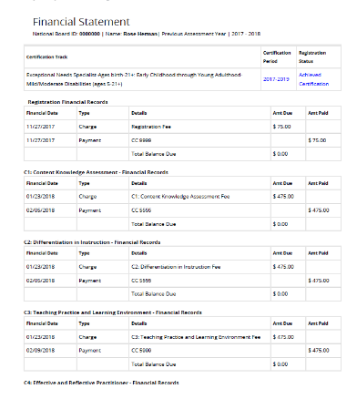
NBCT Financial Records
PDF record from NBPTS account
Candidate name and ID
Year of certification
Itemized charges
  Component
  Date
  Method of payment
  Amount paid

Slide 16
Payment Documentation
What if the NBCT cannot find documentation in their NBPTS account?
TEA will also accept PDF documentation in place of a financial statement:
NBPTS line item in personal credit card statement; or
Original email receipt from NBPTS; or
Email confirmation of payment from NBPTS customer service
Must include dates of payment(s) and payment method

Slide 17
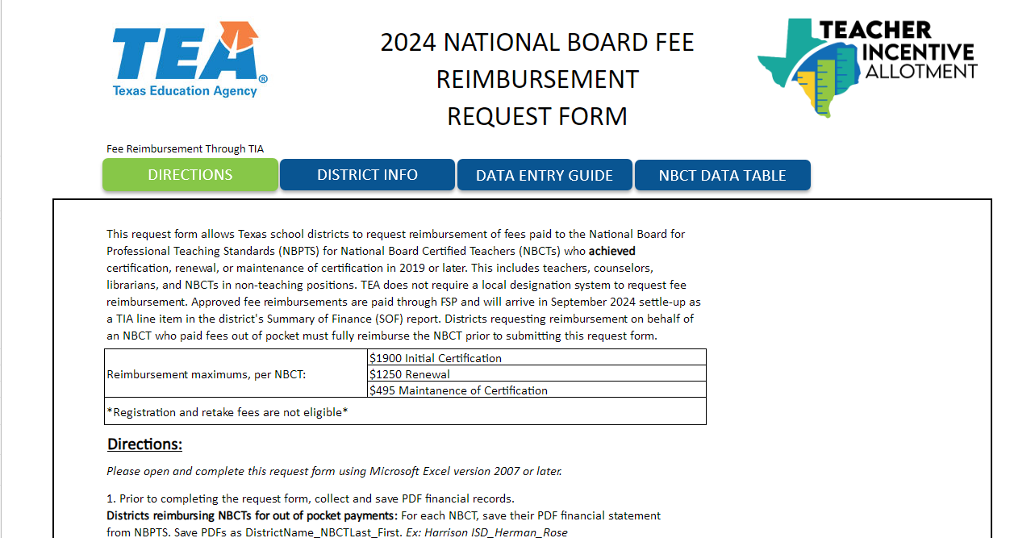
Fee Reimbursement Request Form
Excel File, submitted through Qualtrics
Instructions embedded
NBCT and District Identifying Information
Reimbursement Details
  Amount Paid and method of payment
  Specify Certification or MOC
  Year of certification/renewal
  Date NBCT was reimbursed if applicable

Slide 18
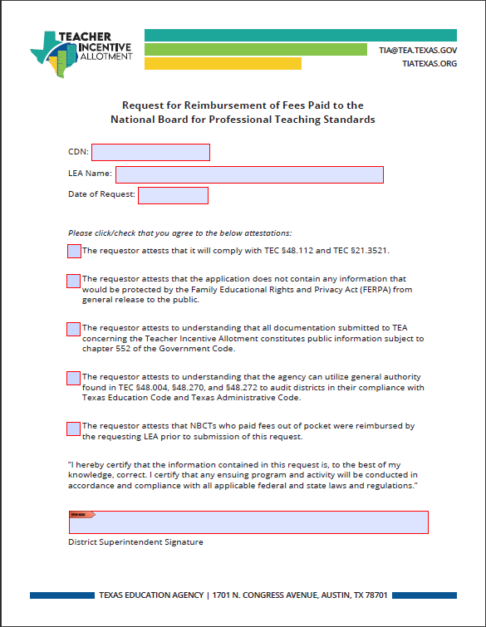
District Submission Requirements
1. Completed Request Form
2. Assurances with Superintendent Signature
  Arrange for superintendent sign-off
  Consult with legal if needed
3. Supporting Documentation
  NBCT financial statement(s) and/or 3rd party payer report
Zip all files and submit via Qualtrics by March 31

Slide 19


What will TEA verify?
TEA Will Verify…
TEA Will NOT Verify…
NBCT identity and year of certification
Fees paid
Method of payment
Compliance with TEC §48.112 and TEC §21.3521
NBCT’s current position or employer
NBCT’s TIA Designation status

Slide 20
NBCT Next Steps
Check eligibility criteria
Visit National Board Fees and Reimbursement (tiatexas.org) for resources
  Template email to district
  Fee reimbursement request form
  Fee reimbursement assurances
Print/save a PDF of National Board financial records
Determine total eligible fees
Contact your district administration

Slide 21
District Next Steps
Consult with CFO and Human Resources to plan for receipt of TIA funds
Outreach to possible NBCTs and candidates
Collect documentation
Verify which fees are eligible, reach out to tia@tea.Texas.org
Reimburse NBCTs, if applicable
Complete and submit reimbursement request form

Slide 22
Reimbursement Request Form Practice
Sample Scenario:
Which fees are eligible for reimbursement?
Rose Herman, NBCT, certified in 2019
Employed by Harrison ISD as a SPED teacher
Harrison ISD is Cohort G, does not track NBCTs
Rose paid $1,975 out of pocket
  $75 registration fee
  $475 x 3 components
  2nd component was covered by a grant
  Retake fee $475

Slide 23
Eligible/Ineligible Fees
Which fees are ineligible?
Component | Paid | Paid by | Eligible for reimbursement through TIA?
Registration | $75 | NBCT | No
Component 1 | $475 | NBCT | Yes
Component 2 | $475 | Grant | No
Component 3 | $475 | NBCT | Yes
Component 4 | $475 | NBCT | Yes
Retake comp 2 | $475 | NBCT | No
Total Fees Eligible for Reimbursement $1,425

Slide 24
Next Steps for Rose
Contact Harrison ISD using email templates from TIA website
2. Share resources with her district administrators
  Reimbursement request form (due to TEA by March 31)
  Financial statement from NBPTS
  Reimbursement pre-recorded webinar

Slide 25
Rose’s Financial Statement
Her name and NB Candidate ID
Certified in 2019
Itemized charges
  Paid for 3 components, $475 each
  Payment method is not third-party

Slide 26
Next Steps for Harrison ISD
Determine the point(s) of contact for TIA in their district
Preview TIA National Board resources
Connect with CFO/HR if needed
Review NBCT documentation
Reimburse Rose for eligible fees
Complete and submit fee reimbursement request form
Ensure that Rose is coded as a 087 teacher in Class Roster Winter Submission
Review TIA spending timelines and requirements
Develop a spending plan for allotment funds

Slide 27
Harrison ISD’s Reimbursement Request Form
LEA | CDN | NBCT Candidate ID | DOB | Last Name | First Name | NBCT Employment Status | Eligible fees pd | Paid Via | Year of NB Cert/MOC | Date of Reimbursement
Harrison ISD | 111111 | 222222 | 5/5/1975 | Herman | Rose | Current | $1,425 | Reimburse to teacher | 2019 | Feb. 20
District & NBCT Information
Reimbursement Information
District name and CDN
NBCT name, candidate ID, and DOB
Employment status
Fees Paid
Initial certification or MOC
Year of certification or MOC
Date NBCT reimbursed, if applicable

Slide 28
Q & A r Slide

Slide 29
National Board and Local Designation Systems
What if our district employs a designated teacher or National Board Certified teacher before our local designation system is approved?
A local designation system is not required to receive TIA funding. All districts in Texas that employ a designated teacher(s) are eligible to receive allotment funds. Districts are required to spend the funds by August 31.
Districts applying for TIA with Cohort F or later will likely need to implement a tentative spending plan prior to the approval of their local designation system. We encourage districts to seek stakeholder input in the tentative spending plan.

Slide 30
District Obligations
Are districts required to submit fee reimbursement requests? Why can’t NBCTs request reimbursement directly?
While districts are not required to request reimbursement of fees through TIA, it is an opportunity to recoup costs paid for the intensive National Board certification process. Per statute, TIA is funded through the Foundation Schools Program (FSP), which flows the allotment to districts.

Slide 31
Verification
How will TEA verify that the information in the application is accurate?
TEA will verify the submitted documentation with records from NBPTS and track reimbursement requests for each NBCT. Districts will submit assurances along with the reimbursement request form. The superintendent must sign off that all information is accurate and in compliance with statute.

Slide 32
Third-Party Payers
How can our district become a third-party payer?
Districts may choose to cover some or all National Board candidacy costs. Fees for each candidate are eligible for reimbursement through TIA once they achieve certification. Districts interested in registering as a third-party payer can review the Third Party Payer Guide for more information.

Slide 33
Designations
Must the NBCT have a TIA designation or be employed as a teacher to be eligible for fee reimbursement?
TEA will not verify the NBCT’s designation status or current assignment.

Slide 34
Employment
What if the NBCT is no longer employed by the district or was employed by another district when they certified?
Any district may request reimbursement of eligible fees paid to NBPTS if:
The district reimburses the teacher prior to requesting reimbursement OR
The district paid fees as a third-party payer

Slide 35
Retakes and Registration
What about registration and retake costs?
Districts may request up to:
$1900 for initial certification
$495 for maintenance of certification
Registration and/or retake fees are not eligible for reimbursement

Slide 36
Thank You
TIAtexas.org
TIA@tea.Texas.gov

