Slide 1

Engaging District Stakeholders
September 10, 2025

Slide 2


Webinar Meeting Norms
This session will be recorded and saved on the district ShareFile. Participants will not appear in the recorded session.
This session will be recorded and saved on the district ShareFile. Participants will not appear in the recorded session.
Use the Q&A feature for questions. The chat will not be visible to all participants.
Use the Q&A feature for questions. The chat will not be visible to all participants.

Slide 3
Agenda
10:00-10:10 AM
Engaging Stakeholders: A Key to Sustainable TIA Implementation
10:10-10:20 AM
Best Practices for Stakeholder Engagement
10:20-10:30 AM
Everyone Has a Role: Stakeholder Engagement in TIA
10:30-10:40 AM
Surveys: Effective Utilization
10:40-10:50 AM
Stakeholder Engagement Turnkey Resources
10:50-10:55 AM
District Panel
10:55-11:00 AM
Next Steps

Slide 4




Objectives
The Value of Stakeholder Engagement: Explore key strategies that help districts successfully implement local designation systems through strong stakeholder engagement.
Best Practices: Receive guidance to engage and get to know stakeholders throughout the academic year.
Utilize Formative Surveys Effectively: Learn how to maximize response rates and analyze TIA stakeholder surveys to drive continuous improvement and strengthen buy-in.
Turnkey Stakeholder Engagement Resources: Access and edit turnkey resources that can be used to immediately engage with stakeholders.

Slide 5
Engaging Stakeholders
A Key to Sustainable TIA Implementation

Slide 6






TIA Journey
Pre-Application
System Development
Stakeholder Engagement
Year 1
Apply for TIA
Stakeholder Engagement
Year 2
TIA Teacher Buy-In Survey
Capture Data
Expansion & Modifications
Stakeholder Engagement
Year 3
Data Submission
Full System Approval
Designate & Compensate
Expansion & Modifications
TIA Annual Evaluation Survey
Stakeholder Engagement
Post-Approval
New or Higher Designations
Expansion & Modifications
Annual Program Submission
TIA Annual Evaluation Survey
Stakeholder Engagement

Slide 7

What is Stakeholder Engagement?
Stakeholder engagement is a continuous cycle of steps and decisions to reach the level of buy-in districts need to build strong systems.
We cultivate stakeholder engagement through:
collaboration
shared ownership
feedback loop
frequent and clear communication

Slide 8
Importance of Stakeholder Engagement
Develops buy-in from teachers, administrators, and other staff who are critical to the development of the Local Designation System.
Promotes a positive work environment, shared ownership, and collaboration.
Ensures stakeholders have a voice in decision making related to TIA.

Slide 9
How Can Stakeholders Be Engaged at Different Phases?
Planning & Design
Application Development
Gather input on teacher observation systems, student growth measures, and designation criteria
Build understanding and trust around TIA
Ensure the plan reflects campus-level realities and equity considerations
Incorporate feedback to strengthen the application
Describe how stakeholder involvement was prioritized
Ensure the planning process met TEA stakeholder requirements
Implementation
Ongoing Support & Review
Ensure stakeholders know their roles in implementation
Offer training and communication to ensure clarity
Address concerns & build buy-in
Monitor effectiveness and quality
Adjust based on feedback and data
Keep stakeholders informed and engaged in continuous improvement

Slide 10
Poll #1: Reflection
At which phase of the TIA journey is stakeholder engagement like trying to assemble IKEA furniture?
Planning & Application: We’ve unboxed all the pieces and everyone has a different idea about what the final product should look like.
Data Capture: We’re on step 3 of the instructions and discover a crucial piece is missing.
Data Submission: We finally packed everything into the tiny box, but we’re pretty sure a few pieces are upside down.
Post Approval: We’re finished, but there are a few extra parts leftover and the end result is a little wobbly.

Slide 11
Best Practices for Stakeholder Engagement

Slide 12

Stakeholder Engagement is Cyclical
Set Goals for Stakeholder Engagement
Identify and Select Stakeholders
Analyze and Respond to Feedback
Develop the Stakeholder Engagement Plan

Slide 13

Set Goals for Engagement
Define what success looks like for stakeholder engagement.
Share the district’s vision and goals for the TIA system.

Slide 14
Identify and Select Key Stakeholders
Engage a diverse group of stakeholders:
  Teachers
  District leaders
  Campus administrators
  Community members and school board members
Understand the values, motivations, and concerns of each group.

Slide 15
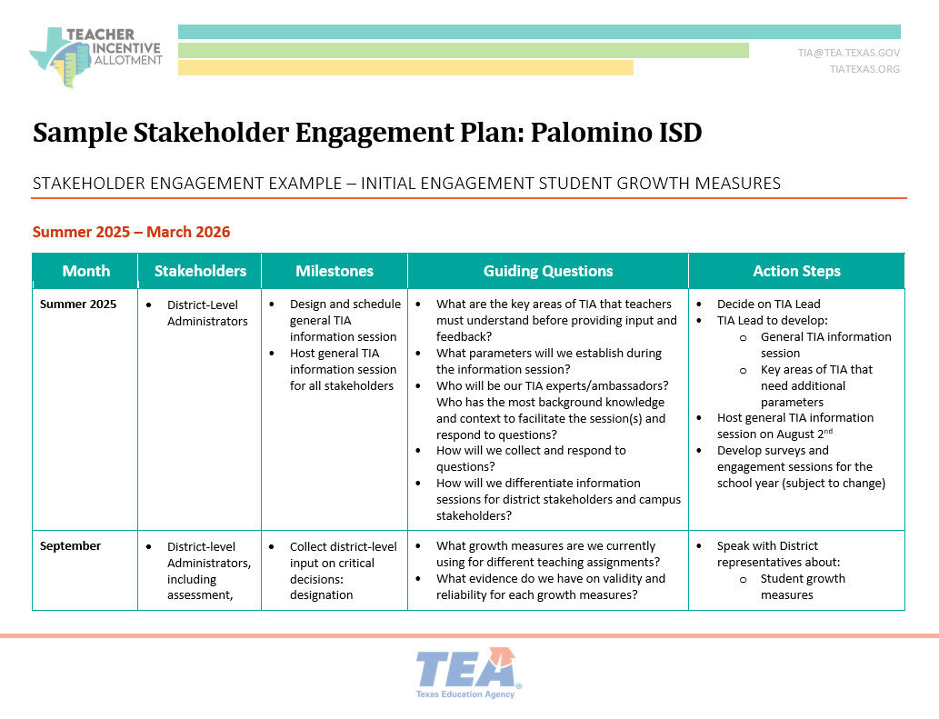
Develop a Stakeholder Engagement Plan
Use various channels to reach stakeholders:
  formal meetings
  professional development
  surveys
  informal listening sessions
Create a detailed scope and sequence for sharing information, gathering feedback, and following up.
Establish a timeline aligned with TIA application and implementation phases.
Sample Stakeholder Engagement Plan

Slide 16
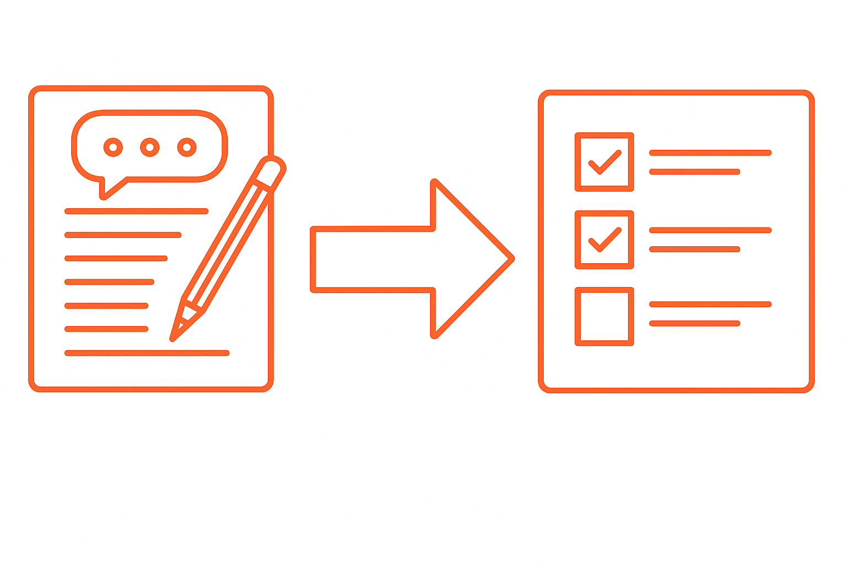
Analyze and Respond to Feedback
Share how feedback will be used to improve the development of the TIA local designation system.
Make adjustments based on stakeholder input and clearly communicate changes.
Finalize decisions with transparency, documenting how feedback shaped the outcomes.

Slide 17
Poll #2: Current Level of Readiness
After reviewing the best practices for stakeholder engagement, I feel confident in my ability to develop and implement effective stakeholder engagement strategies in my school systems TIA local designation system.
Strongly Disagree | Disagree | Neutral | Agree | Strongly Agree
1
2
3
4
5

Slide 18
Everyone Has a Role
Stakeholder Engagement in TIA

Slide 19



Who are the Stakeholders?
TIA Planning Committee
District Stakeholders
Campus Stakeholders
Key District Leader with influence, TIA lead, district administrators, campus leaders, teachers
District administrators, human resources, finance, school board members, PEIMS
Campus administrators, teachers, other campus leaders, students

Slide 20
TIA Planning Committee
School System Leader with Influence
Superintendent, Assistant Superintendents
Teachers
Diverse representation of grade levels, content, years of experience, at least 50% of the committee
District Administrators
Directors, Coordinators, Specialists
School Board
Trustees
Campus Administrators
Principals, Associate Principals, Assistant Principals
Community Members
Parent, local organizations, etc.
These may not be as departmentalized for smaller districts.

Slide 21
District-Level Stakeholders
Curriculum and Instruction, Special Programs
Selecting student growth measures, eligible teaching assignments
PEIMS Designee
Eligible teaching assignments
Human Resources and Talent Acquisition
Teacher appraisal and eligible teaching assignments, compensation plan
Executive Cabinet
Ensure alignment with district goals and strategic plan
Business Office, Finance, Payroll, School Board
Compensation plan
Assessment and Accountability
Student growth measures and eligible teaching assignments
These may not be as departmentalized for smaller districts.

Slide 22
Campus-Level Stakeholders
Teachers
Student growth measures, teacher observations, and eligible teaching assignments
Students
Student surveys and student growth measures
Campus Administrators
Student growth measures, teacher observation, and eligible teaching assignments
Instructional Coaches
Support for teacher and student growth
Campus Leaders
Champion TIA communications and information
Community Members
Communication on plans to recruit and retain great teachers
These may not be as departmentalized for smaller districts.

Slide 23



When to Engage Stakeholders
Who can earn a designation?
Eligible campuses and teachers
How will we designate?
Observations, student growth measures, and optional components
How and when will we compensate?
Distribution of funds, timing of compensation

Slide 24
Poll #3: Stakeholder Support Gaps
After reviewing the different stakeholder groups, I feel confident in my ability to apply my understanding to the roles they have in my school system’s TIA local designation system.
Strongly Disagree | Disagree | Neutral | Agree | Strongly Agree
1
2
3
4
5

Slide 25
Surveys
Effective Utilization

Slide 26


TEA TIA Surveys
Teacher Buy-in Survey
Annual TIA Evaluation Survey
Required
Measures teachers’ buy-in to local designation system
Currently administered in the Fall of the data capture year as part of the application process
Who: All teachers
Required
Administered after system approval
Used to evaluate and improve TIA local designation system
Administered annually, early to mid-spring
Who: Teachers, Campus Principals, HR professionals

Slide 27

Optional: Internal Surveys
The Benefits of "Pulse Checks"
Provides a low-stakes opportunity for school systems to practice the survey process.
Cultivates a habit of survey-taking among stakeholders.
Enables school systems to test their communication plan and logistics.
Offers an early read on stakeholder sentiment, allowing for course correction.
Helps boost response rates for the statutorily required surveys, with a target of 70% or higher.
Builds trust by demonstrating a commitment to continuous feedback and improvement.

Slide 28

Triple A Strategy for Surveys
ADMINISTER
ACTION
ANALYZE

Slide 29

Administer
Communicate the purpose.
  Reminder that the survey is non-evaluative and anonymous.
Empower teacher leaders and campus administrators to champion the survey.
Keep it accessible.
Use multiple communication channels.
Provide designated time to fill out the survey.
Recognize participation by campus.
Use strategically timed reminders.

Slide 30

Analyze
TIA planning committee analyzes survey results
Locate trends and areas of opportunity.
Identify which Stakeholder Groups are impacted.
Determine Root Cause(s).
Identify Action Step(s).
  Person(s) Responsible
  Timeline
  Deliverables

Slide 31

Action
Foster an open environment where concerns can be addressed promptly with transparency.
Share data, objectives, and development updates regularly with your stakeholders.
Use accessible tools and resources, such as district flyers and campus-based informational materials
  Share how the data from surveys is used/ turned into actionable steps.
TIA Overviews

Slide 32
Stakeholder Engagement Turnkey Resources

Slide 33
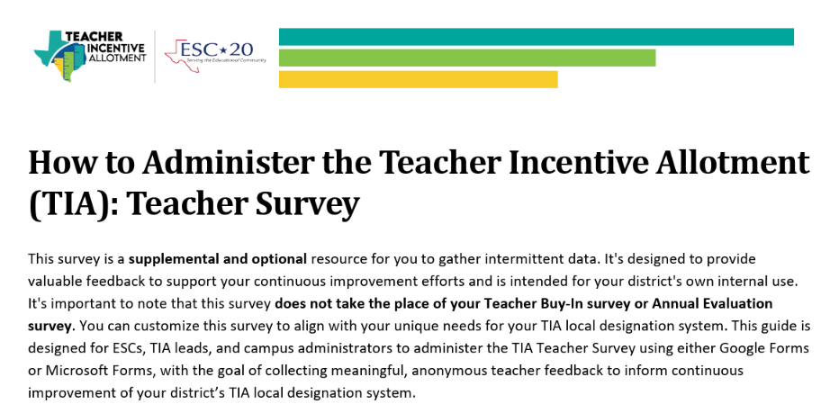
Engagement Resource: Survey
How to guide (PDF)
Google survey format
Microsoft survey format

Slide 34

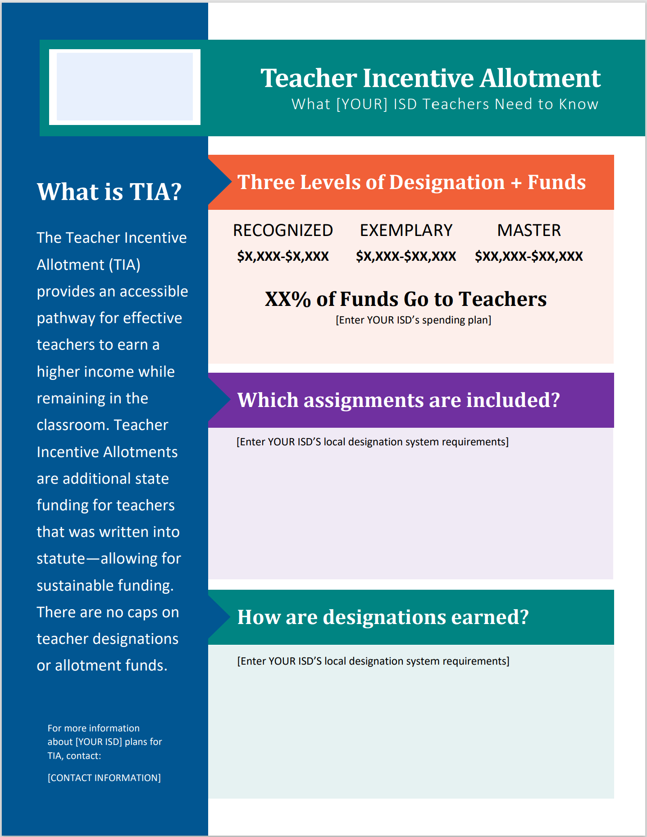
Engagement Resources: Flyers
TIA Turnkey District Flyer
TIA Turnkey Campus Flyer

Slide 35

Turnkey Stakeholder Engagement Deck
TIA Turnkey Stakeholder Engagement Deck

Slide 36
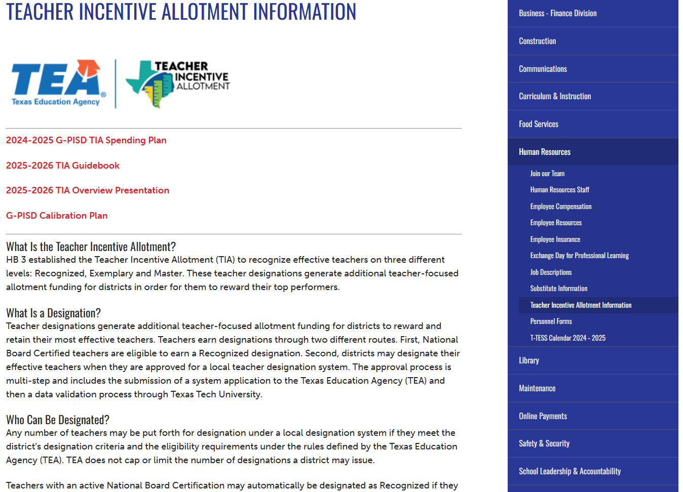
Exemplar Websites: Gregory-Portland ISD
Includes:
  G-PISD TIA Guidebook
  TIA PowerPoint
  G-PISD Calibration Plan
  Overview of the Teacher Incentive Allotment (TIA)
  Informational Resources on:
    What a designation is
    Who can be designated
    How TIA works
    LDS Requirements
Teacher Incentive Allotment Information - Gregory-Portland Independent School District

Slide 37
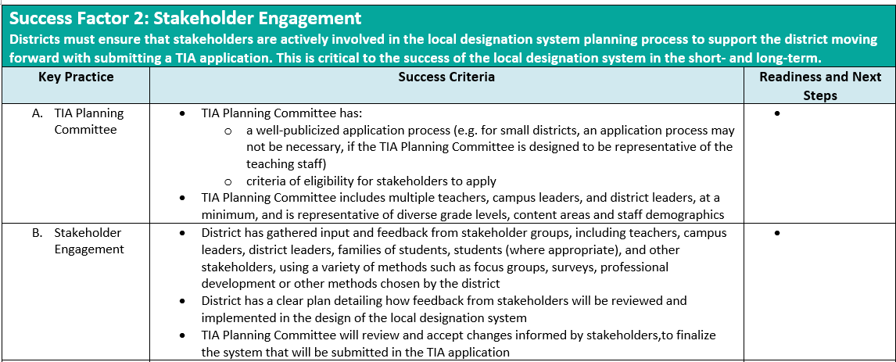
Readiness Guide: Success Factor 2

Slide 38
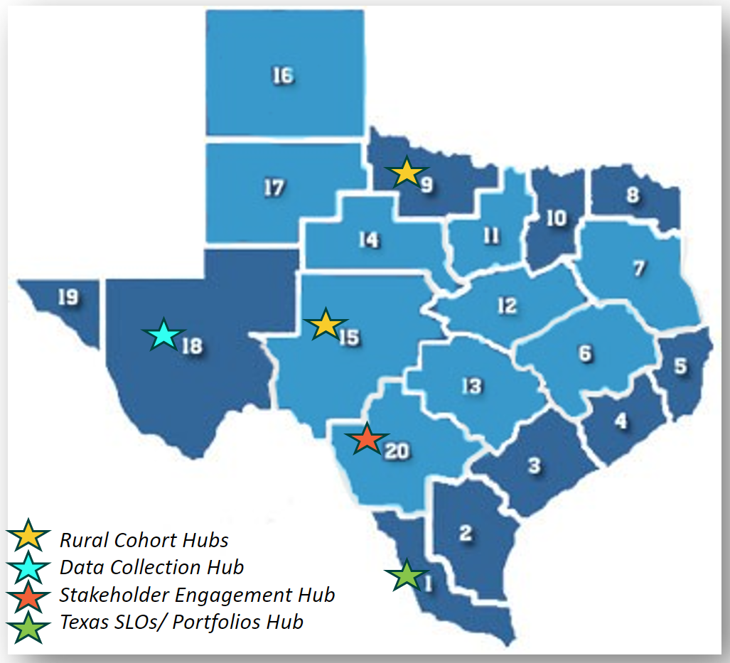
Regional Support
ESCs are available to assist districts in bringing TIA to the district, help guide local designation system development and implementation, and provide technical assistance.
Regional and Specialized TIA Support

Slide 39
District Panel

Slide 40

Dr. Dustin Breithaupt
Superintendent, Lytle ISD

Slide 41
Next Steps

Slide 42
Next Steps
What should my school district do next?
Develop a stakeholder engagement plan for every major component of the TIA system (backwards plan from application due date).
Utilize turnkey resources to share accurate and consistent information about TIA to your district stakeholders.

Slide 43
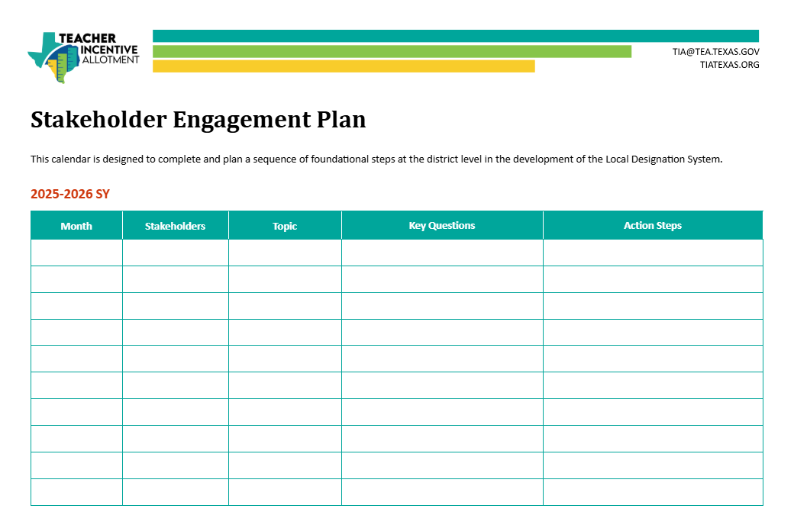
Stakeholder Engagement Planning Template
Template to begin planning district Stakeholder Engagement
Stakeholder-Engagement-Plan Template (2024) Sample Stakeholder Engagement Plan

Slide 44
Survey

Slide 45




Upcoming TA Sessions
Getting Started with TIA: Overview of Teacher Observation @10 AM
Wednesday,
September 17
Getting Started with TIA: Overview of Student Growth Measures @1 PM
Wednesday,
September 17
Choosing Student Growth Measures: Overview of Pre-Tests and Post-Tests @10 AM
Wednesday,
September 24
Choosing Student Growth Measures: Overview of Portfolios @10 AM
Wednesday,
October 1
Technical Assistance Calendar Available Here

Slide 46
Thank You

