Slide 1
2023-24 TIA Expansion and Modification Application Launch
November 30, 2023

Slide 2
Objectives
Review key planning considerations and resources for expanding and modifying the local designation system
Understand how to propose system changes using the appropriate Expansion & Modification application tabs
Understand the Scoring Rubric as a complementary resource to developing answers that meet Full Readiness

Slide 3
Planning for Expansion and Modification of the Local Designation System

Slide 4
Purpose of the Application
Explain the details of your proposed system changes
Ensure all required areas meet statutory compliance
Signal strong stakeholder engagement practices
Set district up for successful implementation

Slide 5
The Big Three Critical Decisions
Who can earn a designation?
Eligible campuses and teachers
How will we designate?
Observations, student growth measures, and optional components
How and when will we compensate?
Distribution of funds, timing of compensation

Slide 6
System Changes Which Require an Expansion & Modification Application
Adding new eligible teaching categories
Removing eligible teaching categories and/or student growth measure
Changing observation rubric or assessment used for pre-/post-test
Adding additional campuses
Revising Spending Plan
See pages 55 – 56 in the TIA Guidebook

Slide 7
FAQ #1
Do we have to complete all tabs on the Expansion & Modification application?
No. Completing the Expansions-Modifications tab will indicate which tabs your district is required to complete based on the proposed changes to the local designation system.

Slide 8
Determining Which Application Tabs to Complete
Adding new eligible teaching categories
Removing eligible teaching categories and/or student growth measure
Changing observation rubric or assessment used for pre-/post-test
Adding additional campuses
Revising Spending Plan
Complete and update the Weighting tab for all existing and modified eligible teaching categories and assessments
If yes to assessment, complete the section(s) of the PtPt tab
If yes to changing rubric, complete the TO tab
If yes, add campus(es) on the Eligible Campuses tab
If yes, complete the Spending tab

Slide 9
System Expansion/Modification Timeline
Application due to TEA
Submitted via Qualtrics link on the Directions tab
Application acceptances communicated
Capture data for expanded or modified system
Submit data and proposed designations
Data validation results of the local designation system
April 15, 2024
Summer 2024
2024-2025
October 2025
February 2026

Slide 10
FAQ #2
Are districts required to collect data for all teachers in newly added assignments?
Fully approved districts are not required to repeat the formal data capture year when new assignments are added. However, best practice is to continue to capture data for as many teachers as possible each year and to use appraisal waivers sparingly.

Slide 11
FAQ #3
How soon can the district designate teachers added through an accepted 2023-24 Expansion & Modification application?
The district should collect data for new assignments in 2024-25 and may designate in fall 2025. Data collected in 2023-24 may not be used, as the application was not yet accepted.
Best practice is to continue to capture data for as many teachers as possible each year and to use appraisal waivers sparingly.
Notes:
D

Slide 12
FAQ #4
Does an Expansion & Modification application acceptance extend the renewal period for my district's local designation system?
No. The Expansion & Modification application will not change or extend the full system approval period. Renewal applications will be required in the fourth year of system approval in order to:
ensure continued compliance with TIA standards/statute; and
allow districts to continuously improve the local designation system based on collected data.

Slide 13
Decision Making: Choosing Eligible Teaching Assignments

Slide 14
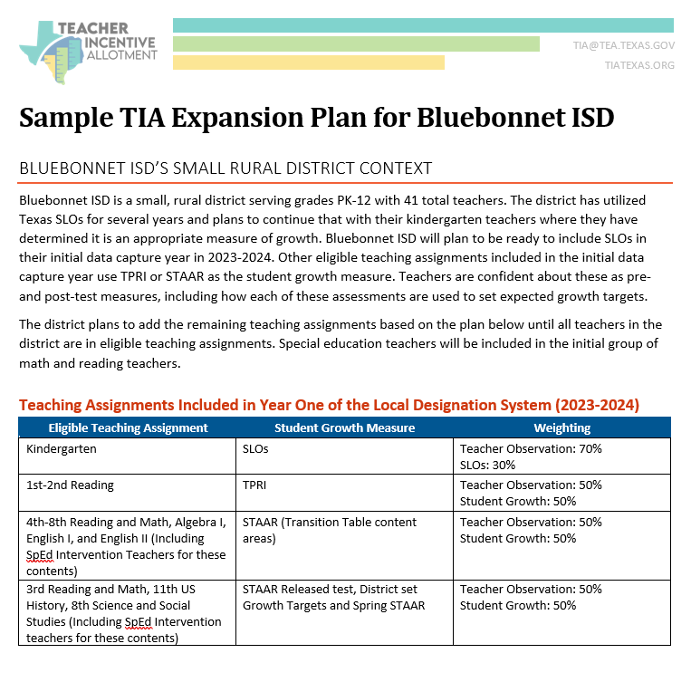
Example local context for small, medium, and large district sizes
Proposed multi-year plan to expand teaching assignments and strengthen implementation
Resources to self-assess readiness to expand or modify the local designation system

Slide 15
Planning for Eligible Teaching Assignments
Download & review the planning document as a resource to use with your district team.

Slide 16
2023-2024 TIA Expansions & Modifications Application Overview

Slide 17
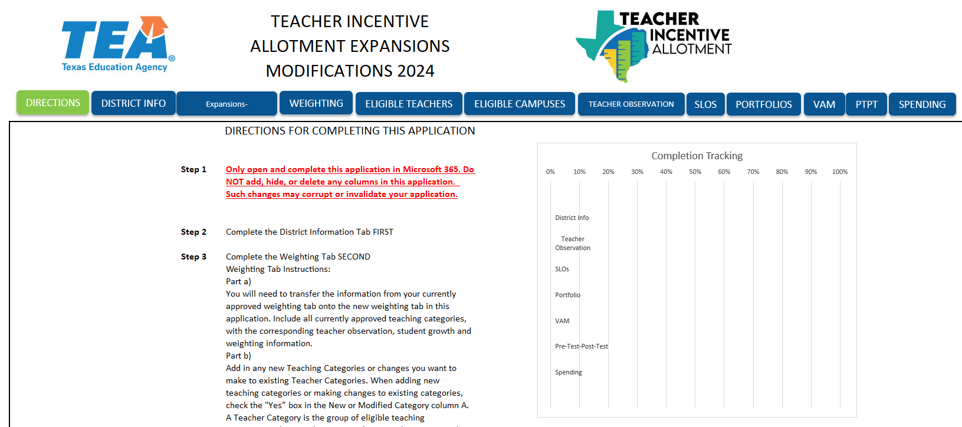
2023-24 Expansion & Modification Application

Slide 18
Suggested Application Process
Before Starting
System Planning Tabs
Expansions-Modifications Tab
Statutory Tabs
Review the Directions Tab
District Info Tab
Eligible Teachers
Eligible Campuses
Weighting Tab
Add/Remove ETAs and student growth
Changes to currently approved ETAs
Changing TO
Adding/Removing Campuses
Changes to District Spending Plan
Teacher Observation
Portfolio, VAM, SLO, and Pre-/Post-test
Spending

Slide 19
District Info Tab

Slide 20
District Info Tab
Pre-populates Eligible Teachers & Campuses tabs
Optional for 1882s & TA Provider Support

Slide 21
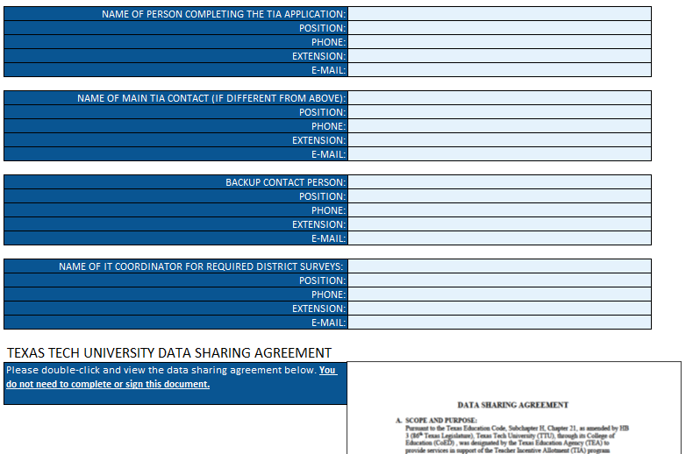
District Info Tab Continued
Maintains updated district contact information for TIA communications
Supports with communications for annual survey requirements
Review this document for future TIA data submission requirements

Slide 22
Eligible Teachers and Eligible Campuses Tabs

Slide 23
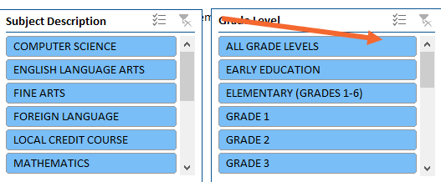
Eligible Teachers Tab
Auto –filled from Weighting Tab*
Can select subject and grade level

Slide 24
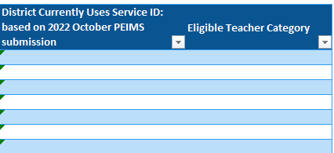
Eligible Teachers Tab Continued
Identify the Teacher Category to which each Service ID belongs

Slide 25
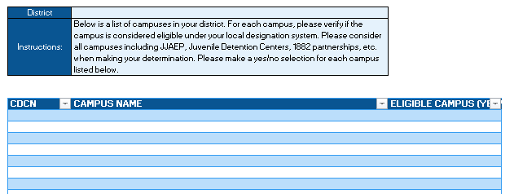
Eligible Campuses Tab
Pre-populated from District Info tab
Campuses assigned to district will prepopulate here. Choose Yes/No.

Slide 26
Weighting Tab

Slide 27
Weighting Tab Action Steps and Considerations
Action Steps
Considerations
Access & review previous Weighting tab(s) based on your district application(s)
Review 2023-24 Expansion & Modification Weighting tab to see where additional information might need to be clarified from current to updated system
Who is eligible for a designation in our approved system?
Can our district expand to additional categories to increase access?
Are there areas we should consider modifying based on what we’ve learned through implementation?

Slide 28
Previous vs. New Weighting Tabs
Previous Wt. Tabs
New Wt. Tab
May not have included names of assessments used as the pre-test/post-test
May not have had 4 options for pre-test/post-test
Did not include who sets expected growth targets
Not as specific regarding what constitutes a Teacher Category
Includes names of all pre-tests/post-test used
Based on answers will identify 4 different options for using pre-test/post-test
Includes info on who sets expected growth targets for each assessment used
Specific definition of “Teacher Category”

Slide 29
Categories of Eligible Teaching Assignments
A category of teachers is the group of eligible teaching assignments that have both:
Same teacher observation rubric at the same weight
Same student growth measure at the same weight
If using pre-/post-test student growth measure, the category must also use the same assessment

Slide 30
Weighting Tab Non-Example
Teaching Category | Eligible T. Assn. | T.O. Rubric | T.O. Wt. | S. Growth Measure | Assessment | SGM Wt.
1 | 1st-3rd Reading | T-TESS | 60 | 3rd party pre-test/post-test | MAP | 40
2 | 1st-3rd Math | T-TESS | 60 | 3rd party pre-test/post-test | MAP | 40
3 | 4th-5th Reading | T-TESS | 60 | 3rd party pre-test/post-test | MAP | 40
4 | 4th-5th Math | T-TESS | 60 | 3rd party pre-test/post-test | Renaissance STAR | 40
5 | 6th-8th ELAR | T-TESS | 60 | 3rd party pre-test/post-test | iReady | 40
6 | 6th-8th Math | T-TESS | 60 | 3rd party pre-test/post-test | iStation | 40

Slide 31
Weighting Tab Example
Teaching Category | Eligible T. Assn. | T.O. Rubric | T.O. Wt. | S. Growth Measure | Assessment | SGM Wt.
1 | 1st – 5th Reading, 1st – 3rd Math | T-TESS | 60 | 3rd party pre-test/post-test | MAP | 40
2 | 4th-5th Math | T-TESS | 60 | 3rd party pre-test/post-test | Renaissance STAR | 40
3 | 6th-8th ELAR | T-TESS | 60 | 3rd party pre-test/post-test | iReady | 40
4 | 6th-8th Math | T-TESS | 60 | 3rd party pre-test/post-test | iStation | 40

Slide 32
Weighting Tab Requirements
Required if the category is New or Modified
Clearly identify existing/revised eligible teaching assignment(s) using same TO and SGM weights
Choose TO Rubric and the weight.
Ensure that the existing/proposed assessment(s) are checked here. For pre- and post-tests, ensure that the assessment is aligned to the grade level and content area(s) in the eligible category. Assign weights to the identified growth measure(s) in each row.
Identify any optional components in your system. If not used, ensure the weight = 0%.
Must total 100%

Slide 33
Expansions-Modifications Tab

Slide 34
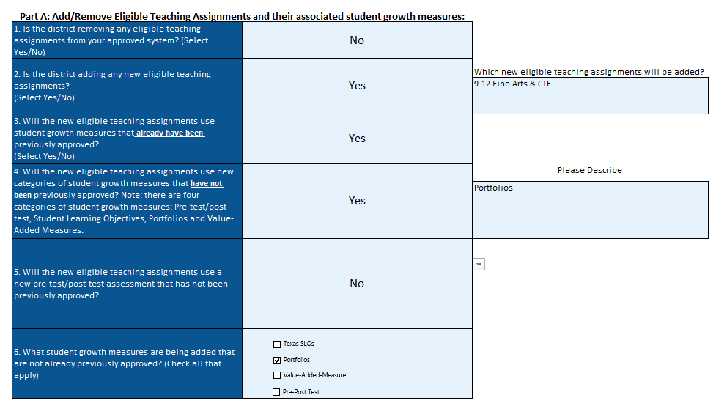
Expansions-Modifications Tab
Note that for some Yes responses, a field will pop-up to enter information that will organize your planning.

Slide 35
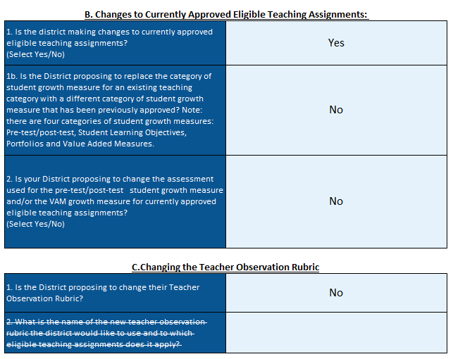
Expansions-Modifications Tab
Note that for some No responses, it will strike out questions or sections that are not relevant to your context.

Slide 36
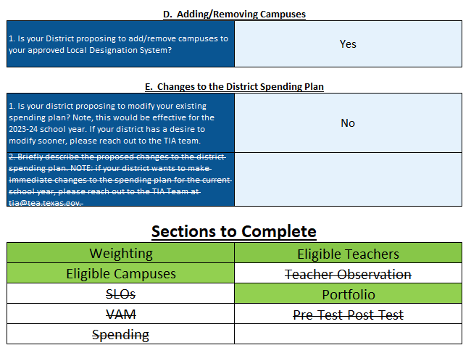
Expansions-Modifications Tab
Note that this is a tool to support your district to complete the application. This responds directly to the choices made in Parts A – E on this tab so read each questions carefully.

Slide 37
Statutory Tabs
Reminders
Resources
These tabs are dependent on the answers provided on the Expansions-Modifications tab
Information can be transferred from approved application(s) to new application
Review the updated questions to ensure the district has completely and accurately answered all questions
Refer to the Directions tab for reminders & completion tracker
Use the Scoring Rubric to self-evaluate all narrative responses on statutory tabs
Refer to the TIA website for content-specific resources
Email TIA@tea.Texas.gov for support with application troubleshooting

Slide 38
Scoring Rubric

Slide 39
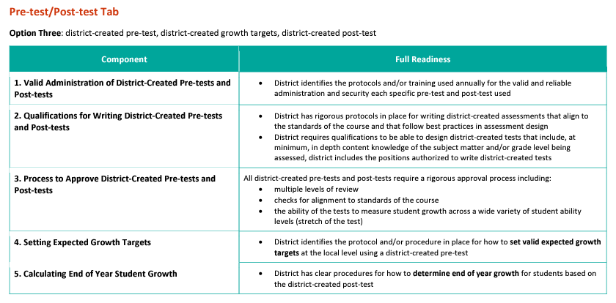
Scoring Rubric Design
Statutory tab
Scoring Criteria
Aligned to application question

Slide 40
Next Steps
Download 2023-24 Expansion & Modification System Application in Excel
Review Full Readiness criteria on the Scoring Rubric
Opt to Submit Wt. Tab for Feedback by Jan. 26, 2024
Attend March Office Hours
New!

Slide 41
March Office Hours
Register & Attend!
Tuesday, March 26 | 9:00 – 10:00 a.m. | Applying for TIA: Teacher Observation Office Hour
Wednesday, March 27 | 9:00 – 10:00 a.m. | Applying for TIA: Spending Office Hour
Thursday, March 28 | 9:00 – 11:00 a.m. | Applying for TIA: Weighting Tab and Student Growth Measures Office Hours

Slide 42
Thank You
Email your questions to TIA@tea.Texas.gov.

