Slide 1
Preparing for Data Validation: Determining Designations in Your LDS
July 23, 2025

Slide 2
Preparing for Data Validation Series
Preparing for Data Validation: Determining Designations in Your LDS
July 23rd 9:30 a.m. – 11:30 a.m.
Learn how to use the features of the TIA Designation Determination Tool to help make decisions around designations.
Preparing for Data Validation: Data Submission and Validation
July 23rd 1:00 p.m. – 2:30 p.m.
Learn what is evaluated during data validation and how to prepare for data submission.
Preparing for Data Validation: Post Data Capture Year
July 24th 9:30 a.m. – 10:30 a.m.
Learn to identify areas of concern and areas of strength in your district’s teacher performance data using the new, web-based TIA Data Analysis Tool

Slide 3
Data Literacy Framework
Ask: Identify problems, frame questions.
Acquire: Understand and acquire relevant data.
Analyze: Transform data into insights.
Apply: Validate insights.
Act: Transform insights into decisions.
Announce: Communicate decisions.
Assess: Evaluate decisions made.
Turning Data into Insight
Source: Klidas, A. & Hanegan, K. (2022). Data Literacy in Practice: A complete guide to data literacy and making smarter decisions with data through intelligent actions

Slide 4
Agenda
9:30 a.m. – 9:40 a.m.
Ask: Who are my most effective Teachers?
9:40 a.m. – 10:00 a.m.
Acquire: The Makeup of Designation Decisions
10:00 a.m. – 10:20 a.m.
Analyze: Using the Designation Tool
10:30 a.m. – 10:40 a.m.
Apply: Adjust
10:40 a.m. – 11:00 a.m.
Act: Make Designation Decisions
11:00 a.m. – 11:05 a.m.
Announce: Communicating Changes and Final Decisions to Teachers
11:05 a.m. – 11:25 a.m.
Assess: Texas VAM & Data Validation
11:25 a.m. – 11:30 a.m.
Closing & Survey

Slide 5
Objectives
Identify the collection of information that makes up designation determinations
Learn how to use the designation determination tool to help make designation decisions
Apply findings using the tool and learn what adjustments can be made
Make final decisions and assess results

Slide 6
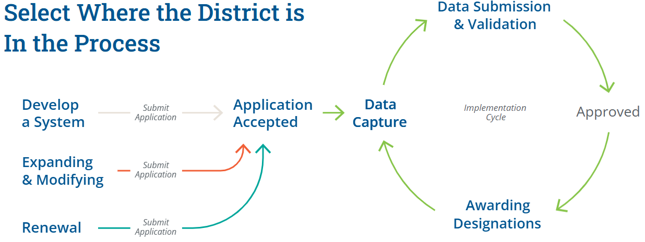
District Approval Process

Slide 7
ASK

Slide 8

Who are my most effective Teachers?

Slide 9
ACQUIRE

Slide 10



Makeup of Designation Determination
Performance Standards
The minimum standards to meet each designation level for student growth and teacher observation.
System Weights
The weighing of system components used by the district:
Teacher Observation (required)
Student Growth (required)
Other Effectiveness Measure (optional)
Optional Prerequisites
Criteria required by the district, but not by statute, to be eligible for designation. Example: teachers must complete # hours of professional development.

Slide 11



Teacher Performance Data
Teacher Observation
Observation based on T-TESS or aligned rubric​. District application must show evidence of calibration and data analysis.
Student Growth
Student growth measures determined by district. District application must show evidence of validity & reliability of development, administration, and scoring.
Optional Components
Districts may consider additional valid and reliable measures of effectiveness (e.g., mentoring other teachers, teacher leadership, family surveys, student surveys, etc.).​

Slide 12

Student Survey Pilot
Opportunity: TEA and TTU are partnering with Education Elements to administer a student survey pilot for TIA districts in SY 2025-26, at no cost.
Student Surveys can be:
Optional components districts use to measure teacher effectiveness and determine designations
Useful tools for providing timely and specific feedback for teachers that can enhance coaching and evaluation conversations
More predictive of student outcomes than observations alone, and combining teacher performance measures increase reliability and validity of evaluation scores overall
Attend a webinar and complete the Letter of Intent if your district would like to participate!
Note: Participating districts are not required to use the student survey data when determining designations in 2026, although they may choose to do so. In the case where there is more interest in the pilot program than funds available, or where the size of the district exceeds the per district funding amount, priority will be given to rural districts.

Slide 13


Student Survey Pilot Webinar
Interested districts should attend one of the following webinars to learn about the pilot design, benefits of participation, and the support they will receive throughout implementation:
Thursday, July 24
Student Survey Pilot Informational Webinar
1:00 p.m. - 2:00 p.m.
Wednesday, August 13
Student Survey Pilot Informational Webinar
1:00 p.m. - 2:00 p.m.
Wednesday, August 27
Student Survey Pilot Informational Webinar
1:00 p.m. - 2:00 p.m.
Visit our webpage to learn more about the pilot!
Note: Participating districts are not required to use the student survey data when determining designations in 2026, although they may choose to do so. In the case where there is more interest in the pilot program than funds available, or where the size of the district exceeds the per district funding amount, priority will be given to rural districts.

Slide 14
HB2: Acknowledged Designation
Effective beginning school year 2025-26
Districts begin collecting data for the new Acknowledged level designation.
Effective beginning school year 2026-27
Districts may submit teachers for the new Acknowledged level designation for Fall 2026 Data Submission.
More information from TEA coming August 2025
Acknowledged designations will not be proposed for Fall 2025 Data Submission.
For the purposes of this session, preparing for Fall 2025 Data Submission, we will only be looking at performance standards for Recognized, Exemplary, and Master designation levels.
How HB2 Impacts TIA

Slide 15
Statewide Performance Standards
The Teacher Incentive Allotment performance standards were established by looking at student growth performance data and teacher observation data on T-TESS.
Recognized represents the top 33%
Exemplary represents the top 20%
Master represents the top 5%
Districts may find that they have more or less than the numbers represented above. Any teacher that meets a local designation system’s eligibility requirements may be submitted for designation.
Statewide Performance Standards

Slide 16
Visual of Performance Standards
Higher performing district = concentration in higher range
Lower performing district = concentration in high-mid range
State average performance = even distribution
*To better visualize the data for the state, each dot represents an average of 67 teachers in All

Slide 17
Student Growth Performance Standards
For student growth performance standards, student STAAR assessment data was observed across 5 years (2014-2019). A value-added model was developed to determine if a student met or exceeded their expected growth target.
Designation Level | % of students meeting or exceeding expected growth
Recognized | 55%
Exemplary | 60%
Master | 70%
Student Growth Statewide Performance Standards

Slide 18
Teacher Observation Performance Standards
For teacher observation performance standards, T-TESS scores were observed across the state looking at only the observable domains, 2 & 3 (collected from Eduphoria and DMAC). Averages were then established based on the aforementioned cut points described.
Designation Level | Average T-TESS Score in Domains 2 & 3*
Recognized | 3.7 or 74% of possible points
Exemplary | 3.9 or 78% of possible points
Master | 4.5 or 90% of possible points
*For a teacher to earn a designation they must have a minimum of Proficient on all observable dimensions.
Teacher Observation Statewide Performance Standards

Slide 19
FAQ Performance Standards
How do I use the statewide performance standards in the development and design of my system as well as making designation decisions?
Performance standards are intended to serve as guide and reference when developing your designation system as well as when making designation decisions. It provides districts a way to see how teachers across the state performed on teacher observation and student growth in comparison to their own.
Since districts can use multiple components in determining designations for their teachers and because these values are statewide averages, it is anticipated that districts will have teachers that perform above and below these values.

Slide 20
FAQ Percent of Teachers
Does TEA expect districts to designate a certain percentage of eligible teachers?
No, there is no expectation for the number of teachers that can earn a designation in a district. Districts are not limited to the 33% that is mentioned in the performance standards. Districts across the state perform above and below the average and, therefore, some will be above and below this 33% mark.

Slide 21
Visual of Performance Standards (repeat)
Higher performing district = concentration in higher range
Lower performing district = concentration in high-mid range
State average performance = even distribution
*To better visualize the data for the state, each dot represents an average of 67 teachers in All

Slide 22
Makeup of Designation Determination (repeat)
Performance Standards
The minimum standards to meet each designation level for student growth and teacher observation.
System Weights
The weighing of system components used by the district:
Teacher Observation (required)
Student Growth (required)
Other Effectiveness Measure (optional)
Optional Prerequisites
Criteria required by the district, but not by statute, to be eligible for designation. Example: teachers must complete # hours of professional development.

Slide 23
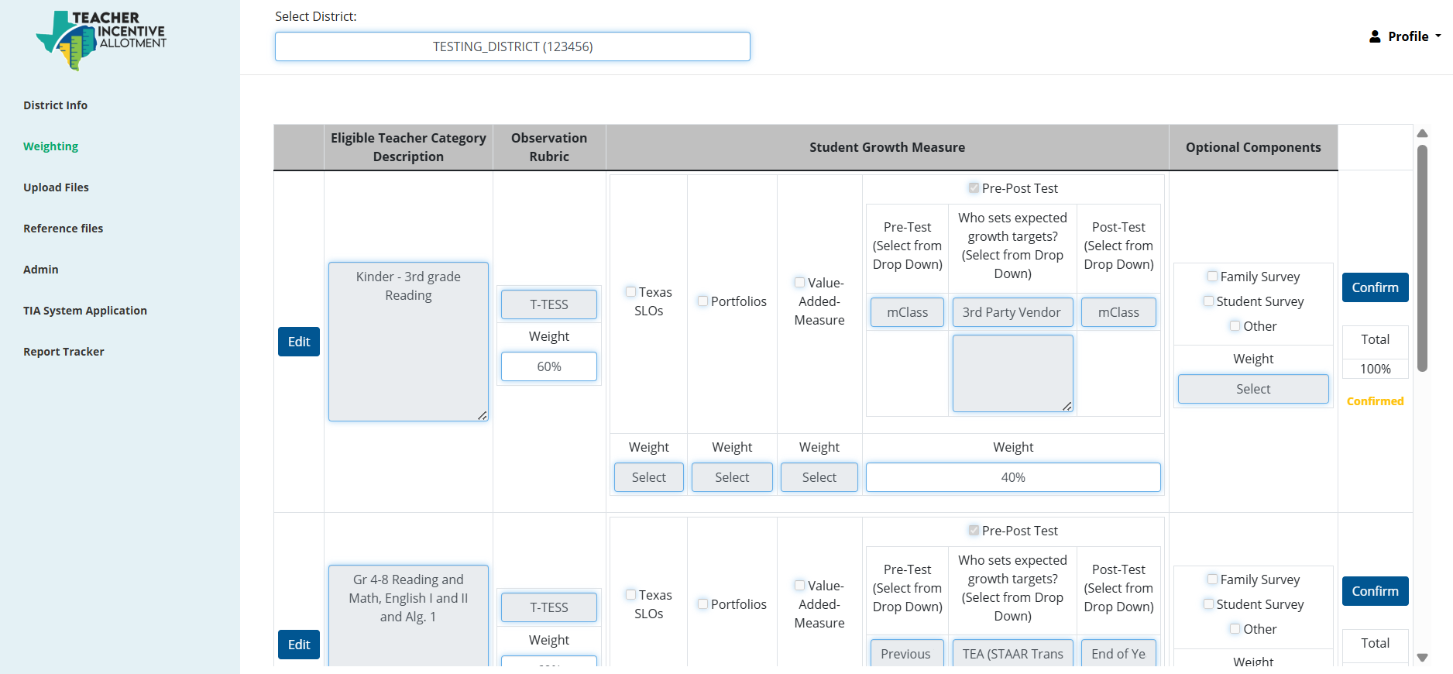
System Application Weights
Review your System of Record and recall how your district came to a decision on your component weights.

Slide 24
Key Questions
Performance Standards: By what standard of performance are you using to determine designations?
Minimum Standards: What minimum standards, if any, is your district establishing for teachers to earn a designation?
Rationale: What components of teacher performance does your local designation system use in evaluating your teachers? Recall the rationale behind the weights for each of the components used.

Slide 25
ANALYZE

Slide 26

What does it mean?
How do the answers to my key questions affect my teachers' designations?

Slide 27
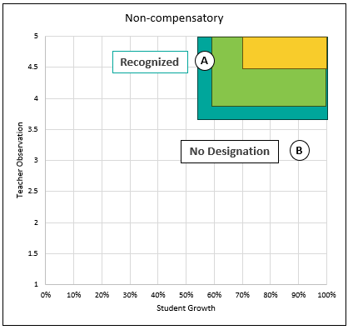
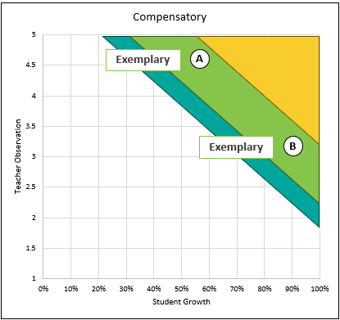
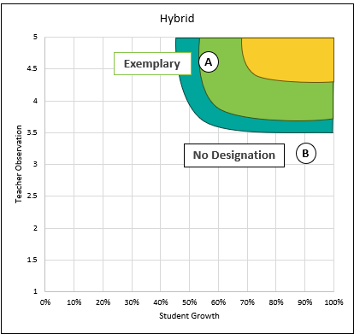
Introduction to Decision Approaches
Three approaches: Non-Compensatory, Compensatory, and Hybrid
These may sound like new names, but these will be familiar methods.
What decision-making approach districts take on will be a local decision.

Slide 28
Non-Compensatory
A non-compensatory approach sets minimum cut points for specific measures, and any teacher who does not meet those minimums is not eligible for a designation.
Recognized
A
Benefits
Forces alignment with statewide performance standards
Simple to communicate
Costs
Teachers who perform high in one component but lack in another may be awarded no/lower designation
No Designation
B

Slide 29
Compensatory
A compensatory decision-making approach values high performance, allowing strengths in one area to offset weaker performance in another.
Exemplary
A
Benefits
More inclusive of high teacher performance (don’t need to meet minimums in both components)
Costs
Possibly misalign with statewide performance standards on one component if data is inflated
Possibly misalign teachers’ performance across campuses and across assignments
Standards are less transparent
Exemplary
B

Slide 30
Hybrid
A hybrid approach combines both non-compensatory and compensatory methods. For example, teachers must first meet the minimum criteria to be considered. Then, a compensatory method is then used to weigh multiple data points and determine the final designation level.
A
Exemplary
A
Benefits
Has some safeguards to meet statewide performance standards
More flexible for nuanced performance
Costs
Possibly misalign with statewide performance standards on one component if data is inflated
Standards are less transparent
No Designation
B

Slide 31
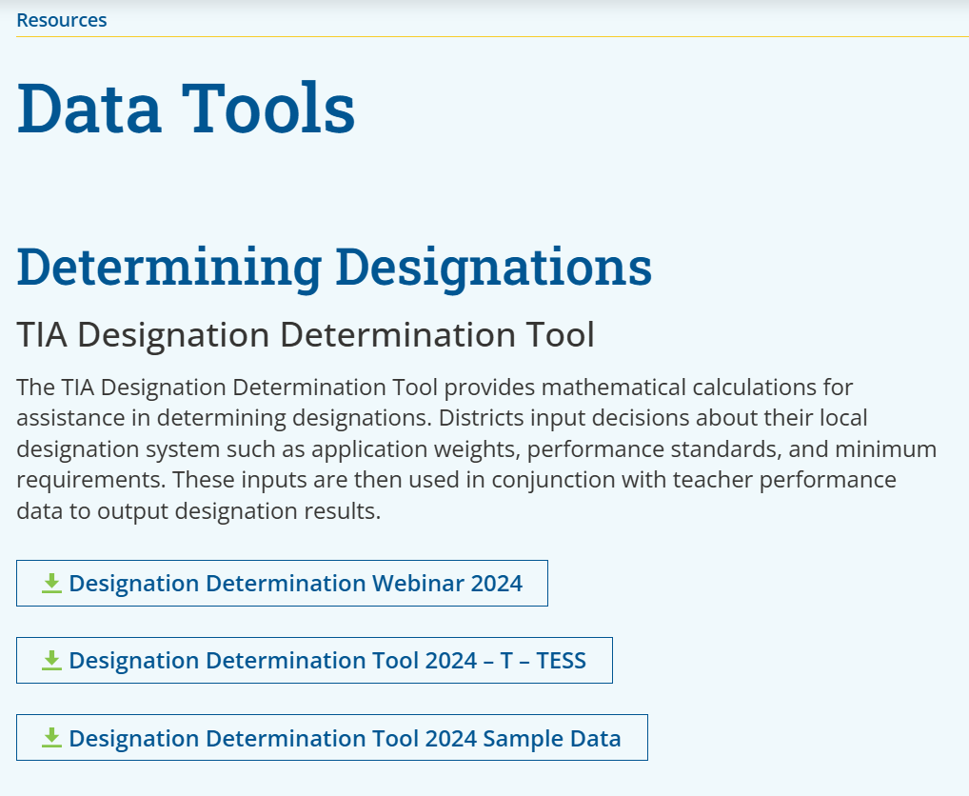
Designation Determination Tool
Designation Determination Analysis Tool
Tabs
Data Entry
Multiple Student Growth Measure
Optional Component Data
Weighting
Designation Decisions
Designation Results
Analysis

Slide 32
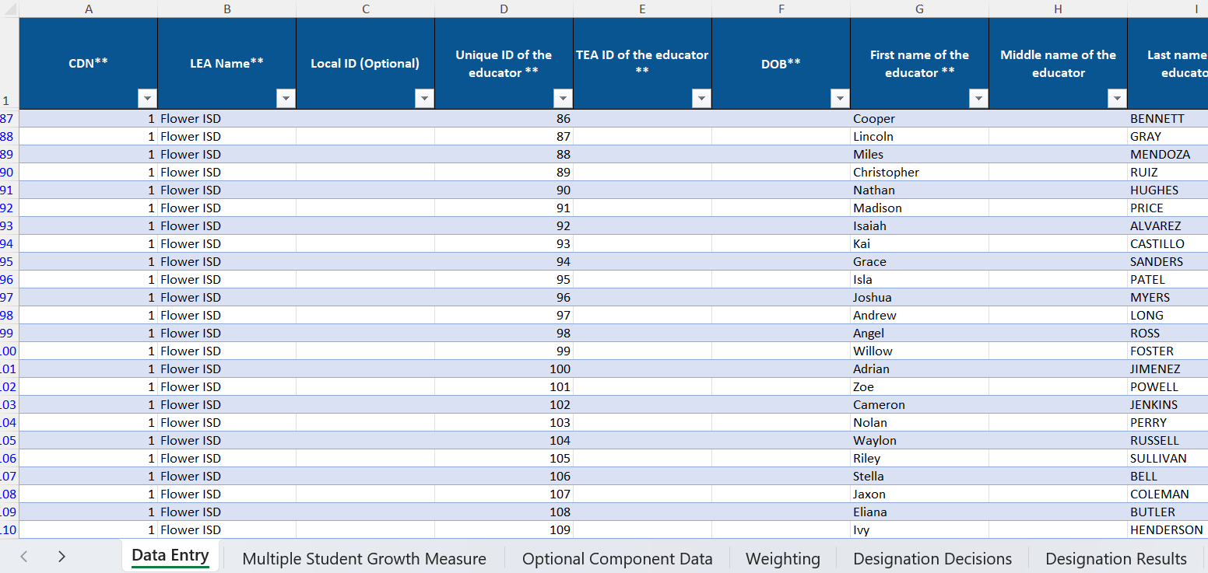
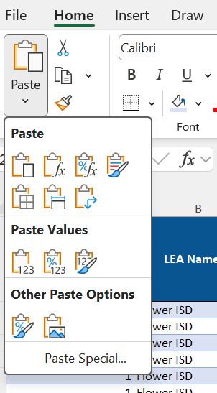
Input Data Entry
Copy rows 2 and below from your data entry tab
Paste values into row 2 of the tool
Using this pasting method will only paste the values you copied and prevent errors from accidentally copying any formulas from the previous table

Slide 33
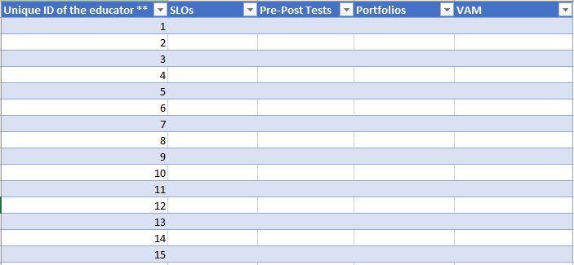
Input Multiple Growth Data
If you have multiple student growth measures for a single teacher category (e.g., Pre-test/Post-test and SLOs), you will need to provide each separate growth percent on the Multiple Student Growth Measure tab.

Slide 34
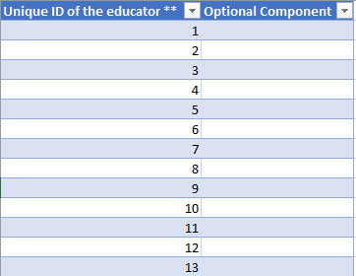
Input Optional Component Data
If you are using optional components, you will need to provide the optional component data on the Optional Component tab.

Slide 35
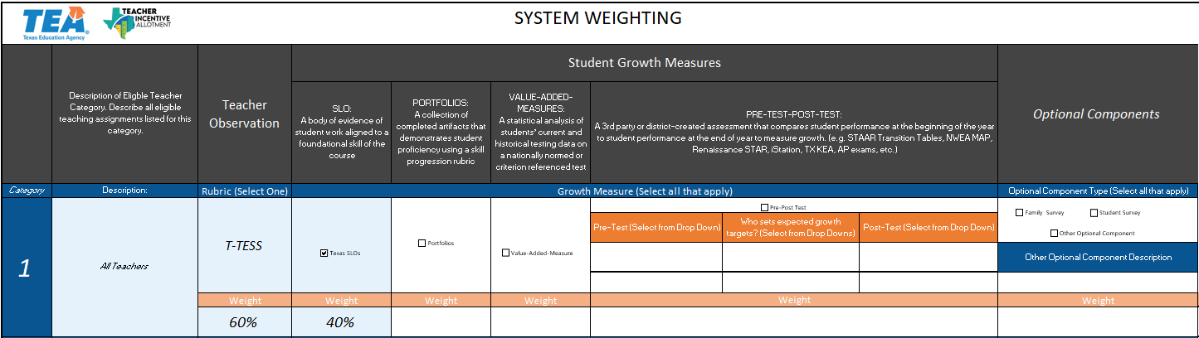
Input Weighting Tab Data
Just like in your System of Record, fill in the Weighting tab. Be sure to align your measures with each percent.

Slide 36
Input Designation Decisions
Step 3: Determine performance standards and requirements for optional components (if applicable)
Step 1: Determine designation performance standards
Step 2: Determine minimum standards to earn a designation
Math behind the decisions.
Compensatory Approach
Non-compensatory Approach
Hybrid Approach
Minimum standards to earn designations.
Non-compensatory Approach
Hybrid Approach

Slide 37
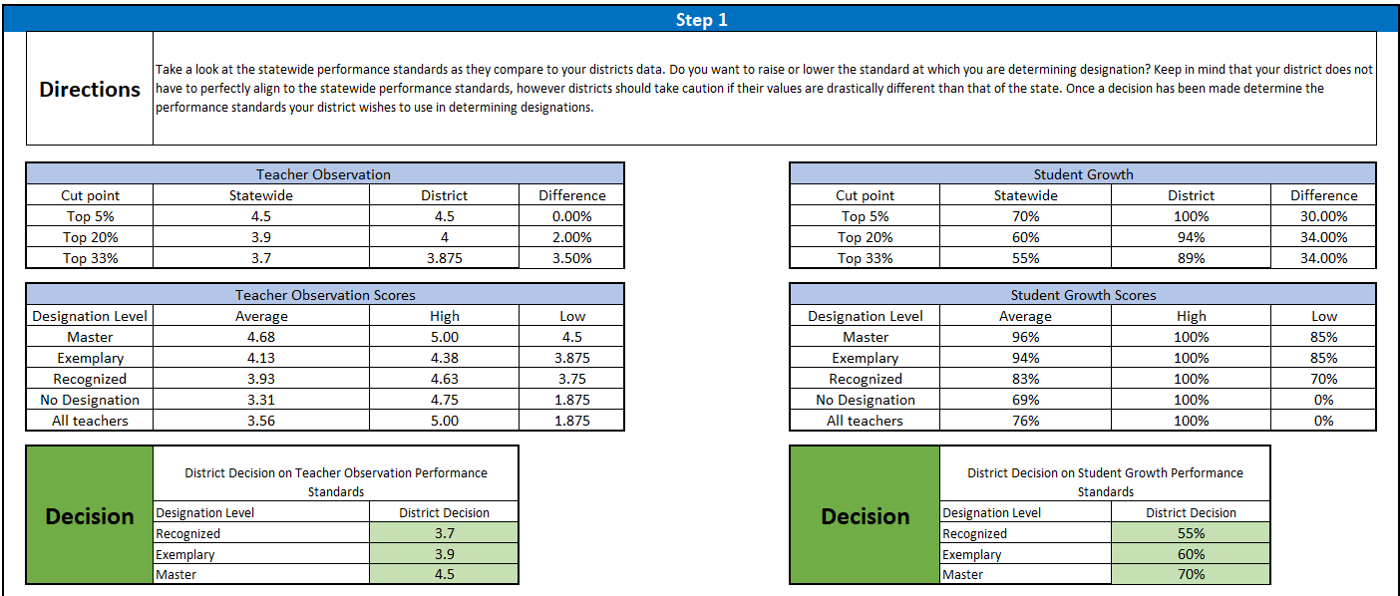
Input Performance Decision

Slide 38

Input Performance Decision cont.
You will need to decide on what standards you are going to establish for each component. By default, the statewide performance standards are applied. However, these can be modified to better align with your system.

Slide 39
Input Performance Decision cont.

Slide 40
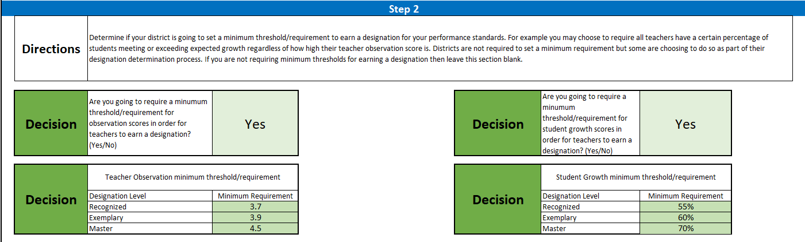
Input Minimum Standards
** You are not required to set a minimum standard to earn a designation.

Slide 41
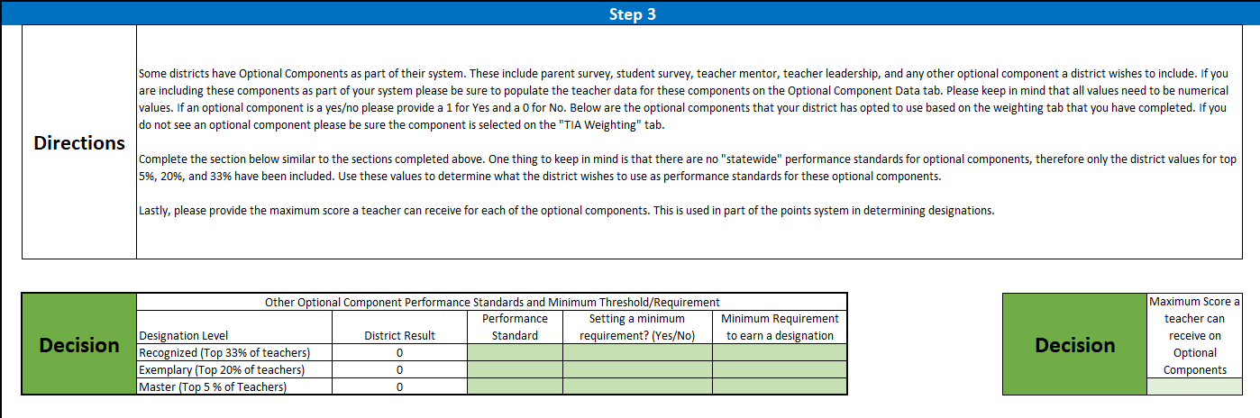
Input Optional Components
Districts using Optional Components will need to complete this same process (setting performance standards and minimum requirements) for their optional components.
Districts will also need to provide the maximum score a teacher can receive for their optional component in the tool. This is used in the calculation process.

Slide 42
Results
Unique ID of the educator ** | First name of the educator ** | Last name of the educator ** | Proposed Designation Level (New or Higher only)** | Designation Result
116 | Lucia | Roman | No Designation | Recognized
5 | Cohen | Richmond | No Designation | No Designation
13 | Chaim | Valdez | No Designation | No Designation
31 | Ariel | Mclaughlin | No Designation | No Designation
46 | Kristopher | Rosario | Exemplary | Exemplary
49 | Savion | Parker | Recognized | Exemplary
54 | Bethany | Newton | No Designation | Exemplary
11 | Jeffery | Lawrence | No Designation | Recognized
21 | Ally | Cook | No Designation | Exemplary
20 | Nina | Church | No Designation | Recognized
8 | Giancarlo | Delacruz | No Designation | No Designation
40 | Finley | Dougherty | No Designation | Recognized
Note: The tool does not catch teachers performing below proficient in an observable domain.

Slide 43
APPLY

Slide 44
Review and Refine
Review Designation Outcomes
Input/adjust data entry information
Input/Adjust weighting tab information
Input/Adjust designation decision information
What are the impacts of adjustments to my system?
How did I make these initial decisions?
Is my current system identifying effective teachers?
Is this a change I can make now, or do I need this for next year?
Stakeholder
Engagement

Slide 45
Make Adjustments
Districts can
Districts cannot
Change the weighting of approved components. Ex: the LEA system application weighted teacher observation at 30% and student growth at 70%. The LEA can change weighting to 50/50.
Remove other optional, non-statutory components. Ex: attendance, student surveys
Adjust the standard at which a teacher is able to earn a designation
Adjust or establish a minimum requirement to earn a designation
Exclude teacher observation or student growth when determining designations
Add or remove eligible teaching assignments
Add or remove student growth measures
Add or remove teacher observation component
TIA Webpage

Slide 46
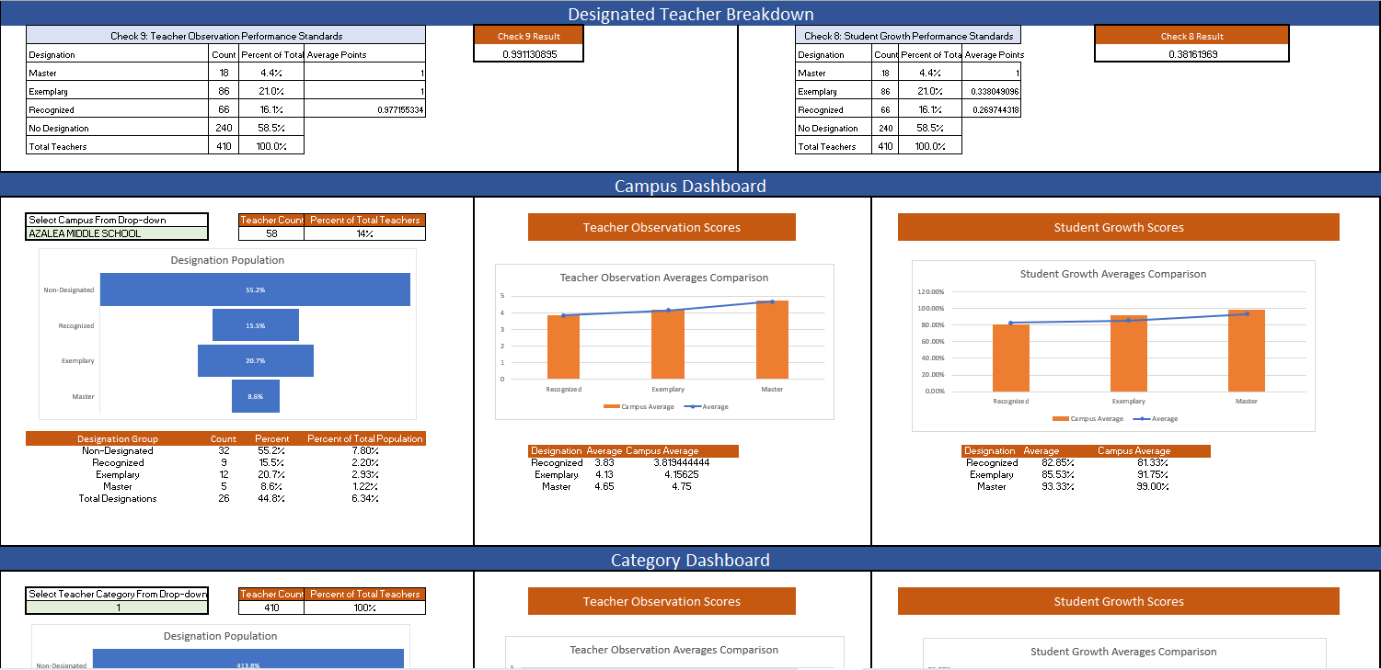
Analysis Tab
The analysis tab will show a breakdown of your designations as well as campus and teacher category dashboards.

Slide 47
ACT

Slide 48





Taking Ownership
Gather teacher performance data
Assemble the data file
Run Analysis
TIA Designation Determination Tool
Training July 24: TIA Data Analysis Tool
Respond
Best Practices for Identifying and Responding to EOY Skew and Correlation

Slide 49
TIA Data Analysis Tool
Attend tomorrow’s webinar 9:30 a.m. -10:30 a.m.
Preparing for Data Validation: Post Data Capture Year
What to expect:
Introduction to and explanation of the new TIA Data Analysis Tool
Run the analysis of how your designation decisions can impact data validation
Use the tool to identify areas of concerns and areas of strengths within your district's data
Determine next steps to improve performance for school year 2025-26

Slide 50
ANNOUNCE

Slide 51
Communicate
Communicate final decision processes to stakeholders.
Have a clear communication strategy for final designation decisions to teachers.
Change management plan for changes to your local designation system.

Slide 52




Designation Communications Timeline
Verify submitted data with campus admins
Optional: Share with teachers if they will be submitted for designation and at what level
Communicate eligibility requirements
Share with teachers:
Data Validation results
Expected eligibility and designation level
Preview spending plan
Confirm designation allotments, funding, and spending plan
August-September
September-October
February
May

Slide 53
ASSESS

Slide 54


Tools for Assessment
Texas VAM Data
TIA Data Analysis Tool
Acts as a valid and reliable measure to compare against other growth measures and components
Allows users to replicate possible data validation outcomes and identify areas of concern and areas of strength within those outcomes.

Slide 55
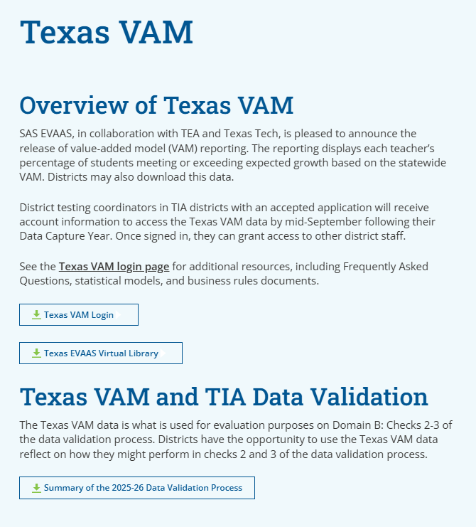
What is VAM?
Value-Added-Model (or Measure) is a method used to estimate a teacher’s causal effect on student achievement. VAM uses statistical modeling to predict expected scores, based on a student’s testing history, to measure growth as more than, less than, or equal to expectations.
Texas VAM

Slide 56




Texas VAM Timeline
New districts receive Texas VAM Web Reporting Data. 2024-25 data released.
Use data to inform designation decision practices.
Determine with Stakeholder Engagement if Texas VAM should be incorporated into your local designation system.
Optional: Complete Expansions Modification Application in April of 2026 if your district wants to incorporate Texas VAM into the local designation system.
Mid-September
September
October-February
April 2026

Slide 57
How do I access my VAM data?
Who gets access:
District Testing Coordinators (as recorded in AskTED) will receive access via email
Application Accepted districts will get access via email in mid-September
District Testing Coordinators can grant account access to other necessary staff in the district
If you believe you should have access and don’t:
Request access from your District Testing Coordinator
If they don’t know how to log in, they can reach out to TIA@tea.texas.gov

Slide 58

Texas EVAAS Virtual Library
SAS webinar: includes a review and interpretation of the web reporting, and how to use the data to support your TIA designation system
Student Report walkthrough
Overview of VAM and how it works
SAS EVAAS FAQs
Teacher Report walkthrough
Virtual Library

Slide 59
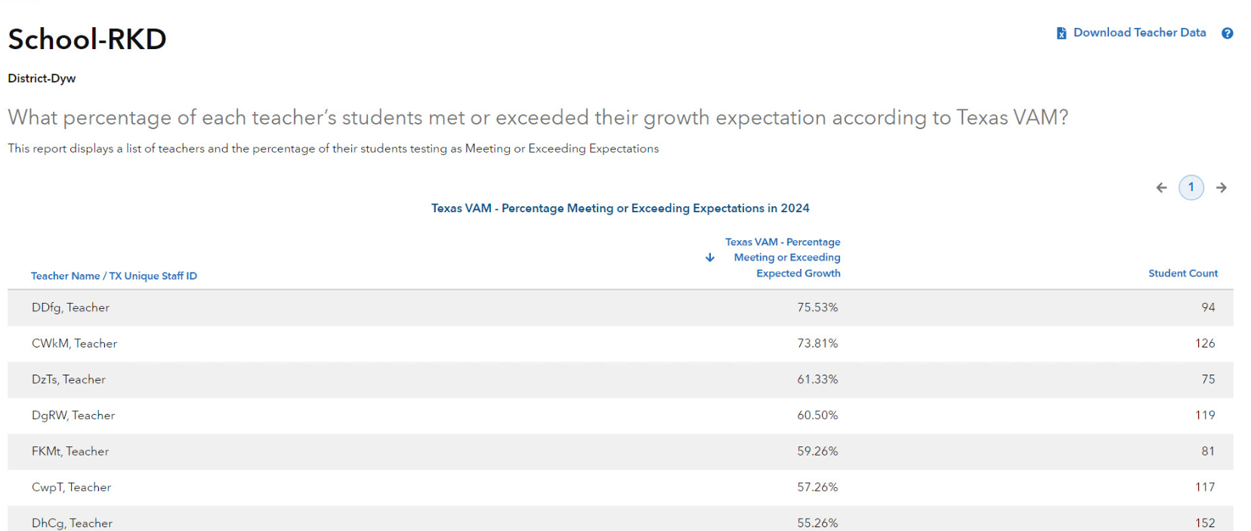
Texas VAM Teacher Report
VAM implied designations
Master
Exemplary
Designation Level | % of students meeting or exceeding expected growth
Recognized | 55%
Exemplary | 60%
Master | 70%
Recognized
Count of unique student assessments

Slide 60



Best Practices for Using Texas VAM
Pressure test efficacy of other student growth measures.
Level-set designation proportions for district.
Determine what adjustments to designation standards need to be made.
Using Scenarios to assess designation decisions

Slide 61
Pressure Test
Pressure test efficacy of other student growth measures.
How do the results of other district growth measures compare to those of Statewide VAM?
How do the results of other components, such as student surveys, compare to Statewide VAM?
Scenarios D, E, and F

Slide 62
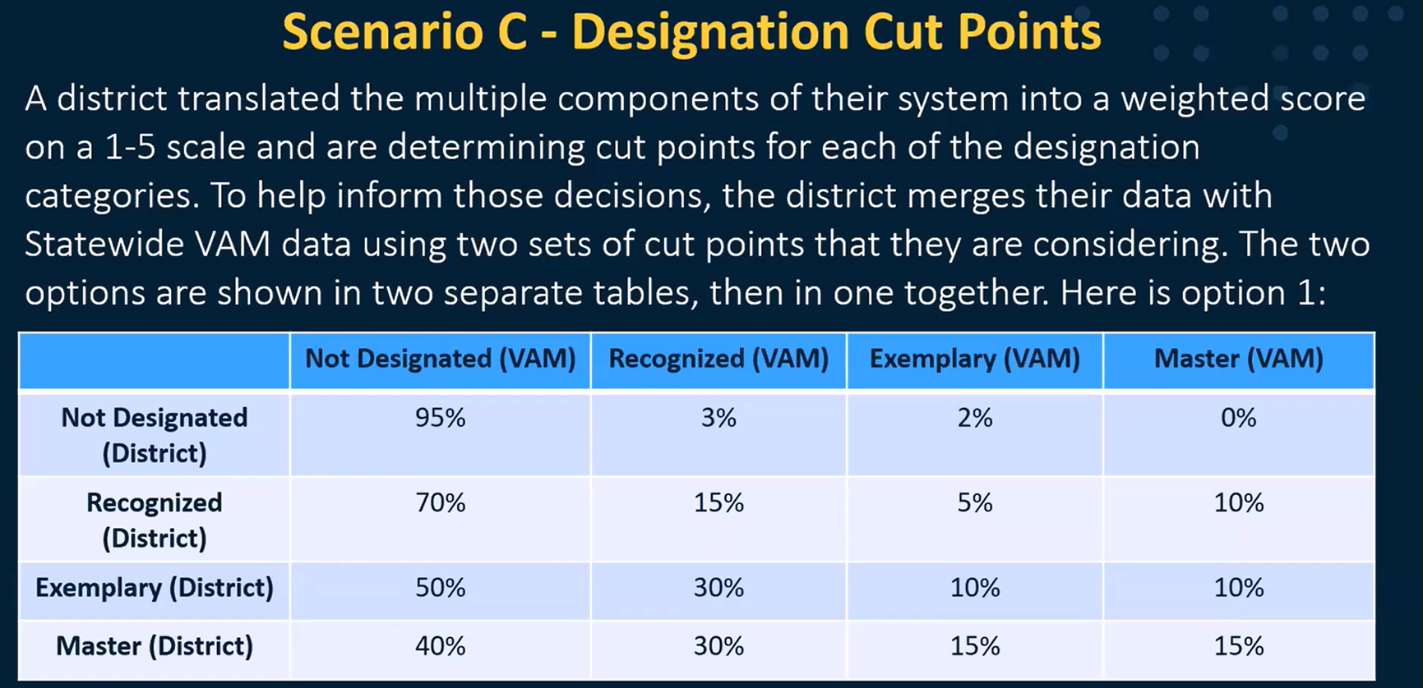
Level-set
Level-set designation proportions for the district.
How might a district set designation cut points?
Scenario C

Slide 63
Determine Adjustments
Determine what adjustments to designation standards need to be made.
Do district designations tend to move in the same direction as Statewide VAM?
How well do district designations align with Statewide VAM? Do differences tend to represent under or over designation?
Scenarios A and B
Any adjustments should be made to overall standards not individual designations.

Slide 64
Relationship to Data Validation
Checks 2-9 look only at new and higher designations and evaluate the quality and fairness of their designation determination process
Domain A: Check #1
Correlation check between teacher observation and student growth scores.
Domain B: Checks #2-3
Compares only VAM-linked district designations with VAM designations.
Domain C: Checks #4-7
Looks at the effect campus, teacher category, or assignment have on designations.
Domain D: Checks #8-10
Compares teacher performance to statewide standards and proportion of designations to statewide performance.
Domain E: Supplemental Checks #11-13
Unscored supplemental checks used to provide additional data for districts.
Checks 1 and 10 look at all teachers in the submission file regardless of proposed designation

Slide 65
Upcoming Support
Preparing for Data Validation: Data Submission and Validation
Preparing for Data Validation: Post Data Capture Year
Portal begins accepting files
July 23
1:00 – 2:30 p.m.
Learn what is evaluated during data validation and how to prepare for data submission
July 24
9:30 – 10:30 a.m.
Identify areas of concern and areas of strength in district data collection using the new data analysis tool
August 4

Slide 66





Next Steps
Review the three decision approaches: non-compensatory, compensatory, and hybrid. Identify which method you are currently using and which you would like to use moving forward.
Apply those decision-making approaches to the tool and review how your designation results are affected.
Plan how to act and respond to your data.
Devise a communication plan to announce your decisions.
Assess how your proposed designation outcomes meet the goal of identifying your effective teachers.

Slide 67
Thank You

