Slide 1
Understanding the Step 2 Data Report (Cohorts A-D) 2023
2/8/2023

Slide 2

Presenter
CODY BROWN
Data Analyst

Slide 3
Agenda
1:00 p.m. – 1:05 p.m.
Overview and Objectives
1:05 p.m. – 1:15 a.m.
Data Validation Changes
1:15 p.m. – 1:20 p.m.
Data Submission and Error Checking
1:20 p.m. – 2:00 p.m.
Data Validation Checks
2:00 p.m. – 2:30 p.m.
Q/A Office Hours

Slide 4



Our Vision
To support districts in independently building and sustaining strategic compensation systems that differentiate teacher effectiveness. These systems will incentivize teachers to stay, support more robust recruitment, and make the profession more desirable.
Recruit
Retain
Reward

Slide 5
Objectives
Gain more clarity on the step 2 data validation process
Learn how to interpret the data report and possible next steps to address issues to continuously improve
Learn from other districts about ways to improve data validation results

Slide 6

2 Step District Approval Process
Designations are dependent upon a two-step approval process
1. Application Approval
2. System Approval
Districts submit application, which may include narrative components to TEA
Districts submit evidence of teacher effectiveness data to Texas Tech University. TEA issues final approval.

Slide 7






Application and Approval Timeline
Pre-Application
System Development
Stakeholder Engagement
Year 1
System Application
TIA Teacher Buy-In Survey
Year 2
Capture Data
Expansion and Modifications
Year 3
Data Submission
Full System Approval
Designate & Compensate
Expansion & Modifications
TIA Annual Evaluation Surveys
Annual Program Submission
Post-Approval
New or Higher Designations
Expansion and Modifications
Annual Program Submission
TIA Annual Evaluation Survey

Slide 8
Data Validation Changes

Slide 9
Summary of Key Changes
Overall purpose of changes is for continuous improvement of the data validation process. These changes apply to this year’s data validation:
Changed numbering for checks
Changed weight of check 2 from a weight of 9 to a weight of 6
Created new check 3 that is a combined check of checks 3-4
Added a new supplemental (non-scored) check 11

Slide 10
Data Submission

Slide 11


District Approval Process
Pre-Application
Districts engage with stakeholders and develop their local designation system.
System Application
Districts submit their application to TEA after building their system then submit the TIA Teacher Buy-In Survey to TTU.
Data Capture Year
Districts implement their system and track student growth and teacher observations.
Data Submission
Districts submit their data to TTU for data validation and TEA reviews outcomes and other pieces of data to determine final approval.
TIA Annual Program Submission & Surveys submitted to TTU.

Slide 12
Overview of the Data Submission Process
Districts submit one file for data submission, which includes district information, system weighting tab, and data entry tab.
District Information Tab
Include contract information and address all supplementary questions.
Data Entry Tab
Observation and student growth scores for all teachers in an eligible teaching assignment during the 2021-2022 school year (both designated and non-designated).
Includes a column for new or higher designations.
Weighting Tab
Should reflect your approved local designation system.

Slide 13
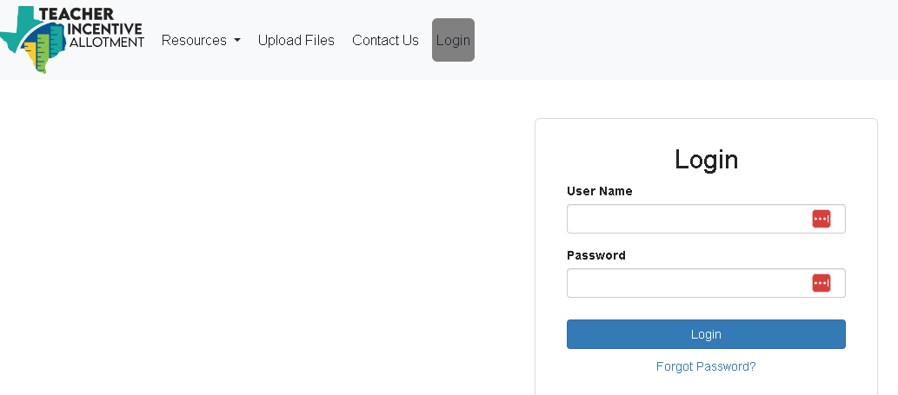
Error Checking
Districts submitting data in the fall went through an extensive data checking process both through the TTU data submission portal and through system alignments checks conducted by TIA team.

Slide 14
Data Validation

Slide 15

TTU Data Validation
TTU Data Validation
Is the observation and student growth data valid and reliable?
Is the designation system fair and accurate?
9 scored checks
2 unscored supplemental checks
TEA system approval

Slide 16
Overview of TTU Data Validation Process
How will district data be validated by TTU?
5 domains
9 scored checks
2 unscored supplemental checks

Slide 17
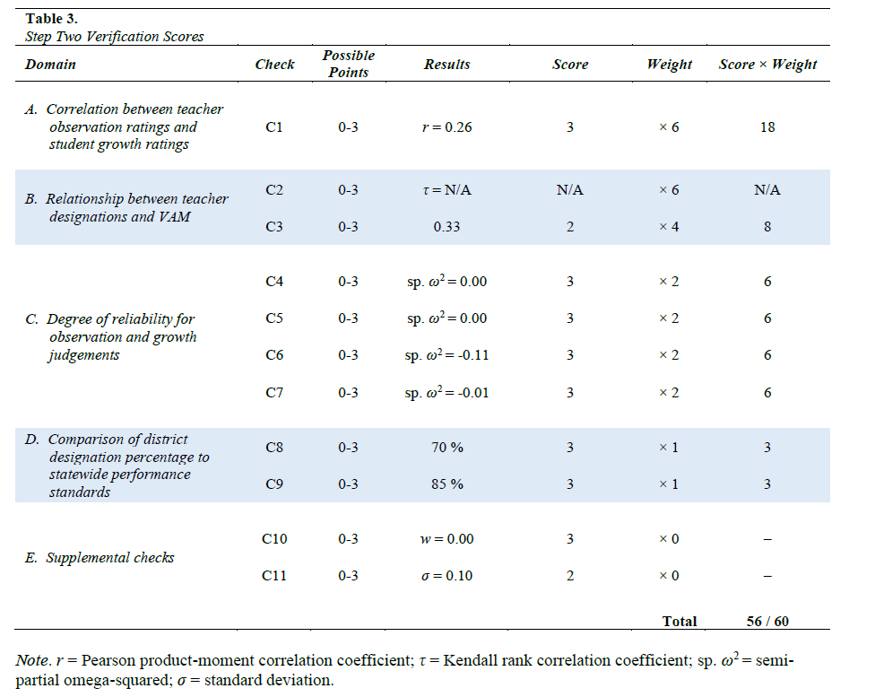
Scores

Slide 18
TTU Data Validation Summary
Domain A: Check #1
Correlation check between teacher observation and student growth scores.
Domain B: Checks #2-3
Compares district designations with VAM designations.
Domain C: Checks #4-7
Looks at the effect campus, teacher category, or assignment have on designations.
Domain D: Checks #8-9
Compares designated teacher’s observation scores to that statewide performance standards.
Domain E: Supplemental Checks #10-11
Unscored supplemental checks used to provide additional data for districts.

Slide 19
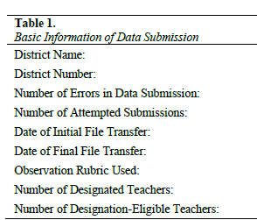
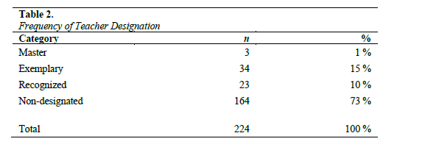
Descriptive Statistics Page
Table 1*:
Shows the Basic Information of Data Submission
Table 2*:
Shows the Frequency of Teacher Designations
N - Number of teachers
% - Percentage of designations based on the number of eligible teachers.
*Data in these tables are not used in scoring during data validation

Slide 20



Domain A: Check 1
Domain A
Correlation between teacher observation ratings and student performance ratings
Check 1
The correlation coefficient between observation and growth among all eligible teachers is within the range of expected magnitude reported in the research literature.
Checks for:
How closely aligned district created observation scores and percent of students that met or exceeded their growth target are.
Data used:
Teacher observation and student growth scores of all teachers included in submission file
Are teacher designations used for this check?
No, teacher designations were not used as part of the analysis

Slide 21
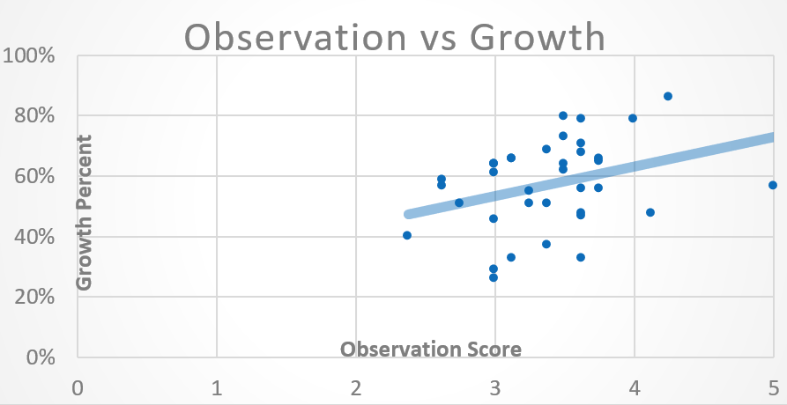
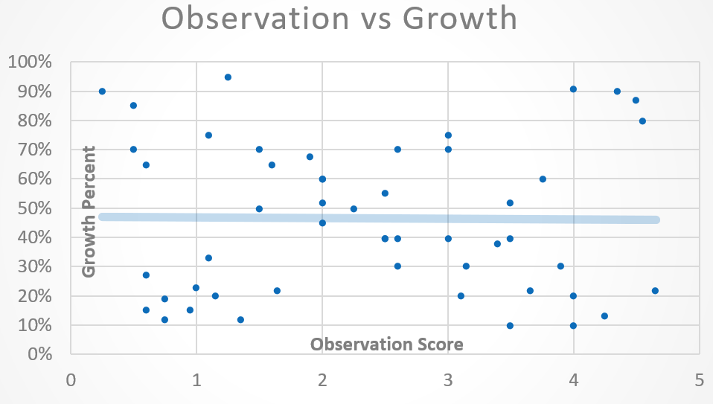
What is correlation?
Comparison of teacher observation scores to student growth scores
Positive Correlation
No Correlation
Districts have the most control over the results of this check because the data used is coming from the district.

Slide 22
Domain A Next Steps
Next Steps
Questions to Consider
Dive deeper into your district’s correlation to uncover areas of focus to improve on. This could be a particular campus/appraiser, student growth measure, TIA teacher category or even a subject/grade-level
Look for areas of inflation in your teacher observation and growth scores.
Resources
Excel Analysis Tool
Correlation Training
Correlation Resources
Do flaws exist in your appraisal system that require recalibration or, more training?, etc.?
Do flaws exist in the construction, administration and/or calculation of your student growth measure?
Is inflation in teacher observation and growth scores happening at a particular campus, a specific subject/grade level, or maybe with a certain appraiser.

Slide 23



What Determines Designations?
District Performance Standards
The minimum standards to meet each designation level for student growth and teacher observation.
System Weights
The weighing of teacher observation, student growth, and other optional components used by the district. Example: 40% teacher observation and 60% student growth.
Optional Prerequisites
Components required by the district but not by statute. Example: teacher’s attendance must be 90% or above to earn a designation.

Slide 24
Domain B: Checks 2-3
District Designations
Statewide VAM Designations
Teacher​ | Designation​
Teacher 1​ | Recognized​
Teacher 2​ | Recognized​
Teacher 3​ | Exemplary​
Teacher 4​ | Exemplary​
Teacher 5​ | Master​
Teacher​ | Designation​
Teacher 1​ | Recognized​
Teacher 2​ | Exemplary​
Teacher 3​ | No Designation​
Teacher 4​ | Recognized​
Teacher 5​ | Master​

Slide 25
Subjects Used in VAM
Mathematics, grades 4-8
Reading, grades 4-8
Science, grades 5 and 8
Social Studies, grade 8
Writing, grades 4 and 7
Algebra I
Biology
English I
English II
US History

Slide 26
Domain B: Check 2
Domain B
Confirm relation between district designations and student growth calculations
Check 2
District designations of Recognized, Exemplary, and Master (REM) teachers are found in similar proportion to designations as determined by the state-wide VAM.
Checks for:
How closely aligned district designations are to VAM designations.
Data used:
Only designated teachers are used that also have a VAM designation from statewide data
Are teacher designations used for this check?
Yes, only designated teachers are used in this check.

Slide 27


Domain B: Check 2 Explained
No Designation | Recognized | Exemplary | Master
1
1
Aligned
2
Under
2
3
Over
3
4
Over
4
5
5
Aligned
District Designations
VAM Designations

Slide 28
Domain B: Check 3
Domain B
Confirm relation between district designations and student growth calculations
Check 3
District designation decisions for REM teachers, in tested subjects, are in proximity to designations as determined by the state-wide VAM.
Checks for:
Proximity of district designations to VAM designations.
Data used:
Only designated teachers are used that also have a VAM designation from statewide data
Are teacher designations used for this check?
Yes, only designated teachers are used in this check.

Slide 29
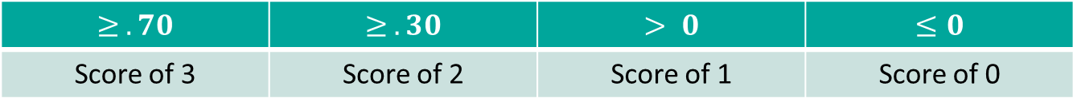
Domain B: Check 3 Explained
Proximity of district designations to designations determined by statewide VAM.
 |  | Designation Determined by state-wide VAM
 | Designation Level | Non-Designated | Recognized | Exemplary | Master
District Designation | Recognized | 0.00 | 1.00 | 0.75 | 0.50
 | Exemplary | -0.25 | 0.75 | 1.00 | 0.75
 | Master | -1.00 | 0.25 | .75 | 1.00
Points will be assigned to results from the average based on these cut points:
$$≥ .70$$ | $$≥ .30$$ | $$> 0$$ | $$≤0$$
Score of 3 | Score of 2 | Score of 1 | Score of 0

Slide 30
Domain B Next Steps
Next Steps
Questions to Consider
Dive deeper into your district’s distribution of both observation and student growth scores.
Dive deeper into the total counts of designations by designation level and overall in your district.
Resources
SAS EVAAS Manual
Walkthrough on the statewide VAM model
TEA 2022 Accountability Rating System
Is there enough stretch in the data to accurately distinguish between effective and ineffective teachers?
What other components are contributing to designation decisions? Is this causing problems in my designation system?
Are the same students being looked at for my growth measure as STAAR? (e.g. the same 20 students who took the STAAR exam are the same 20 students that are used for my SLO process)
Are you measuring growth in a consistent way across all growth measures?
Are you administering the growth measure with the same fidelity as STAAR?
How do the number of designations you issued compared to the state? Does this percent of designations make sense for my district compared to my performance in the state?

Slide 31
Domain C: Check 4-7
Domain C
Degree of inter-rater reliability for observation and growth judgements
Across campuses, observation scores and percentages of student growth are similar for teachers in REM (Recognized, Exemplary, Master) groups.
Across teacher category/assignments, observation scores and percentages of student growth are similar for teachers in REM groups.
Checks 4-7
Checks for:
What effect does campus/assignment have on both observation and student growth values as it relates to each designation group.
Data used:
Teacher observation and growth data from designated teachers
Are teacher designations used for this check?
Teacher designations are used to group teachers into categories: Recognized, Exemplary, Master

Slide 32
Domain C: Checks 4-7 Explained
Goal for these checks is to see alignment between designated teachers’ performance across campuses and across assignments (teacher category, STAAR tested, non-STAAR tested)
Campus 2: Recognized Teacher’s Performance
Campus 1: Recognized Teacher’s Performance

Slide 33
Domain C: Exploring Checks 4-7
Campus 1
Campus 2
Campus 3
Campus 4
Campus 5
Campus 6
Do you believe that a “Recognized” teacher at all campuses is the same? Do you believe that campus had an effect on the designation? Why?

Slide 34
Domain C Next Steps
Next Steps
Questions to Consider
Dive deeper into your district’s observation and growth scores specific to each designation level.
Resources
Teacher Calibration Protocols
Inter-rater Reliability Webinar
Inter-Rater Reliability FAQ
Setting expected growth targets training
Using approved assessments as Pre-Test-Post-Test
Commonly used student growth assessments
Do designated teachers in each respective designation level across campuses, assignments, and teacher categories have similar student growth scores and teacher observation ratings? Do you believe that designation decisions are “fair” for each designation level?
Do you notice trends at the campus level, teaching assignment level, or teacher category level that are causing designations to appear unfair?
What type of support would an appraiser need to ensure they are rating teachers fairly?
Were any trends noted caused because a particular appraiser gave higher scores on a campus relative to other appraisers on that campus or relative to scores on like campuses?
Was the fidelity in administration of growth measure in one teaching assignment different than in another teaching assignment?
How consistent was growth measured across all growth measures?
Are your student growth and teacher observation from the same grade and subject?

Slide 35
Domain D: Check 8-9
Domain D
Comparison of district designation percentage to overall statewide performance
Percentage of students who meet or exceed expected growth in the district is approximately equal to the statewide performance standard for student growth among REM teachers.
Observation ratings for REM teachers in the district are approximately equal to the statewide performance standards for teaching proficiency.
Checks 8-9
Checks for:
Percent of designated teachers that met or exceeded the cut score performance standard for student growth and teacher observation based on the district designation.
Data used:
Teacher observation and growth data from designated teachers
Are teacher designations used for this check?
Yes, only designated teachers are used in this check.

Slide 36
Domain D: Checks 8-9 Explained
Teachers are assigned points based on their proximity to the statewide performance standards established for each designation level.
These values are then averaged within each designation group then a mean value is calculated over all possible designation groups.

Slide 37
Domain D Next Steps
Next Steps
Questions to Consider
Dive deeper into your designated teachers’ observation and growth scores.
Resources
Statewide Performance Standards: Teacher Observation
Statewide Performance Standards: Student Growth
How close are my designated teachers to the statewide performance standards? Are the differences explicable? (e.g. my district is a high performing district compared to that of the average district in the state?)
Are there other contributing factors in making designation decisions that are causing my designated teachers to have large differences to the statewide performance standards?
Are the differences in the performances caused by inflated growth scores or observation scores? (e.g. large number of teachers having 100% growth on the SLO growth measure, or large number of teaches receiving all 4’s and 5’s on T-TESS)
Are the differences explicable? (e.g. my district is a high performing district compared to that of the average district in the state?)

Slide 38
Domain E: Supplemental Check 10
Domain E
Supplemental System Checks (not scored)
Check 10
The proportion of teachers on district campuses who are designated as Recognized, Exemplary, or Master is roughly equivalent to other campuses with the same Domain 2A rating
Checks for:
How similar are designation proportions for individual campuses compared to proportions to VAM designations in the same Domain 2A category.
Data used:
All teachers were included categorized as designated or not designated even teachers that are currently designated in a district were included.
Are teacher designations used for this check?
Yes, teacher designations were used in this check

Slide 39
Domain E: Supplemental Check 11
Domain E
Supplemental System Checks (not scored)
Check 11
The variability in observation ratings among all eligible teachers is within the range of historical magnitude.
Checks for:
Spread of teacher observation scores gathered. The expectation is that observation scores for the districts will be distributed in a manner that gives some evidence about the ability of the district to differentiate between effective and ineffective teachers.
Data used:
Teacher observation scores only from all teachers submitted in the submission file.
Are teacher designations used for this check?
No, teacher designations were not used in this check.

Slide 40
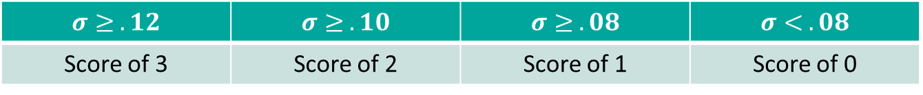
New Supplemental (Unscored) Check 11
The variability in observation ratings among all eligible teachers is within the range of expected magnitude.
The purpose of this check is to display for leaders of the district’s TIA initiative the spread of teacher observation scores gathered during the data capture year. For this check, analysts calculate standard deviation of (max-scaled) observation scores among all eligible teachers. The expectation is that observation scores for the district will be distributed in a manner that gives some evidence about the ability of the local system to differentiate between ineffective and effective instruction.
$$σ≥ .12$$ | $$σ≥ .10$$ | $$σ≥ .08$$ | $$σ< .08$$
Score of 3 | Score of 2 | Score of 1 | Score of 0

Slide 41
Final Takeaway
Based on the data validation report what is going to be your key Domain to improve upon for 2023 Fall data submission?
What action item either next step, question to consider, or resource are you going to take away today to improve upon for 2023 Fall data submission?

Slide 42
Key Reminders
Expansions/Modifications
April 17th, 2023 for 2023-2024 Implementation
Data Submission
FALL 2023

Slide 43
Thank You

