Slide 1
Designation Determination Webinar
July 26th, 2023

Slide 2
Agenda
9:00 a.m. – 9:15 a.m.
Performance Standards
9:15 a.m. – 9:30 a.m.
System Application Weights
9:30 a.m. – 9:55 a.m.
Designation Decision Preparation
9:55 a.m. – 10:00 a.m.
Weighting Tab
10:00 a.m. – 10:05 a.m.
Break
10:05 a.m. – 10:30 a.m.
Designation Decisions Tab
10:30 a.m. – 11:00 a.m.
Designation Results & Analysis Tabs

Slide 3
Objectives
Understand what goes into designation decisions including performance standards and system application weights.
Understand how to use the designation tool to assist with decisions around designations
Begin making decisions around designations

Slide 4
Data Literacy Framework
Ask: Identify problems, frame questions.
Acquire: Understand and acquire relevant data.
Analyze: Transform data into insights
Apply: Validate Insights
Act: Transform insights into decisions
Announce: Communicate Decisions
Assess: Evaluate decisions made
Turning Data into Insight
Source: Klidas, A. & Hanegan, K. (2022). Data Literacy in Practice: A complete guide to data literacy and making smarter decisions with data through intelligent actions

Slide 5
Data Literacy Framework for TIA
Ask: Who are my most effective teachers?
Acquire: Gathering data for data submission. Constructing the data submission file.
Analyze: Excel analysis tool. Determining designations.
Apply: Determine root cause of issues.
Act: Action plan for discoveries from your root cause analysis..
Announce: Communicate decisions through data validation in the fall.
Assess: Evaluation of data through data validation process. Reflection on how to improve moving forward.

Slide 6



What Determines Designations?
Performance Standards
The minimum standards to meet each designation level for student growth and teacher observation.
System Weights
The weighing of teacher observation, student growth, and other optional components used by the district. Example: 40% teacher observation and 60% student growth.
Optional Prerequisites
Components required by the district but not by statute. Example: teacher’s attendance must be 90% or above to earn a designation.

Slide 7
Transition Tables FAQ
For TIA, what is considered growth using STAAR Transition Tables?
Locally, districts set student growth targets for all student growth measures, including the transition tables. Generally, most districts will consider a student that scores 1 point as meeting growth. A district may also make a local decision to assign growth to a student who scores ½ a point.
August Data Submission Office Hours Tuesday, August 22 (9:00-10:00 a.m.)
September Data Submission Office Hours Tuesday, September 26 (9:00-10:00 a.m.)
October Data Submission Office Hours Tuesday, October 10 (9:00-10:00 a.m.)

Slide 8
Performance Standards

Slide 9
What Determines Designations?
Performance Standards
The minimum standards to meet each designation level for student growth and teacher observation.
System Weights
The weighing of teacher observation, student growth, and other optional components used by the district. Example: 40% teacher observation and 60% student growth.
Optional Prerequisites
Components required by the district but not by statute. Example: teacher’s attendance must be 90% or above to earn a designation.

Slide 10
TIA Performance Standards: Student Growth
The Teacher Incentive Allotment performance standards were established by looking at student growth performance data and teacher observation data on T-TESS.
Recognized represents the top 33%
Exemplary represents the top 20%
Master represents the top 5%
Student Growth Performance Standards
Designation Level | % of students meeting or exceeding growth target
Recognized | 55%
Exemplary | 60%
Master | 70%
For student growth performance standards, student assessment STAAR data was observed across 5 years (2014-2019). A value-added model was developed to determine if a student met or exceeded their expected growth target.

Slide 11
TIA Performance Standards: Teacher Observation
The Teacher Incentive Allotment performance standards were established by looking at student growth performance data and teacher observation data on T-TESS.
Recognized represents the top 33%
Exemplary represents the top 20%
Master represents the top 5%
Teacher Observation Performance Standards
Designation Level | Average T-TESS Score Domains 2 & 3 *
Recognized | 3.7* or 74% of possible points
Exemplary | 3.9* or 78% of possible points
Master | 4.5* or 90% of possible points
For teacher observation performance standards, T-TESS scores were observed across the state looking at only domains 2 & 3 on T-TESS. Averages were then established based on the cut points described above.
*For a teacher to earn a designation they must have a minimum of proficient on all observable dimensions. (T-TESS domains 2 & 3)

Slide 12
FAQ performance standards
Question?
How do I use the statewide performance standards in the development and design of my system as well as making designation decisions?
Answer
Performance standards are intended to serve as guide and reference when developing your designation system as well as when making designation decisions. It provides districts a way to see how teachers across the state performed on teacher observation and student growth in comparison to their own.
Since districts can use multiple components in determining designations for their teachers and because these values are statewide averages it is anticipated that districts will have teachers that perform above and below these values.

Slide 13
FAQ Percent of teachers
Does TEA expect districts to designate a certain percentage of eligible teachers?
No, there is no expectation for the number of teachers that can earn a designation in a district and districts are not limited to the 33% that is mentioned in the performance standards. Districts across the state perform above and below the average and therefore some will be above and below this 33% mark.

Slide 14
System Application Weights

Slide 15
What Determines Designations?
Performance Standards
The minimum standards to meet each designation level for student growth and teacher observation.
System Weights
The weighing of teacher observation, student growth, and other optional components used by the district. Example: 40% teacher observation and 60% student growth.
Optional Prerequisites
Components required by the district but not by statute. Example: teacher’s attendance must be 90% or above to earn a designation.

Slide 16
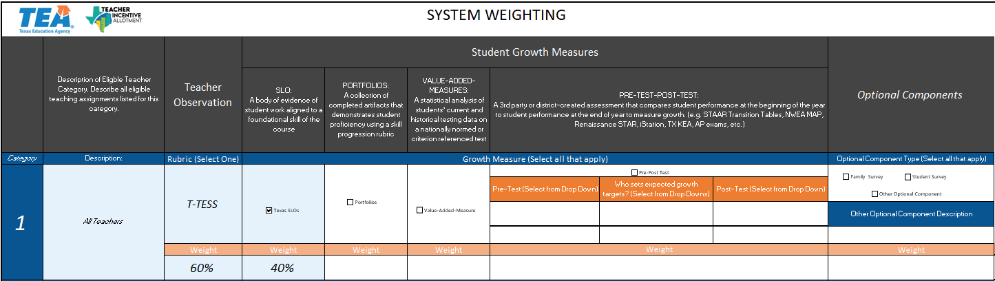
System Application Weights
Recall how your LEA came to a decision on your system application weights.

Slide 17
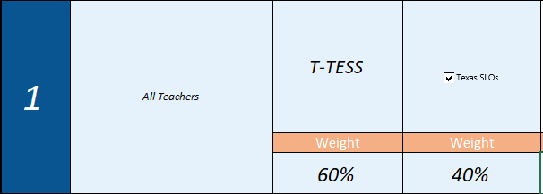
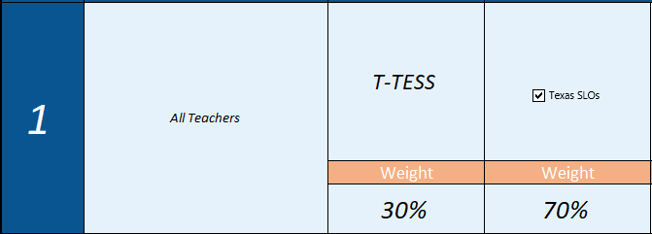
How weights affect designations: Example
Teacher | T-TESS Domains 2 & 3 Average | Percent of students who met or exceeded growth | Designation
1 | 3.8 | 53% | Recognized
2 | 3.0 | 75% | No Designation
Teacher | T-TESS Domains 2 & 3 Average | Percent of students who met or exceeded growth | Designation
1 | 3.8 | 53% | No Designation
2 | 3.0 | 75% | Exemplary

Slide 18
Options for making changes to weights
System application weights can be changed during data submission.
You cannot remove any teacher category, growth measure, or teacher observation component.
You can make changes to the component weight
You can remove existing optional components
**Consider how any of these changes would be perceived by your teachers.

Slide 19
Breakout group: weights
Discuss with your small group:
What changes are you planning to make to your system, if any, prior to data submission?
How did you come to this decision and why?

Slide 20
Designation Decision Preparation

Slide 21
Opening Question in the Chat
What has been the most challenging aspect in determining designations for your district?

Slide 22
What Determines Designations?
Performance Standards
The minimum standards to meet each designation level for student growth and teacher observation.
System Weights
The weighing of teacher observation, student growth, and other optional components used by the district. Example: 40% teacher observation and 60% student growth.
Optional Prerequisites
Components required by the district but not by statute. Example: teacher’s attendance must be 90% or above to earn a designation.

Slide 23
Components of Designation Decisions
Minimum standards to earn a designation
Prerequisites to earn a designation
Teacher Performance Data
Standards to earn a designation
Component weights
Designation Decision
The tool takes your decisions around these components and producing designation results for you.
To learn more about the math behind the tool, check out my training on using weights to determine designations:
https://tiatexas.org/using-weights-to-determine-designations/

Slide 24

Non-Components of Designation Decisions
Bias
Subjectivity
There are reasons and justifications for the choices you made around designation decisions, but these choices should not be targeting an individual or group of teachers.

Slide 25
Designation Decisions: Key Question 1
Key Question 1: Rationale
Look at your system application. What components of teacher performance does your local designation system use in evaluating your teachers? Recall the rationale behind the weights for each of the components used.

Slide 26
Designation Decisions: Key Question 2
Key Question 2: Minimum Requirements
What minimum requirements, if any, is your district establishing for teachers to earn a designation? Do you have a minimum requirement for teacher observation scores, student growth percent, or other optional components? If so, what is the rationale behind this decision?

Slide 27
Designation Decisions: Key Question 3
Key Question 3: Performance Standards
By what standard of performance are you using to determine designations? For most districts this is the statewide performance standards. Some districts may choose to adjust these values to better reflect teacher performance in their own district. Districts that choose this route should use caution as dramatically evaluating teachers different than the statewide performance standards can influence data validation.
**If you are using optional components your district will need to establish performance standards for those components in order to determine designation. This is because the state only created performance standards for both teacher observation and student growth.

Slide 28
Designation Decisions: Breakout Groups
What components of designation decisions are you planning to use in making designation decisions? Why?
Discuss with your group your current thinking regarding these decisions.

Slide 29
Weighting Tab: Data Submission and Application
Districts can
Districts cannot
Change the weighting of approved components. Ex: the LEA system application weighted teacher observation and 30% and student growth at 70%. The LEA can change weighting to 50/50.
Remove other optional, non-statutory components. Ex: attendance, student surveys
Adjust the standard at which a teacher is able to earn a designation
Adjust or establish a minimum requirement to earn a designation
Add or remove eligible teaching assignments
Add or remove student growth measures
Add or remove teacher observation component
Exclude teacher observation or student growth when determining designations

Slide 30
Weighting, Multiple Student Growth Measures, Optional Component Data

Slide 31
Weighting Tab
Just like in your TIA application, complete your TIA weighting tab. Be sure to align your measures with each percent.

Slide 32
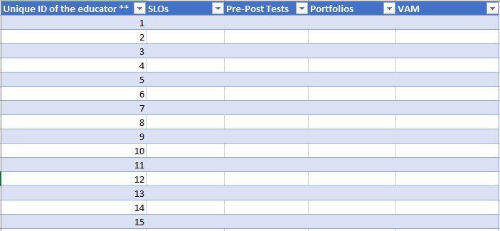
Multiple Student Growth Measures
If you have multiple student growth measures for a single teacher category you will need to provide each separate growth percent on the multiple student growth measure tab.

Slide 33
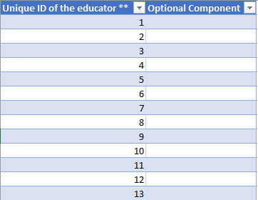
Optional Component Data
If you are using optional components. You will need to provide the optional component data on the optional component tab.

Slide 34
Designation Decisions Tab

Slide 35
Designation Decisions
Step 1: Determine designation performance standards
Step 2: Determine minimum requirements for performance
Step 3: Determine performance standards and requirements for optional components (if applicable)

Slide 36
Designation Decision Tab: Step 1
Look at the statewide performance standards as they compare to your district’s data. Do you want to raise or lower the standard at which you are determining designations?
Teacher Observation
Student Growth
Cut point | Statewide | District | Difference
Top 5% | *4.5 | 4.5 | 0.00%
Top 20% | *3.9 | 4 | 2.00%
Top 33% | *3.7 | 3.875 | 3.5%
Cut point | Statewide | District | Difference
Top 5% | 70% | 100% | 30.00%
Top 20% | 60% | 94% | 34.00%
Top 33% | 55% | 89% | 34.00%
*For a teacher to earn a designation they must have a minimum of proficient on all observable dimensions. (T-TESS domains 2 & 3)

Slide 37
Designation Decision Tab: Step 1 Cont.
You will need to decide on what standards you are going to establish for each component. As a default the standards are set to the statewide performance standards, but you can adjust these.
Teacher Observation
Student Growth
Decision | Designation Level | District Decision
 | Recognized | 3.7
 | Exemplary | 3.9
 | Master | 4.5
Decision | Designation Level | District Decision
 | Recognized | 55%
 | Exemplary | 60%
 | Master | 70%

Slide 38
Designation Decision Tab: Step 2
Determine if your district is going to set a minimum threshold/requirement to earn a designation for your performance standards.
Teacher Observation
Student Growth
Decision | Designation Level | Minimum Requirement
 | Recognized | ??
 | Exemplary | ??
 | Master | ??
Decision | Designation Level | Minimum Requirement
 | Recognized | ??
 | Exemplary | ??
 | Master | ??
** You are not required to set a minimum standard to earn a designation.

Slide 39
Designation Decision Tab: Step 3 Cont.
For districts that use Optional Components they will need to complete this same process for their optional components.
Decision | Designation Level | District Result | Performance Standard | Setting a minimum requirement? (Yes/No) | Minimum Requirement to earn a designation
 | Recognized (Top 33% of teachers) | ?? | ?? | ?? | ??
 | Exemplary (Top 20% of teachers) | ?? | ?? | ?? | ??
 | Master (Top 5 % of Teachers) | ?? | ?? | ?? | ??
Decision | Maximum Score a teacher can receive on Optional Components
 | ??
Districts will also need to provide the maximum score a teacher can receive for their optional component in the tool. This is used in the calculation process.

Slide 40
Designation Results & Analysis Tab

Slide 41
Designation Results Tab: Overview
Unique ID of the educator ** | First name of the educator ** | Last name of the educator ** | Proposed Designation Level (New or Higher only)** | Designation Result
116 | Lucia | Roman | No Designation | Recognized
5 | Cohen | Richmond | No Designation | No Designation
13 | Chaim | Valdez | No Designation | No Designation
31 | Ariel | Mclaughlin | No Designation | No Designation
46 | Kristopher | Rosario | Exemplary | Exemplary
49 | Savion | Parker | Recognized | Exemplary
54 | Bethany | Newton | No Designation | Exemplary
11 | Jeffery | Lawrence | No Designation | Recognized
21 | Ally | Cook | No Designation | Exemplary
20 | Nina | Church | No Designation | Recognized
8 | Giancarlo | Delacruz | No Designation | No Designation
40 | Finley | Dougherty | No Designation | Recognized

Slide 42
Using The Designation Tool Review
Review Designation Outcomes
Input/adjust data entry information
Input/Adjust weighting tab information
Input/Adjust designation decision information
Stakeholder
Engagement

Slide 43
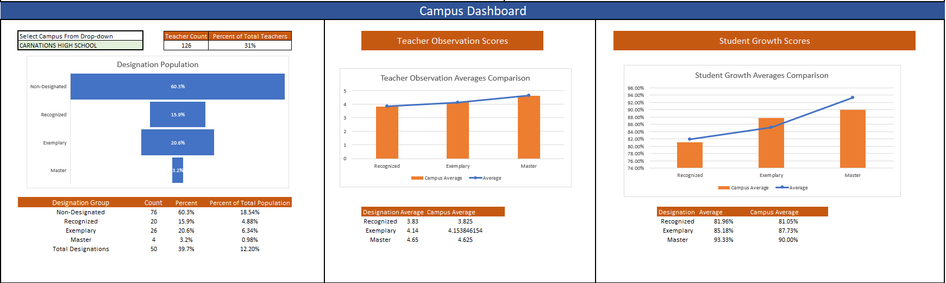
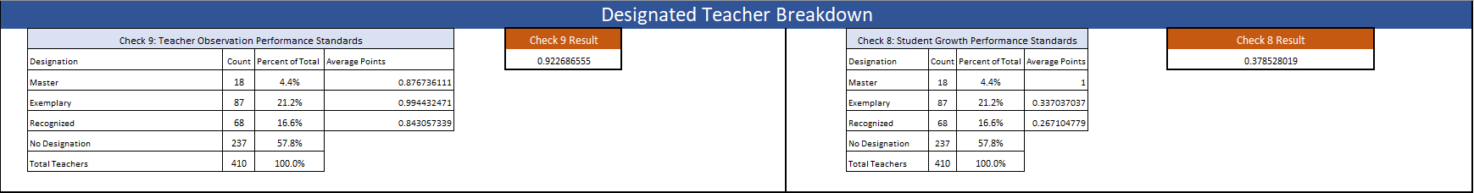
Designation Analysis Tab
The analysis tab will show a breakdown of your designations as well as campus and teacher category dashboards.

Slide 44
Designation Results Tab: Breakout Groups
Explore with your group different designation decisions with the sample dataset. See how the designation decisions can change based on your decisions.
As a group come to a conclusion on your designation decisions. Why did you come to this conclusion? Be prepared to share with the group.

Slide 45
Closing
Districts can
Districts cannot
Change the weighting of approved components. Ex: the LEA system application weighted teacher observation and 30% and student growth at 70%. The LEA can change weighting to 50/50.
Remove other optional, non-statutory components. Ex: attendance, student surveys
Adjust the standard at which a teacher is able to earn a designation
Adjust or establish a minimum requirement to earn a designation
Add or remove eligible teaching assignments
Add or remove student growth measures
Add or remove teacher observation component
Exclude teacher observation or student growth when determining designations

Slide 46
Alternative Rubric?
If you need an alternative rubric for the Designation Determination tool. Please email our inbox at:
TIA@tea.texas.gov

Slide 47
Survey
Please take a few minutes to complete our session survey!

Slide 48
Closing Cont.
Why this is important for data submission and validation:
Domain A: Check #1
Correlation check between teacher observation and student growth scores.
Domain B: Checks #2-3
Compares district designations with VAM designations.
Domain C: Checks #4-7
Looks at the effect campus, teacher category, or assignment have on designations.
Domain D: Checks #8-9
Compares designated teacher’s observation scores to that statewide performance standards.
Designation decisions are evaluated in checks 2-9 of the data validation process

Slide 49
Thank You
TIAtexas.org
TIA@tea.texas.gov

