Slide 1
Setting Expected Growth Using Circle/TX-KEA

Slide 2
TX-KEA and Circle
What we thought | What is now true | TEA’s Response
Circle and TX-KEA set expected growth goals | Circle and TX-KEA DO NOT set expected growth goals Circle and TX-KEA only set benchmark cut points Districts now have to determine how they are going to set growth targets locally | Updated all materials on our website Sent an e-mail to all cohort all D districts on Friday, January 14th with information and office hours Will host office hours on January 24th from 4-5 p.m. and January 27th from 4:30-5:30 p.m.
Key Point: Districts will not need to submit an expansions or modification because of this change

Slide 3
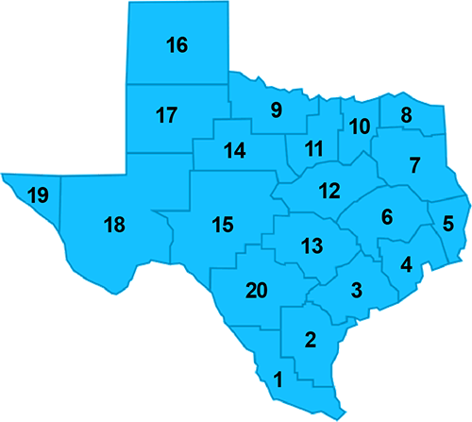
Regions Affected
All 20 Regions have at least one district with this issue

Slide 4
Districts not required to use Circle/TX KEA
Districts can decide which growth measure to use for pre-kindergarten and kindergarten
Does not have to be Circle/TX KEA
Early childhood literacy requirements and growth measure for purposes of TIA can be different

Slide 5
Measuring Student Growth in Early Childhood
Required Reporting
Growth Measure for TIA
Must administer assessment in the 5 required domains for pre-kindergarten
Must administer literacy screener for kindergarten (has to be TX-KEA or mClass)
Could be a combination of a variety of subtests
Could be a different growth measure like SLOs or portfolios
Could use the assessment in the 5 required domains for pre-K and the literacy screener for kindergarten
Could combine multiple measures

Slide 6
Using Circle for ECDS and TIA

Slide 7
Required Early Childhood Reporting vs. use for TIA
Required Early Childhood Reporting
Pre-K Student Growth Measure for TIA
Early Childhood Data System (ECDS)
Required to test in Five Domains
Specific tests within each Domain are required
Some of the required specific tests in each domain have subtests
Don’t have to use Circle at all
Can use Circle
Can use the tests (and subtests) that are required for each of the Five Domains
Can add additional tests
Can use different tests than the required ones for Early Childhood

Slide 8
Required Circle Measures for ECDS
EDCS Domain | English Measure (Test Name) | Spanish Measure (Test Name
Language and Communication | Rapid Vocabulary Naming | Vocabulario Rápido
Emergent Literacy: Reading | Rapid Letter Naming | Letras Rápidas
Emergent Literacy: Writing | Early Writing Skills | Escritura temprana
Mathematics | Mathematics | Matemáticas
Health and Wellness | Social and Emotional | Socio-Emocional

Slide 9
Recommended Circle Measures for ECDS
EDCS Domain | English Measure (Test Name) | Spanish Measure (Test Name
Language and Communication | Rapid Vocabulary Naming Story Retell and Comprehension Speech Production and Sentence Skills | Vocabulario Rápido
Emergent Literacy: Reading | Rapid Letter Naming Letter-Sound Correspondence Phonological Awareness | Letras Rápidas
Emergent Literacy: Writing | Early Writing Skills | Escritura temprana
Mathematics | Mathematics | Matemáticas
Health and Wellness | Social and Emotional | Socio-Emocional

Slide 10
Decisions to Make First
Best practice is to use a combination of subtests.
Which of the various subtests will the district use ?
Math subtests
Rote Counting
Shape Naming
Number Discrimination
Number Naming
Shape Discrimination
Operations
Counting sets
Social Studies
Science
Observation-based assessments
Literacy subtests
Rapid Letter Naming
Rapid Vocabulary
Phonological Awareness (which has 4 subsets within it)
Letter-Sound Correspondence
Story Retell and Comprehension
Book and Print Awareness
Speech Production
Motivation to Read
Circle Subtests

Slide 11
Scenario: Zinnia ISD
Zinnia ISD decided to use all 5 of the required ECDS tests for their TIA systesm (Rapid Vocabulary Naming, Rapid Letter Naming, Early Writing Skills, Mathematics, Social and Emotional) but also added in the Phonological Awareness tests as part of how they would measure student growth for pre-kindergarten, due to their district wide focus on literacy and the connections with Reading Academy.
What are the benefits and considerations for choosing this option?

Slide 12
Zinnia ISD’s plan
Benefits
Considerations
Makes use of the five required tests that they would have had to give anyway
Aligns with district focus
Aligns with Reading Academy
Are the five required literacy screening tests actually the best measure of growth for pre-kindergarten?
What are the implications on students and teachers of adding in additional tests?
Are there reliability concerns with teacher administered tests?

Slide 13
Scenario: Lantana ISD
While Lantana ISD is implementing all five required Circle tests for purposes of ECDS, they have chosen not to use any of the Circle tests for purposes of TIA and instead are planning to use a portfolio system so they can base student growth on actual student work instead of on a “test” since 4-year olds and tests can be very tricky.
What are the benefits and considerations of choosing this option?

Slide 14
Lantana ISD’s plan
Benefits
Considerations
Grounded in student work
Removes the “unpredictability” factor when testing 4-year olds
Multiple sources of data in the portfolio as opposed to just two test scores (Wave 1 to Wave 3)
Additional workload on the district to develop a valid and reliable portfolio system
Additional workload on teachers to implement a portfolio system
Might there be a way to use some of the Circle tests, since they have to be given anyway?

Slide 15
Determining Expected Growth Using Circle

Slide 16

Now What?
Your district has decided how it will use Circle and which tests/subtests it will use…

Slide 17
Options for districts to consider…
Using the Circle Benchmark cut points to determine overall point gain (by test) from Wave 1 to Wave 3.
Remaining On Track for respective age band by end of Wave 3
Determining average growth based on actual district data and using that as the expected growth target

Slide 18
Circle Benchmark Cut Points
View Circle Benchmarks

Slide 19
Overall Point Gain from Wave 1 to Wave 3
Example
Rapid Letter Naming Test Cut Points, by Wave
From Wave 1 to Wave 3: 7-point gain
Wave | On Track Cut Point Score
1 | 7
2 | 11
3 | 14

Slide 20
Using Wave 1 to Wave 3 Growth Gain (7-point gain)
Student | Actual Wave 1 Score | Expected Growth Target | Actual Wave 3 Score | Student met expected growth target
Student A | 7 | 14 | 14 | Yes
Student B | 7 | 14 | 11 | No
Student C | 5 | 12 | 12 | Yes
Student D | 5 | 12 | 10 | No
Student E | 9 | 16 | 16 | Yes

Slide 21
Remaining On Track at end of year
Expected growth could be defined as remaining on track for a student’s specific age band
There are four age bands identified via the Circle Assessment, defined as the student’s age as of September 1st
3 years- 3.5 years old
3.5 years- 4 years old
4 years old to 4.5 years old
4.5 years old and above
Growth defined as:
Remaining On Track for the student’s respective beginning of year age band by the Wave 3 score

Slide 22
Circle Benchmarks: Rapid Letter Naming Test by Age Band
Age as of September 1st
 | 3.0-3.5 years old |  | 3.5-<4.0 years old |  | 4.0-<4.5 years old |  | 4.5 years old or above
 | English | Spanish | English | Spanish | English | Spanish | English | Spanish
Wave 1 | 4 | 1 | 10 | 6 | 16 | 6 | 16 | 7
Wave 2 | 9 | 6 | 11 | 8 | 18 | 14 | 19 | 15
Wave 3 | 10 | 7 | 12 | 9 | 19 | 16 | 20 | 16

Slide 23
Moving Up a Band or Staying On Track: Rapid Vocabulary Test
Student | Wave 1 age Band | Expected Growth Target | Wave 3 Band | Student met expected growth target
Student A | 3.0-3.5 | 10 | 11 | Yes
Student B | 3.5-4.0 | 12 | 10 | No
Student C | 4.0-4.5 | 19 | 19 | Yes
Student D | 4.5+ | 20+ | 21 | Yes

Slide 24
Average District Growth
Instead of using national cut points, districts calculates their own average growth
Involves calculating average growth based on actual district data, on each subtest being used, from BOY to EOY
Applies the district average growth points, to students’ BOY scores to determine expected growth (after the fact)

Slide 25
Overall Point District Growth from Wave 1 to Wave 3
Example
Rapid Letter Naming Test District Average Scores
Average district growth from Wave 1 to Wave 3: 10-point gain
Wave | District Average Score
1 | 9
2 | 13
3 | 19

Slide 26
Average District Growth (10-point gain)
Student | Wave 1 Band | Expected Growth Target | Wave 3 Band | Student met expected growth target
Student A | 7 | 17 | 17 | Yes
Student B | 8 | 18 | 16 | No
Student C | 5 | 15 | 16 | Yes
Student D | 6 | 16 | 14 | No
Student E | 7 | 17 | 18 | Yes

Slide 27
Using TX-KEA for ECDS and TIA

Slide 28
Required Literacy Screener for ECDS (Using TX-KEA)
ECDS Domain | English Measure (Test Name) | Spanish Measure (Test Name
Statewide Literacy Screener | Vocabulary Letter Names Spelling | Vocabulario Nombres de las Letras Ortografía
Notes:
.

Slide 29
Recommended TX-KEA Measures for ECDS (in addition to literacy screener)
EDCS Domain | English Measure (Test Name) | Spanish Measure (Test Name
Language and Communication | Vocabulary Listening Comprehension | Vocabulario Comprensión Auditiva
Emergent Literacy: Reading | Letter Names Letter Sounds Blending | Nombres de las Letras Sonidos de las Letras Combinación de Sonidos
Emergent Literacy: Writing | Spelling | Ortografía
Mathematics | Mathematics | Matemáticas
Health and Wellness | Social and Emotional | Socio-Emocional

Slide 30
Decisions to Make First
Best practice is to use a combination of subtests in addition to the required screener
Which of the various subtests will the district use?
Literacy subtests
Letter Names
Decoding
Spelling
Letter Sounds (Receptive)
Letter Sounds (Expressive)
Blending (Receptive)
Blending (Expressive)
STEM subtests
Math Part 1
Math Part 2
Science
Language subtests
Vocabulary
Listening Comprehension
The Literacy Screener is a combination of three subtests
Vocabulary
Letter Names
Spelling
Social Emotional
Executive Function
Academic Motor Skills subtests
TX KEA Subtests

Slide 31
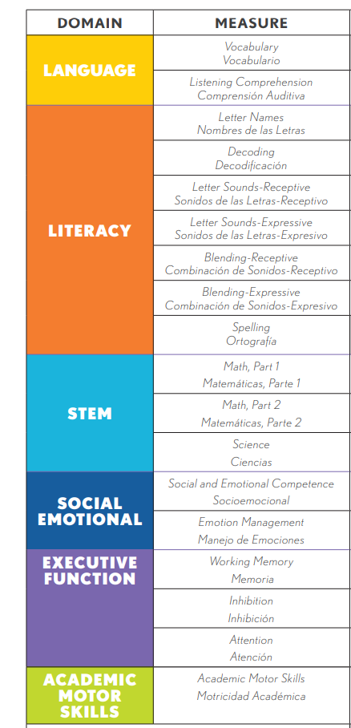
TX KEA Domains and Subtests
Domains include multiple subtests

Slide 32
Sample Combinations of TX-KEA subtests to use
Use the 3 subtests in the Literacy Screener, and add Listening Comprehension
Use the 3 subtests in the Literacy Screener and add one of the STEM subtests
Use all of Language and all of Literacy ( a total of 9 subtests)
Use the Literacy Screener and one of the Executive Function subtests

Slide 33
Scenario: Hydrangea ISD
Hydrangea ISD plans to use the BOY and EOY results of the required Literacy Screener test from TX-KEA (Vocabulary, Letter Names, Spelling) as well as all three Executive Function subtests (Working Memory, Inhibition and Attention) as their student growth measure for kindergarten for purposes of TIA. They believe that teaching students “how to do school” is a key part of kindergarten and felt strongly that these subtests should be included, beyond just the literacy screener.
What are the benefits and considerations of choosing this option?

Slide 34
Hydrangea ISD’s Plan
Benefits
Considerations
Aligns to district goals for kindergarten literacy
Aligns to district goals for kindergarten social emotional development and building skills to be successful in school overall
Makes use of required screener that they have to give anyway
What are the implications of the additional tests?
What is the additional training and monitoring load for a) teachers and b) campus leaders?
How can the district ensure reliable results?

Slide 35
Setting Expected Growth Using TX KEA

Slide 36
TX-KEA Benchmark Cut Points
View TX_KEA Benchmarks
Notes:
TX KEA also has Benchmark cut points. There are three levels, “Needs Support”, “Monitor” and “On Track”. You can download the TX KEA benchmarks using the link on this slide.

Slide 37
Options for districts to consider…
Moving up a band or remaining On Track
Determining average growth on the selected subtests and calculate district average growth from BOY to EOY

Slide 38
Moving Up a Band or Remaining On Track
Expected growth defined as moving up a band, or remaining on track
There are three bands identified via the TX-KEA Assessment
Needs Support
Monitor
On Track
Growth defined as:
Moving from Needs Support to Monitor
Moving from Monitor to On Track
Remaining On Track

Slide 39
FAQ
Why are the cut points for some of the TX-KEA subtest lower in Wave 3 than they were in Wave 1?
The Wave 3 tests are at a higher level of difficulty, so even though for some tests the Wave 3 score to be On Track is lower than the Wave 1 score to be On Track, the Wave 3 On Track represents student mastery of more complicated material

Slide 40
Using TX-KEA Benchmark Performance Bands
Vocabulary Subtest
Listening Comprehension Test
Wave | Needs Support Score | Monitor Score | On Track Score
Wave 1 | 8 | 9 | 10
Wave 2 | 5 | 6 | 7
Wave 3 | 4 | 5 | 6
Wave | Needs Support Score | Monitor Score | On Track Score
Wave 1 | 9 | 10 | 11
Wave 2 | - |  | -
Wave 3 | 12 | 13 | 14

Slide 41
Moving Up a Band or Staying On Track
Student | Wave 1 Band | Expected Growth Target | Wave 3 Band | Student met expected growth target
Student A | Needs Support | Monitor | Monitor | Yes
Student B | Monitor | On Track | Monitor | No
Student C | Needs Support | Monitor | Monitor | Yes
Student D | On Track | On Track | Monitor | No
Student E | On Track | On Track | On Track | Yes

Slide 42
In Other Words…
Moving from
Moving from
Remaining
All of these conditions could signal meeting expected growth
to
to

Slide 43
Average District Growth
Instead of using national cut points, districts calculates their own average growth on the series of subtests selected
Involves calculating average growth based on actual district data, on each subtest being used, from BOY to EOY
Applies the district average growth points, to students’ BOY scores to determine expected growth (after the fact)

Slide 44
Overall Point District Growth from Wave 1 to Wave 3
Example
Literacy Screener subtests+ Language subtests average district scores
Average district growth from Wave 1 to Wave 3: 8-point gain
Wave | District Average Score
1 | 14
2 | 18
3 | 22

Slide 45
Average District Growth on 4 combined subtests (8-point gain)
Student | Wave 1 Band | Expected Growth Target | Wave 3 Band | Student met expected growth target
Student A | 7 | 15 | 16 | Yes
Student B | 8 | 16 | 15 | No
Student C | 5 | 13 | 15 | Yes
Student D | 6 | 14 | 12 | No
Student E | 7 | 15 | 18 | Yes

Slide 46
Thank you visit us at TIATexas.org or email us at TIA@tea.Texas.gov

