Slide 1
Portfolio Overview and Resources
October 19, 2022

Slide 2
Objectives
Districts will:
Become familiar with portfolios as a student growth measure for TIA
Understand and give examples of requirements for a skill progression rubric, setting expected growth, and student artifacts
Be able to use the Portfolio Planning Document to begin the design of a potential portfolio system

Slide 3
Overview of Portfolios

Slide 4




Student Growth Measures for TIA
Pre-Test/ Post-Test
Vendor or locally created
Vendor or locally set expected growth targets
Value Added Measures (VAM)
Compares predicted to actual scores based on multiple years of past testing history
Based on statistical modeling and often conducted by independent researchers
Student Learning Objectives (SLO)
Aligned with TexasSLO.org
Built around a foundational skill and assessed with a body of evidence
Ideal for Performance-Based Courses
Must include a skill proficiency rubric with at least 5 proficiency levels and varied artifacts
Portfolios

Slide 5



Why Use Portfolios?
Portfolios can be a good fit for content areas not easily measured by traditional methods, particularly for performance-based courses.
Student work products can be varied:
Audio or video recordings of student musical, choir or theatrical performances
Student artwork is either scanned digitally or hard copy or both
Sample student-created products such as welding, woodwork, etc.
Student work assessed against skill proficiency rubric

Slide 6


What are Portfolios for TIA?
Portfolios: A collection of a student’s academic work(tasks, assignments, projects, performances) that are scored against a skill progression rubric.
Working Portfolio
Works in Progress
Display/Showcase Portfolio
A student’s “best work”
Assessment Portfolio
Levels of content/skill proficiency

Slide 7

TIA Portfolio Requirements
Validity of Content
the development of quality skill-progression rubrics with at least 4 skill levels
the design of student projects/tasks/performances that will measure student skill levels
student artifacts (more than one included in portfolio)
strong protocols around administration and scoring, using a rubric
Valid and Reliable Administration Protocols (including training)
Valid and Reliable Scoring
Security Protocols in Place
Can be used to set expected growth targets

Slide 8
Portfolios for TIA
Beginning of year- students placed at a specific level on the skill progression rubric.
Teacher sets an expected growth target for each student .
End of the year- students will be placed on the same rubric used at BOY.
Difference in levels will demonstrate how much growth was made from the beginning of the year to the end of the year.
The percentage of students who met/exceeded their growth target will be used by the district to help inform teacher designation levels.
Note: These numbers are used as a guide to inform districts of statewide averages. These averages can vary, and districts would need to decide where set the averages based on their local context. For more information, please see
Student Growth Performance Standards

Slide 9




How are Districts Currently Using Portfolios?
All content and courses can use Portfolios, but they are mostly used for these eligible teaching assignments:
Career and Technical Education (CTE)
Welding
Architecture
Agriculture
Fine and Performing Arts
Art
Music
Theater Arts
Early Childhood
Pre-Kindergarten
Kindergarten
1st Grade
Special Education
Inclusion
Resource
Life-Skills
Most use district-created rubrics with input from ESCs and other partners.

Slide 10





Portfolio Best Practices
Include all the students in a class period that most represents the students the teacher teaches.
To increase the reliability of scoring, train a team of teachers or other professionals to evaluate portfolios using the rubric.
Begin the process early.
Ensure all participants have a clear understanding of the district’s Portfolio system.
Align the district system to the standards outlined in the Portfolio Planning Worksheet.

Slide 11
SLO and Portfolio Differences
Texas SLOs
Based on a Skill Statement
Required elements like Initial Skill Profile, Targeted Skill Profile, etc.
Aligned to the process outlined on TexasSLO.org
Portfolios
Based on a skill progression rubric across multiple skills
One rubric, not two
Student artifacts assessed using the skill proficiency rubric at EOY by a team of trained scorers
Require Artifacts
Use of Rubric(s)

Slide 12
Portfolio Design Process

Slide 13





Timeline: Four Steps of the Portfolio Process
Part A: Determine Curricular Content & Set Growth Targets
Content lends itself to being measured by student artifacts
Content is aligned to standards/TEKS and is foundational to the course
Expected growth targets are evidence-based
Part B: Skill Progression Rubric
Detailed skill descriptors across multiple skill proficiency levels
Range of skill levels
Descriptors specifically describe what student work looks/sounds like at different levels
Part C: Design Artifacts
Design projects/tasks/ performances that will make up the portfolio artifacts
Students complete all portfolio tasks
Part D: Evaluate Student Artifacts
Determine end-of-year skill levels student artifacts assessed by the skill progression rubric
Mid-August to late August
Early to late September
September to mid-May
Mid to late May

Slide 14
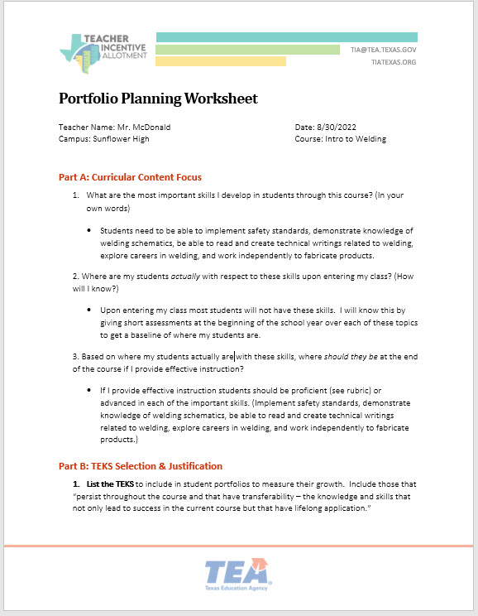
Portfolio Planning Worksheet
A Portfolio Planning Worksheet is available on the TIA Website
Streamlines the process when designing a portfolio
Broken down into 4 sections
Part A: Curricular Content Focus
Part B: TEKS Outcomes and Justification
Part C: Rubric Planning for Assignments/Projects/Performances
Part D: Rubric Design
Turn-key exemplar Portfolio Planning Worksheets available for:
Welding
7th Theater Arts
Agricultural Mechanics
Pre-Kindergarten
Link to Portfolio Planning Worksheet

Slide 15
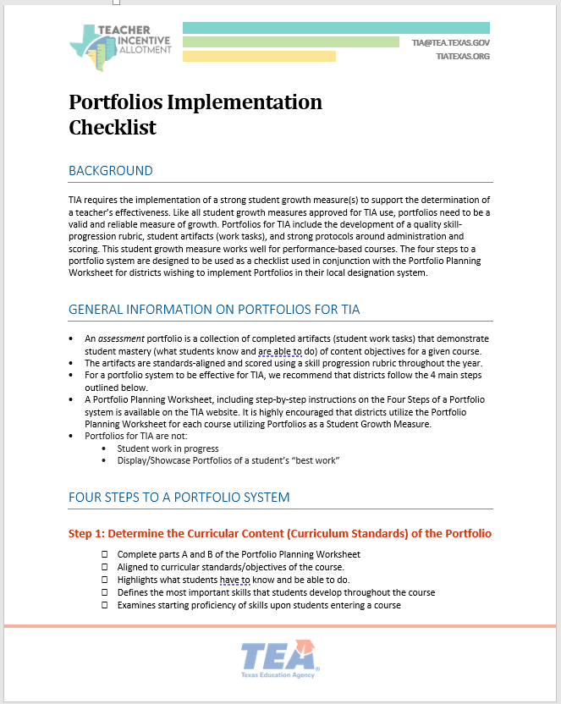
Portfolio Implementation Checklist
To assist campus-level administrators and teachers TIA has created a Portfolio Implementation Checklist and a Portfolio Approval Process Checklist to be used in conjunction with the Portfolio Planning Worksheet
Portfolio Implementation Checklist
Portfolio Approval Process Checklist

Slide 16
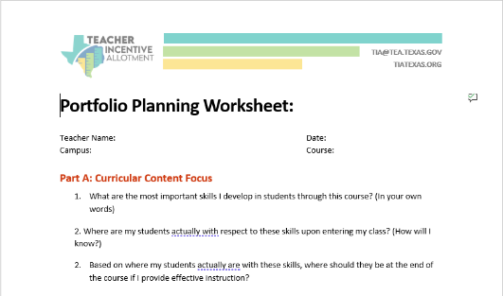
Part A: Curricular Content Focus
What are the most important skills of the course?
What are my students’ current abilities at the beginning of the year with respect to the focused skill areas?
Based on where my students are currently with these skills, where should they be at the end of the course if I provide effective instruction?
Part A: Determine Curricular Content & Set Growth Targets
Content lends itself to being measured by student artifacts
Content is aligned to standards/TEKS and is foundational to the course
Expected growth targets are evidence-based
Mid-August to late August

Slide 17
What is a Foundational Curriculum Skill?
A:
B:
Writing a Haiku
Providing evidence to support your claim
It depends
Is this a poetry course?
Answer is A
Is this a rhetoric and composition course?
Answer is B
When in doubt, check TEKS!

Slide 18
Culinary Arts Example
Course: Culinary Arts I
Focus Skills for the Course:
Evaluates and determines equipment, ingredients, and procedures used in a professional food setting
Can prepare a variety of essential food service dishes including soups, salads, yeast breads, breakfast items, and desserts
Demonstrates their understanding of the various food-service operations such as quick service, fast-casual, casual, fine dining, institutional, and beverage service.
Uses technology and computer applications to manage food service operations

Slide 19
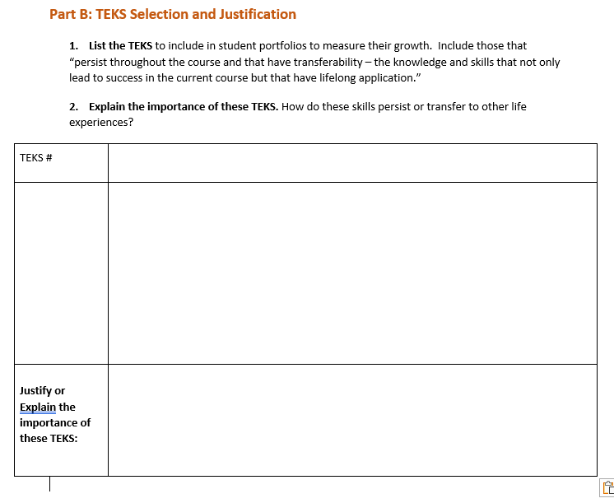
Part B: TEKS Selection and Justification
What specific TEKS align to the skill focus area?
How do these TEKS persist throughout the course?
How do these TEKS transfer to success in this course and beyond?
Part B: Skill Progression Rubric
Detailed skill descriptors across multiple skill proficiency levels
Range of skill levels
Descriptors specifically describe what student work looks/sounds like at different levels
Early to late September

Slide 20



TEKS Selection
Let's begin, by listing the TEKS we want to use to measure student growth. We should consider TEKS/Pre-K outcomes that lead to success not only in Pre-k but beyond.
From my experience I think “I.A.2, Child shows self-awareness and can express pride in age-appropriate abilities and skills.” is fundamental to success beyond Pre-k.”
I agree, I would also include “III.A.1, Child shows understanding by responding appropriately.”
Mr. Rodriguez
Appraiser
Ms. Garvey
Teacher
Ms. Reyes
Teacher
Pre-Kindergarten PLC

Slide 21
TEKS Justification
Great, we now have some TEKS to work with. Our next step is to justify and explain why we chose those particular TEKS.
This Outcome is important because it identifies how a student communicates with the world around them, connects ideas, responds to others, and their ability to listen and follow directions.
This Outcome is important because it is a great marker for social development and engages the child in conversation.
Mr. Rodriguez
Appraiser
Ms. Garvey
Teacher
Ms. Reyes
Teacher
Pre-Kindergarten PLC

Slide 22
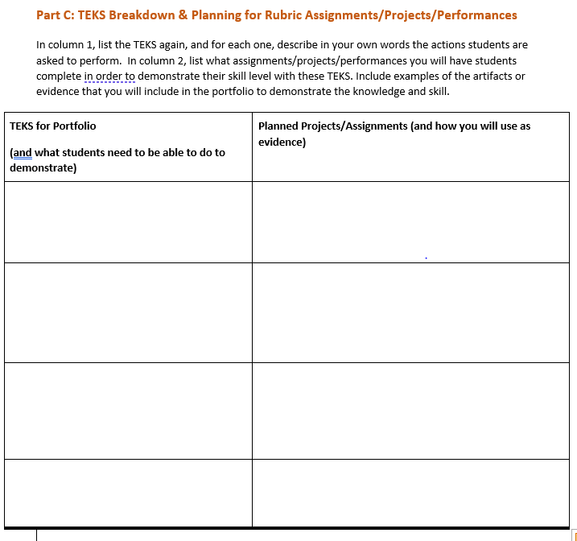
Part C: Planning for Student Projects and Evidence Collecting
What specific actions will students need to be able to perform to demonstrate mastery of the selected TEKS?
What student projects/tasks/performances will be assigned in order for students to demonstrate their skill level?
What will the teacher collect as evidence for each assignment in order to build the portfolio of student work?
Part C: Design Artifacts
Design projects/tasks/ performances that will make up the portfolio artifacts
Students complete all portfolio tasks
September to mid-May

Slide 23

TIA Artifact Requirements
More than one included in portfolio (best practice is to include 5 student artifacts in a portfolio.)
Designed to represent the content and skill levels students will need to demonstrate and align with the course standards.
Designed to differentiate levels of performance.
Are valid and specific to the content being evaluated by the portfolio.

Slide 24



Artifacts
Artifacts can vary depending on the content.
Audio/video recordings of student musical, choir or theatrical performances
Student artwork either scanned digitally/hard copy/both
Sample student-created products such as welding, woodwork, etc.

Slide 25

Example 7th Grade Drawing Class
Main Curricular Standards
Which would be Valid Artifacts?
Shading
Proportion
Use of light and dark
2-dimensional sketch
3-dimenstional sketch
Ceramic vase project
Short answer quiz analyzing use of proportion by the Impressionists
Spirit Week collage

Slide 26
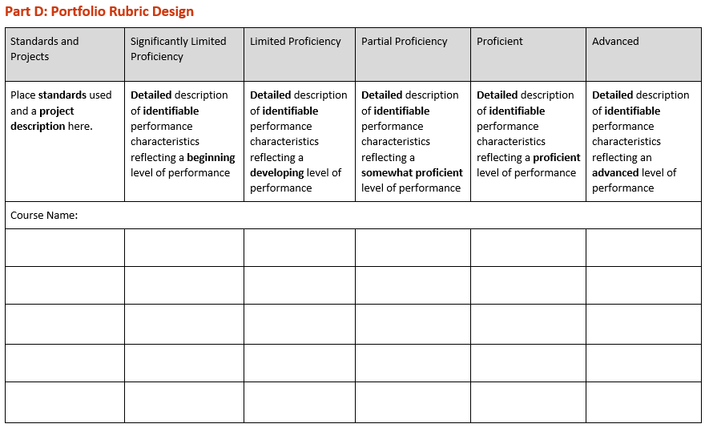

Part D: Rubric Design
What will student work look like at a beginning level?
What will student work look like at a developing level?
What will student work look like at a somewhat proficient level?
What will student work look like at a proficient level?
What will student work look like at an advanced level?
Part D: Evaluate Student Artifacts
Determine end-of-year skill levels student artifacts assessed by the skill progression rubric
Include SPECIFIC descriptions of what student work will look/sound like and include details for each proficiency level.
Mid to late May

Slide 27
Rubric Requirements and Recommendations
Requirements
Recommendations
District has a clear plan for who creates the portfolio scoring rubric
Rubric aligned to standards of the course
Rubric specifies what students need to know and be able to do across at least 4 different skills
Selection and training process for rubric scorers
Annual training on scoring, guidance, and protocols using rubrics
Describe (descriptors) what the various levels of proficiency look like
Specify in detail what skill proficiencies are required across a variety of proficiency levels

Slide 28
Rubric Development Example
Progression of Proficiency Levels
Standards/Skill Assessed | Project | Significantly Limited Proficiency | Limited Proficiency | Partial Proficiency | Proficient | Advanced
II.A.1. Child shows understanding by responding appropriately. | During story time teacher keeps a running tally of students who ask and answer questions. The teacher has individual conversations with students while keeping a running tally of students listening and responding to the teacher in a multiple-turn conversation. | The student does not show understanding during story time. The student did not ask or answer any questions during story time over a 36-week period. | The student shows some understanding during story time and asked or answered 6 to 10 questions over the course of 36 weeks. | The student shows understanding during story time and asked or answered 11-18 questions over the course of 36 weeks. | The student shows understanding during story time and asked or answered 19-30 questions over the course of 36 weeks. | The student shows understanding during story time and asked or answered 31 or more questions over the course of 36 weeks.
Descriptors
Skills Assessed
Align with standards
Focus TEKS for the course

Slide 29
Possible 7th Grade Drawing Rubric
Curricular Standards | Significantly Limited Proficiency | Limited Proficiency | Partial Proficiency | Proficient | Advanced
Shading | Drawing shows recognizable figures with limited or no use of shading | Attempt is made to use shading, in some parts of the drawing | Shading is used to add some sense of dimensionality, in some parts of the drawing | Shading used to add sense of dimensionality consistently to the drawing | Use of shading used in a purposeful manner to convey meaning
Proportion | Drawing shows one perspective only | Various representations of proportion are used | Proportions of objects are represented consistently but are not aligned with each other | Proportions are used consistently to convey meaning and sense of perspective | Proportions are consistent and enhance the sense of perspective to communicate a clear message
Use of Light and Dark | Light and dark not used | Light and dark can be seen inconsistently throughout the drawing | Use of light and dark is present but does not align with proportionality | Use of light and dark creates a sense of proportion and contrast | Use of light and dark conveys additional depth to the work

Slide 30
Did the student meet their Growth Target?
Curricular Standards | Significantly Limited Proficiency | Limited Proficiency | Partial Proficiency | Proficient | Advanced
Shading |  |  | BOY |  | Growth Target EOY
Proportion | BOY |  | Growth Target | EOY
Use of Light and Dark |  | BOY |  | Growth Target | EOY
Key:
Met
Exceeded
Did not meet
Yes, the student met their growth target for 7th-grade Drawing!

Slide 31
Rubric Examples
Two rubric examples: Pre-K emergent writing and HS Agricultural Resources
Which rubric more closely aligns with the best practices for rubric design?
Is there enough difference in the descriptors at one level versus another?
Does the rubric describe in detail what student work will look like at each of the various levels?

Slide 32
Agricultural Resources Skill Progression Rubric
Skill | Significantly Limited Proficiency | Limited Proficiency | Partial Proficiency | Proficient | Advanced
Safely performs basic power, structural, and technical system skills in agricultural applications | Insufficiently or incorrectly identifies major areas of power, structural, and technical systems, in agriculture | Inconsistently identifies major areas of power, structural, and technical systems, in agriculture | Sufficiently identifies major areas of power, structural, and technical systems, in agriculture | Exceptionally identifies major areas of power, structural, and technical systems, in agriculture | Masterfully identifies major areas of power, structural, and technical systems, in agriculture
Descriptors clearly different from the performance levels below and above it.
Describe what student performance looks like at the most limited to the most advanced levels

Slide 33

Pre-K Skill Progression Rubric
Skill | Significantly Limited Proficiency | Limited Proficiency | Partial Proficiency | Proficient | Advanced
Name Writing Emergent Writing | The name is represented by unrecognizable scribbles without letters. | The name consists of random isolated symbols, some of which are recognizable letters. | The name consists of some correct letters, other letters and symbols. | The name consists of many correct letters with some backward letters. | The name begins with an uppercase letter and consists of all correct letters with no backward letters.
Descriptors are clearly different from the performance levels below and above it.
Describe details of what student performance looks like at the most limited to the most advanced levels

Slide 34
Culinary Arts Rubric Review
Strengths
Areas for Growth
Three different skills were addressed.
Rubric included five proficiency levels.
Descriptors differ in number of instances only and not in any other way.

Slide 35
Evaluating Artifacts

Slide 36
Evaluate Student Artifacts in a Portfolio
All student artifacts in the portfolio are assessed based on the rubric designed in Step Three of the Portfolio Planning Worksheet.
Reviewers are trained and calibrated (normed) on use of the rubric, and preferably, have content knowledge of the course.
Multiple reviewers who are trained in the content review student portfolios in order to increase the reliability of the portfolio system.
Comparison of student artifacts (using the rubric) from the beginning of the year to student work products toward the end of the year demonstrates growth along the proficiency rubric over the school year.

Slide 37
Best Practices for Portfolio Scoring Calibration
Certify and train portfolio scorers
Best practice is to train multiple scorers
Include practice, practice, and more practice
Use student-created artifacts to provide an authentic scoring experience
Compare scores
Defend ratings using evidence
Norm on scoring expectations

Slide 38



Portfolio Scoring
Significantly Limited Proficiency
The student is unable to create an autobiography picture book or is unable to express personal characteristics, likes/dislikes, and family last name with help from the teacher.
Proficient
The student creates an autobiography picture book and is able to express personal characteristics, likes/dislikes, and family last name independently.
Advanced
The student creates an autobiography picture book and is able to express personal characteristics in detail, likes/dislikes in detail, and family last names independently.
Great point! I overlooked that. My score is now calibrated with yours. Thanks for pointing out that evidence.
Based on the evidence the student moved from Significantly Limited Proficiency at the beginning of the year to Proficient.
I scored the student as Advanced based on the details included on their dislikes page. The picture explains “Why” the student dislikes Grapes. It is clear that the student thinks grapes taste sour from the picture.

Slide 39
Putting it all Together

Slide 40
Key Takeaways
Portfolios:
Require significant planning
Require a quality skill progression rubric (DETAILED)
Require teachers to determine expected growth targets based on BOY student performance as aligned to the rubric
Require thoughtful student project/task design
Require planning for evidence to be used
When done well, are a valid and reliable, evidence-based measure of student growth!

Slide 41
Resources
Portfolio Resources for Implementation
Portfolio Planning Worksheet
Portfolio Implementation Checklist
Portfolio Approval Process Checklist

Slide 42
Thank You

