Slide 1
Overview of the 2023-2024 Data Capture Year
August 23, 2023

Slide 2



Welcome
Please make sure you are muted.
If you are able, turn on your camera.
Locate your participant video and click on the more icon to rename yourself with your name and district

Slide 3

Session Materials and Recordings
All 2023-2024 TIA webinar materials in Google Drive, in chronological order
Live recordings available in Google Drive. Recordings will not display participant names or faces.

Slide 4
Objectives
Understand the Success Factors for capturing your TIA system data
Use the Data Capture Planning Guide to plan Data Capture Year
Review and recognize best practices in the Sample Implementation Calendar
Customize your district Implementation Calendar based on local context

Slide 5
Agenda
10 minutes
Welcome and Introduction
20 minutes
Overview of Data Capture Planning Guide
The “what” are we doing
15 minutes
Deep Dive with Planning Guide
10-15 minutes
Overview of Implementation Calendar
The “when” are we doing it
15 minutes
Deep Dive with District Implementation Calendar
10-15 minutes
Survey, Resources, and Upcoming Support

Slide 6

Drop in the chat:
What is the biggest concern you have going into the 2023-24 Data Capture Year?

Slide 7
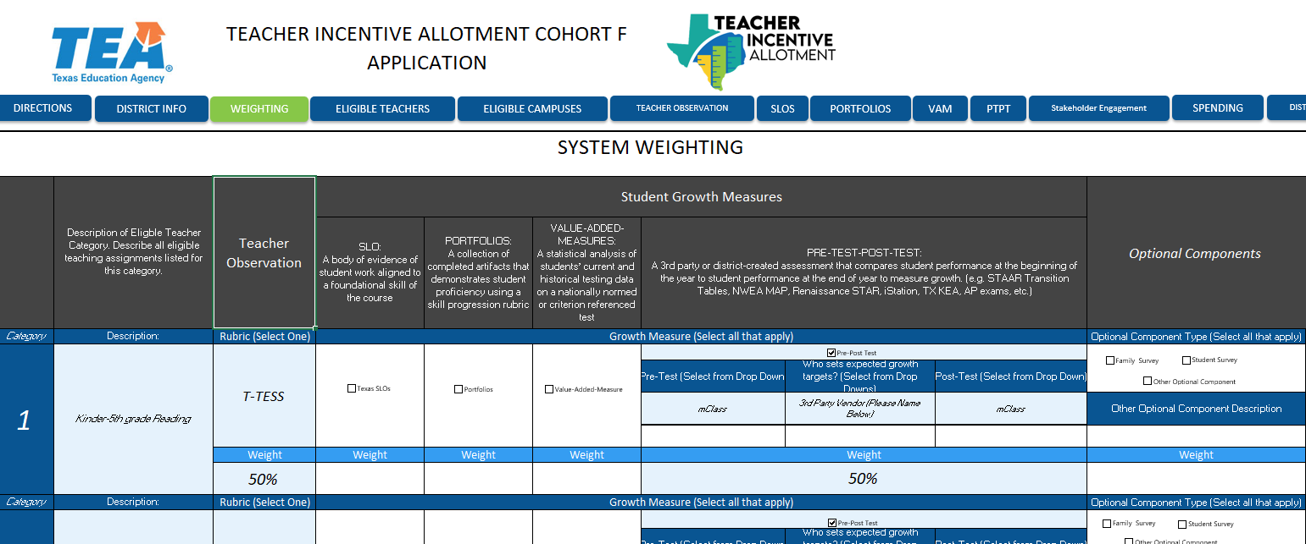

Implement Your Local Designation System

Slide 8






Application and Approval Timeline
Pre-Application
2021-2022
System Development
Stakeholder Engagement
Year 1
2022-2023
System Application
TIA Teacher Buy-In Survey
Year 2
2023-2024
Capture Data
Year 3
2024-2025
Data Submission
Full System Approval
Designate & Compensate
Expansion & Modifications
TIA Annual Evaluation Surveys
Annual Program Submission
Post-Approval
2025-2030
New or Higher Designations
Expansion and Modifications
Annual Program Submission
TIA Annual Evaluation Survey

Slide 9
Planning to Capture Data

Slide 10
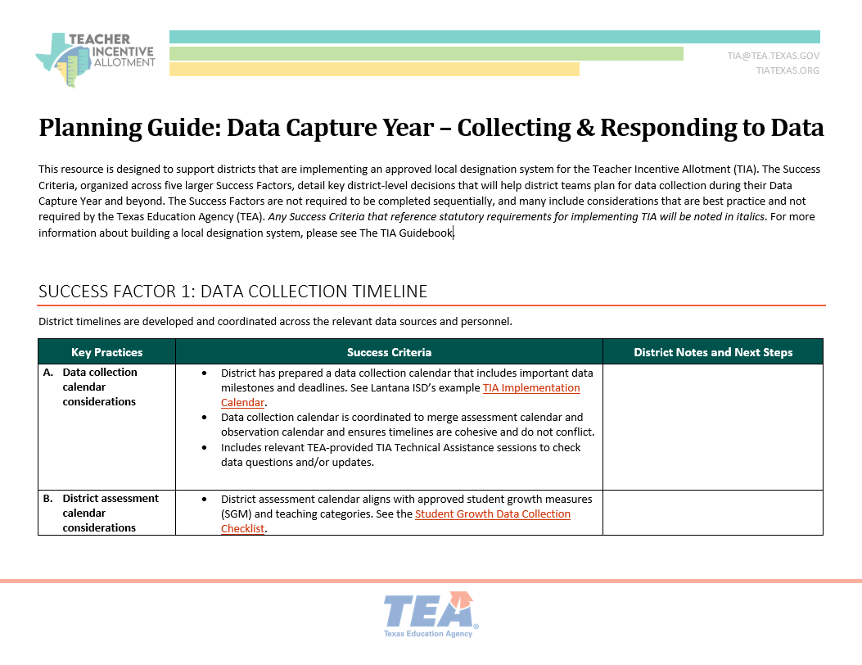
Planning Guide

Slide 11





Data Capture Considerations
Timeline
District timelines are developed and coordinated across the relevant data sources.
Data Systems
A system for assembling and tracking data is established early in the Data Capture year.
District Data Coordination and Communication
All necessary district departments coordinate and communicate throughout the year.
Data Analysis and Problem Solving
Data problems happen. The district is aware of common issues and has a plan to address.
Building a TIA Data Culture
District has a plan to engage teachers around their data.

Slide 12
Success Factor: Timeline
Considerations for Data Capture Timeline

Slide 13
Calendar Considerations
TIA Teacher Data Collection Calendar
District Assessment Calendar
Observation Calendar
  Eligible teaching assignments
  HR/PEIMS data into teacher list and updated with late-hires, resignations, etc.
  Approved Student Growth Measures
  Pre-tests scheduled within first 9 weeks (semester courses, first 6 weeks)
  Post-tests are given within last 9 weeks
  Appraiser training, certification, and calibration is scheduled early
  Walk-throughs, summative observations

Slide 14







TIA Data Collection Timeline
Create and finalize calendar
Review the Planning Guide for Data Capture
Build a TIA-Eligible Teacher List
Communicate with Teachers
Update Teacher List, based on Fall HRIS/PEIMS
Add in BOY Assessment data, if applicable
Observations calendar is set, appraiser calibration has begun
Collect and enter all BOY data, data from semester-long courses
Enter observation and/or walkthrough data
MOY Data Excel Tool
Update Teacher List based on late hires, departing teachers, etc.
Ensure all teachers have observation data
Teachers verify student rosters
TEA provides Eligible Teacher list as guide
EOY Data Excel Tool
Enter EOY data, STAAR, Portfolios, SLO data
Calculate student growth
Determine Designations based on Performance Standards, system Weights, and optional components
Summer before Data Capture
Fall
Winter
Spring
Summer before Data Submission

Slide 15
Success Factor: Data Systems
Considerations for Building TIA Dataset

Slide 16
Identify Eligible Teaching Assignments
Which teaching assignments are eligible?
How do Service IDs connect to data collection?
What data will the district collect for eligible teachers?
1
2
3
Districts identified eligible teaching assignments within each Teacher Category on the Weighting tab and then corresponding service IDs on the Eligible Teachers tab within the TIA application.
Service IDs are tied to eligible teaching assignments established by Teacher Categories from the Weighting tab. They are identified by districts as eligible on the Eligible Teachers tab on the TIA application.
Effectiveness data, appraisals and student growth, must be collected for all teachers in eligible teaching assignments during a data capture year following application acceptance.

Slide 17
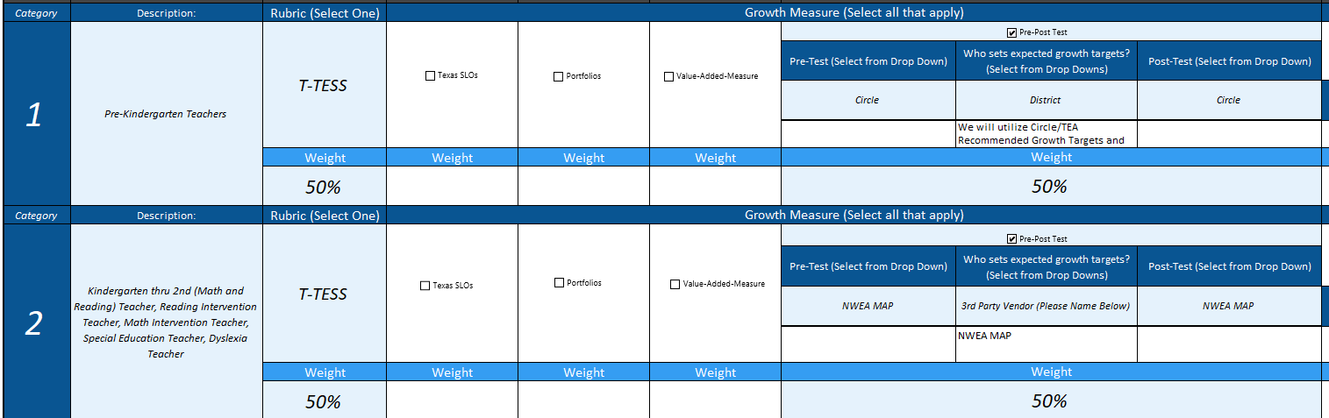
Weighting tab and Eligible Teachers
Start by reviewing Weighting tab:
  Teacher categories
  Assessments needed for Student Growth

Slide 18
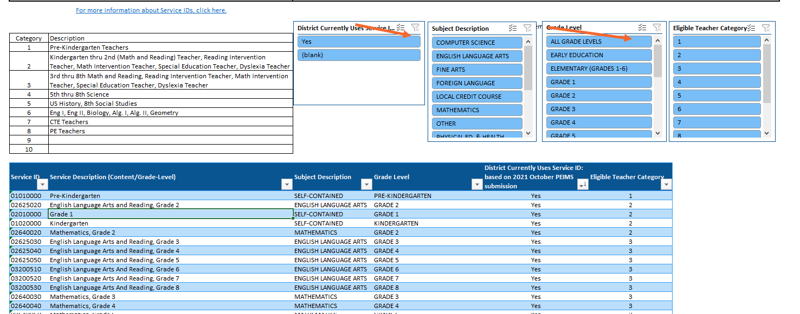
Eligible Teachers tab
Use to compile list of teachers to track data
  Which Service IDs correspond to which Teacher Category (from Weighting tab)

Slide 19




Levels of Implementation in Assembling Your Data
Level 1: Manually typing in data for each teacher based on the student growth and observation data you have collected.
Level 2: Copy-paste the data. This method involves copying and pasting the data from the various sources to assemble your data.
Level 3: Indexing/ V-Lookup data. This method involves indexing/ v-look up to link the data sources when assembling the data.
Level 4: Direct connection to the data source. This method is the most advanced method of assembly of the data. It requires knowledge of databases and data management to directly link the data from the source.

Slide 20
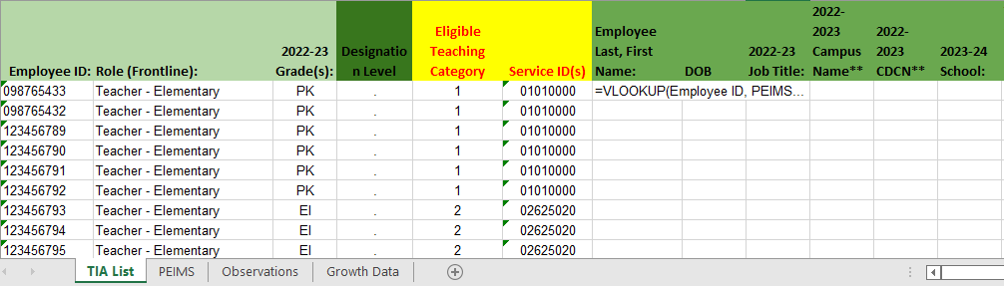
Data Systems – Level 3 Example
List of TIA-eligible teachers
Data pulled into TIA list from various sources using Excel formula:
To learn more about how to use the VLOOKUP in Excel: VLOOKUP function - Microsoft Support

Slide 21
Success Factor: District Coordination
Considerations for Coordinating Data Capture

Slide 22

District Testimonial
“Start by surrounding yourself with people that can answer the questions.”
-Crowley ISD

Slide 23
Data Coordination
TIA Coordinator(s):
Accesses student assessment data, observation data
Data procedures are recorded and available for reference in case of turnover
TIA Data Analyst vs. TIA Decision Person roles are clear, if different people
HR + PEIMS Coordinator(s):
Communicates about teacher resignations, late new hires, retiring teachers, and teachers on FMLA
Verifies teacher roster, at campus level

Slide 24
Success Factor: Analysis and Problem Solving
Considerations for Analyzing Data and Planning Ahead

Slide 25
Common Question #1
How will you identify and track (at the campus and district level) eligible teaching assignments and eligible teachers?
Our district shares a list of eligible courses based on eligible Service IDs with campuses and allows campus administrators to verify against the master schedule. If support teachers are included, ensure administrators are aware of their eligibility and verify the courses and students they support.
Sample District Decision:

Slide 26
Common Question #2
How will teachers in multiple teaching assignments or in multiple categories be measured?
Some teachers teach multiple eligible courses, however, for TIA Data Submission purposes, districts can only report up to four service IDs.
For example, for teachers with two assessments available to calculate student growth, we will use total students met or exceeded growth on each assessment/over the total number of assessments given.
Sample District Decision:

Slide 27
Common Question #3
How will you determine teacher/student linkages?
The district use multiple snapshots to assess student growth to account for outlier students who did not receive a full year of instruction.
Sample District Decision:

Slide 28
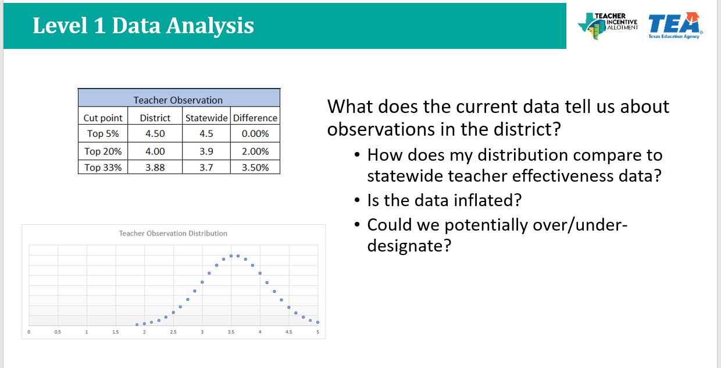
Data Analysis
Looking for and responding to skew in teacher observations and student growth
  Analyzing data at various points throughout the year
  Responding to root causes of skew

Slide 29
Success Factor: Building a TIA Data Culture
Considerations for Involving Teachers in Data Capture

Slide 30



Building a TIA Data Culture
Teacher-level Verification: Teacher able to verify student roster, teacher can view and sign off on their TIA data before submission.
TIA Liaisons and Appeals Process: campus-level/district-level point of contact for teachers, structured internal appeals process for discrepancies.
Teacher Log-ins: if using third party data warehouse, train teachers in accessing their data, tracking student growth.

Slide 31
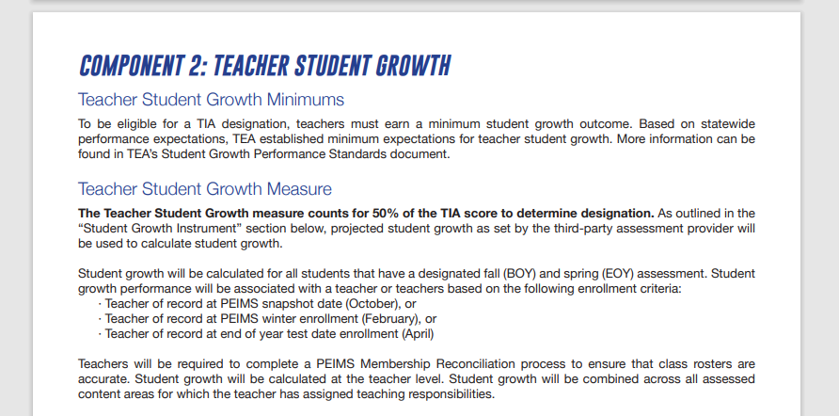
Example 1
Source: Crowley ISD TIA Employee Handbook
Source: Waco ISD HR Website

Slide 32
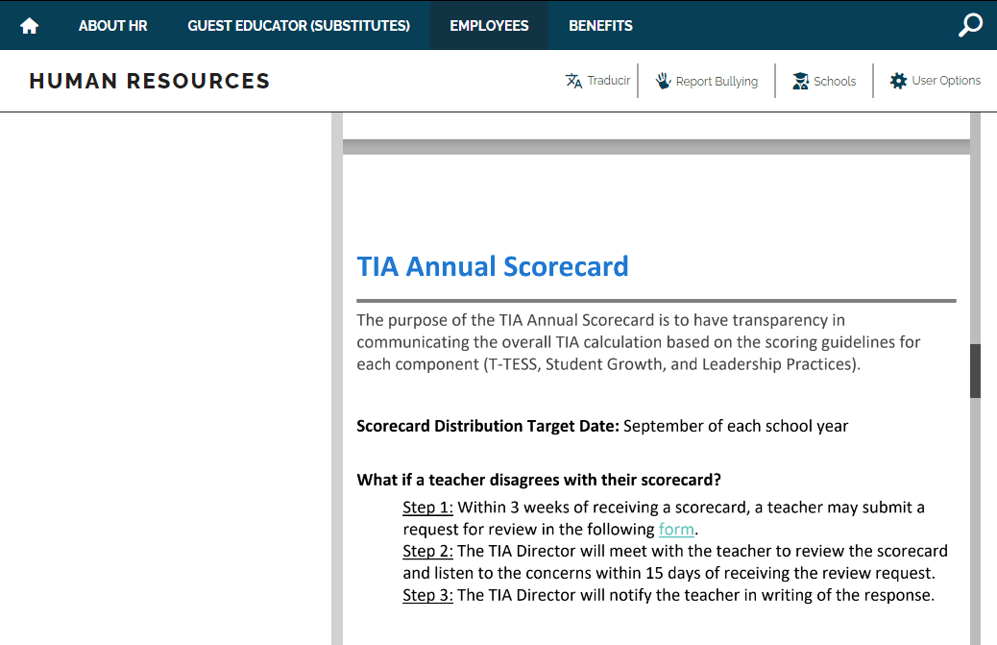
Example 2
Source: Waco ISD HR Website

Slide 33

District Testimonial
“The first TIA Scorecard was issued without a data warehouse for student growth and T-TESS, so the initial scorecard was a surprise for most teachers. The following year, we implemented the data warehouse, and it made a significant difference in teachers using their data throughout the school year to make adjustments and grow professionally.”
- Waco ISD

Slide 34
Planning Guide

Slide 35
Activity
1) Open Planning Guide and download to your computer.
2) Pick one Success Factor to begin planning around.
3) 5-minute solo work time to start taking notes within the document.

Slide 36

Break out Room
10-minute Break-Out room to discuss your plans and next steps to capture data.

Slide 37

Share Out
What was something you heard or shared in your Break-Out room that was an “A-ha” moment regarding planning for your Data Capture year?
Come off mute to share or drop in the chat.

Slide 38
Best Practices for Implementing Your Local Designation System

Slide 39





Best Practices in Teacher Observation
Schedule Appraisal Trainings
Calibration Protocols
Observation and Feedback Expectations
Analyze Observation Trends for Skew
Address Skew

Slide 40
Best Practices in Student Growth Measures
Identify Growth Measures & Schedule
Trainings with Staff
Align Expected Growth Targets with Approved Growth Measure(s)
Collect & Communicate Growth Data in Real-time with Staff
Correlate Growth and Observation Data &
Identify Skew

Slide 41
Implementation Calendar
Planning the TIA Data Capture Year

Slide 42
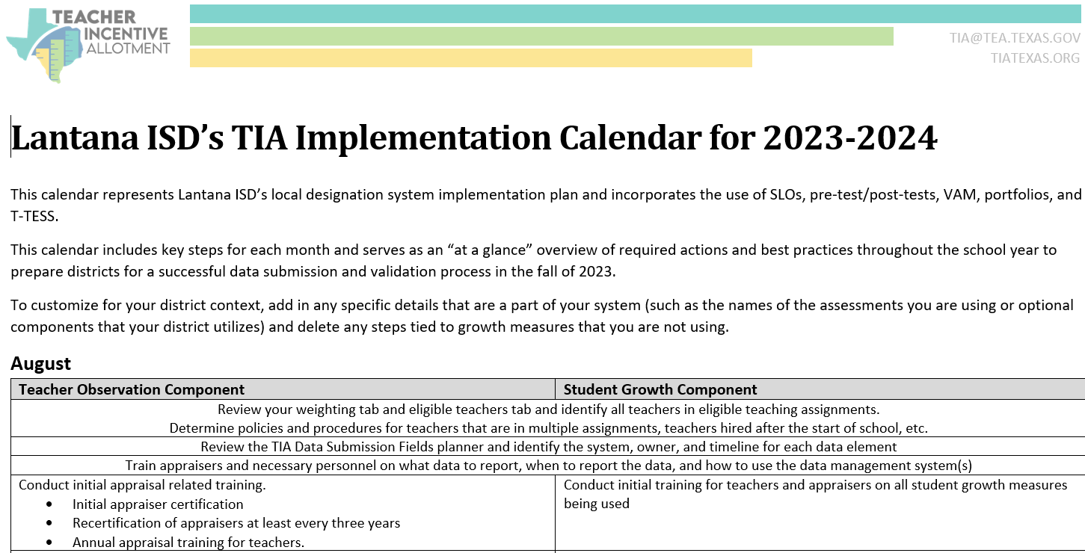
Sample Implementation Calendar

Slide 43

Take a few minutes to review the Implementation Calendar for the key areas of the data capture year.

Slide 44
Customizing the Implementation Calendar
Adjust
Delete
Months to match your district’s plan
Data management platform for the system your district uses
Growth measures that you do not use
Multiple campus activities, if your district has only one campus

Slide 45
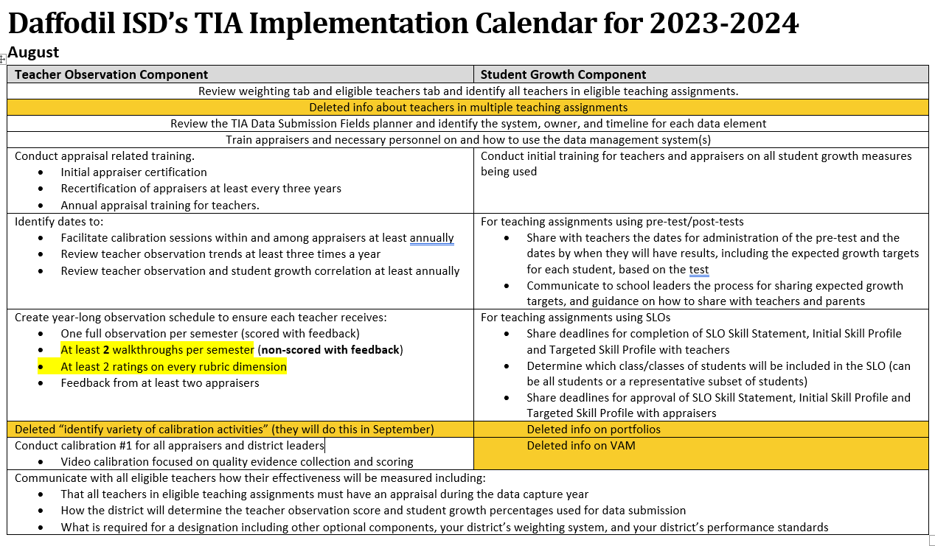
Sample Calendar Customization

Slide 46
How would you customize the Implementation Calendar for your district?

Slide 47
Breakout Room
10 minutes
Share in breakout rooms how you customized the calendar for your district.

Slide 48
Shout Outs
What was something you heard in your breakout room that you will use, or hadn’t even considered?
Come off mute to share or drop in the chat.

Slide 49
Survey

Slide 50
Considerations:
Ensure all appraisers complete assigned observations within timelines, and sign off on the summative
Ensure all teachers implement student growth measures as required by approved system and within prescribed timelines
  Reminder: All pre-tests must be completed within the first nine (9) weeks of SY23-24
Ensure all teachers in eligible assignments are on track for appraisals in 2023-24
  Reminder: Teachers cannot be on appraisal waivers in SY23-24
Plan for time to analyze effectiveness data mid-year to identify skew between teacher observation data and student growth measure data
  Reminder: TIA offers Technical Assistance resources for this process at mid-year

Slide 51
Training and Support
TIA offers Technical Assistance to (1) support key milestones in Data Capture and (2) considerations for system expansion & modification
Expansions_Modifications Launch
Check in on Data Capture Year
Reviewing and Responding to Mid_Year Data
Using Excel Tool with District Data
Responding to End of Year Skew
Data Submission and Validation
Designation Determination

Slide 52




Key points
Keep 2024 data submission in mind through your 2023-24 data capture year
Use the Planning Guide to establish next steps
(e.g. the what to do)
Include all required elements of your approved system
Create
Implementation Calendar
(e.g. the when to do a task)

Slide 53
Thank You

