Slide 1
Data Submission and Validation
July 26th, 2023

Slide 2
Agenda
1:00 p.m. – 1:05 p.m.
Welcome
1:05 p.m. – 1:15 p.m.
Data Submission Timeline and Review Process
1:15 p.m. – 1:30 p.m.
Data Submission File Overview
1:30 p.m. – 1:45 p.m.
Data Submission Portal
1:45 p.m. – 1:50 p.m.
Break
1:50 p.m. – 2:50 p.m.
Data Validation Updates and Process
2:50 p.m. – 3:00 p.m.
Closing

Slide 3
Objectives
Understand the data submission timeline and review process
Review the components of the data submission file
Explore the TIA Data Submission Portal
Understand the data validation process and updates

Slide 4
Data Submission Timeline and Review Process

Slide 5




District Approval Process
Pre-Application
Districts engage with stakeholders and develop their local designation system.
System Application
Districts submit their application to TEA after building their system then submit the TIA Teacher Buy-In Survey to TTU.
Data Capture Year
Districts implement their system and track student growth and teacher observations.
Data Submission
Districts submit their data to TTU for data validation and TEA reviews outcomes and other pieces of data to determine final approval.

Slide 6







Data Submission Timeline 2023
August 1: Portal will begin to accept data submission file
August 8: Final STAAR Assessment Reports sent to districts
August 22: Data Submission Office Hours
Sept. 1: VAM districts requests for extension due
Sept. 26: Data Submission Office Hours
Oct. 10: Data Sub. Office Hours
Oct. 19: Submission Deadline, Technical Error Review
Oct. 24: Deadline to resolve any technical errors
After Oct. 24: System Alignment Review
Nov. 15: Designation Fees due and Qualtrics Fee Form due
TTU begins Data Validation checks
Districts notified of validation results
August
September
October
November
February

Slide 7
Data Submission Office Hours
Registration Link | Date | Time
August Data Submission Office Hours | Tuesday, August 22 | 9:00-10:00 a.m.
September Data Submission Office Hours | Tuesday, September 26 | 9:00-10:00 a.m.
October Data Submission Office Hours | Tuesday, October 10 | 9:00-10:00 a.m.

Slide 8
TIA Data Submission Deadline
When is the deadline for Data Submission?
Portal will open for submissions beginning in August. You may upload multiple times ahead of the deadline.
October 19, 2023 is the deadline to make upload attempt. October 24, 2023 is the last day to address technical errors and upload error-free file.

Slide 9
Data Submission Review Process
October 19
October 24
October 24
Nov. 15
Technical Error Review
System Alignment Review
Report generated within the Portal if errors
Contact TTU with questions
Correct all technical errors
After file passes technical review, TIA Team checks the file aligns with approved system
Expected teaching categories included, all expected teachers included
Note: Districts may need to respond to issues on a quick turnaround

Slide 10

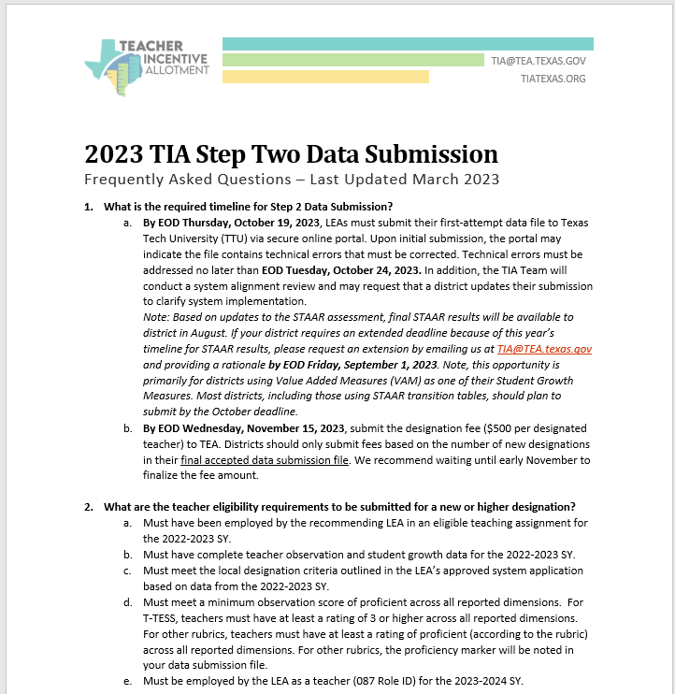
Resources
Instructions for Data Submission
Data Submission FAQs

Slide 11
Data Submission File

Slide 12
Data Submission File
Districts submit one file for data submission, which includes:
District Information Tab
Include contact information
Address all supplementary questions
If missing teachers, explain in Questions 6 and 7 for TIA Team to reference during System Alignment Review
Weighting Tab
Should reflect district’s 2022-23 approved local designation system
Data Entry Tab
Observation and student growth scores for all teachers in an eligible teaching assignment during the 2022-23 school year (both designated and non-designated)
Includes a column for new or higher designations

Slide 13
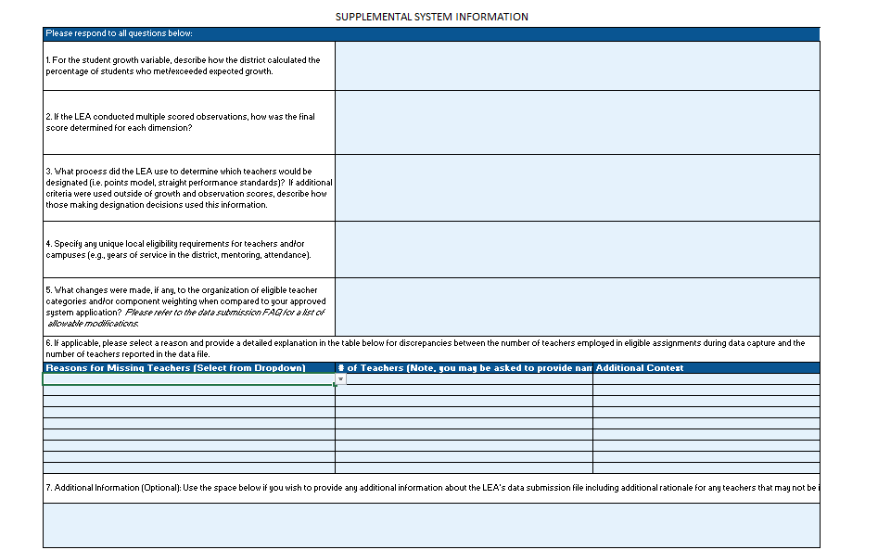
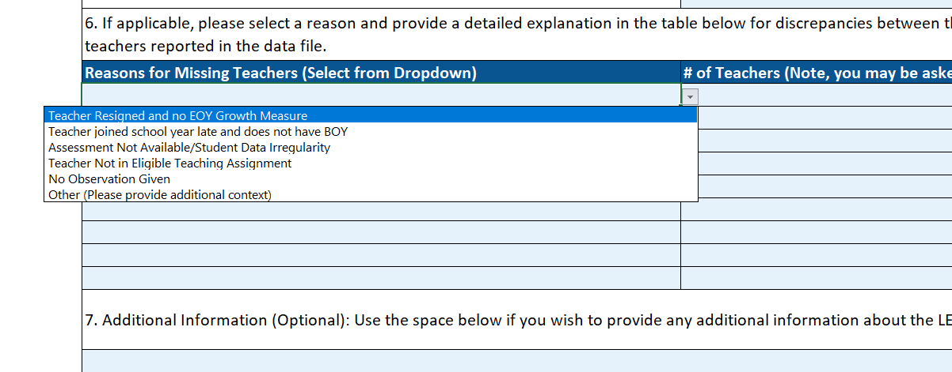
District Info Tab
Describe District process for calculations, Weighting
If applicable, make clear why teachers missing

Slide 14
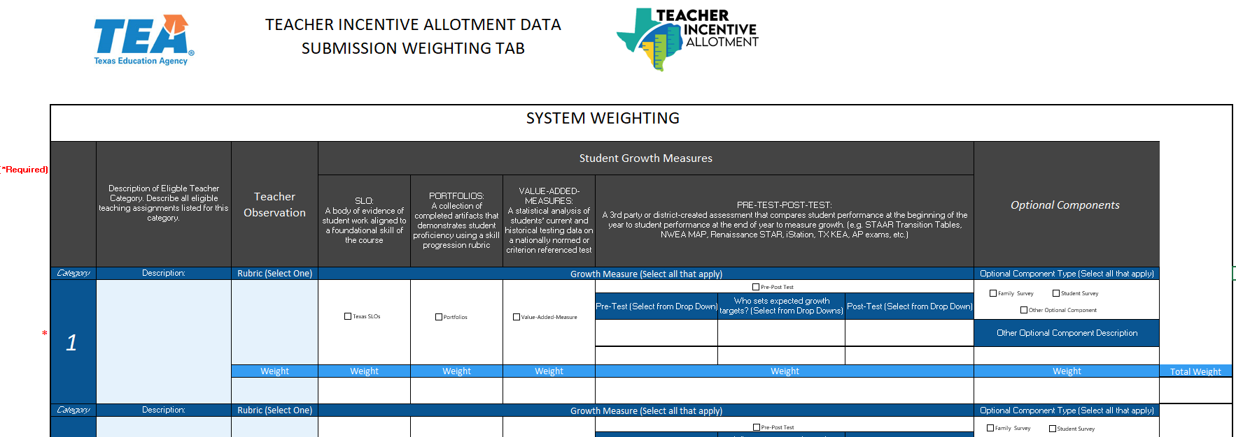
Weighting Tab
Teaching categories should reflect district’s approved system
Templates include 10 categories, can leave the extras blank

Slide 15
Weighting Tab: Changes
Districts can:
Districts cannot:
Change the weighting of approved components. Ex: the LEA system application weighted teacher observation at 30% and student growth at 70%. The LEA can change weighting to 50/50.
Remove other optional, non-statutory components. Ex: attendance, student surveys
Adjust the standard at which a teacher is able to earn a designation
Adjust or establish a minimum requirement to earn a designation
Add or remove eligible teaching assignments
Add or remove student growth measures
Add or remove teacher observation component
Exclude teacher observation or student growth when determining designations

Slide 16
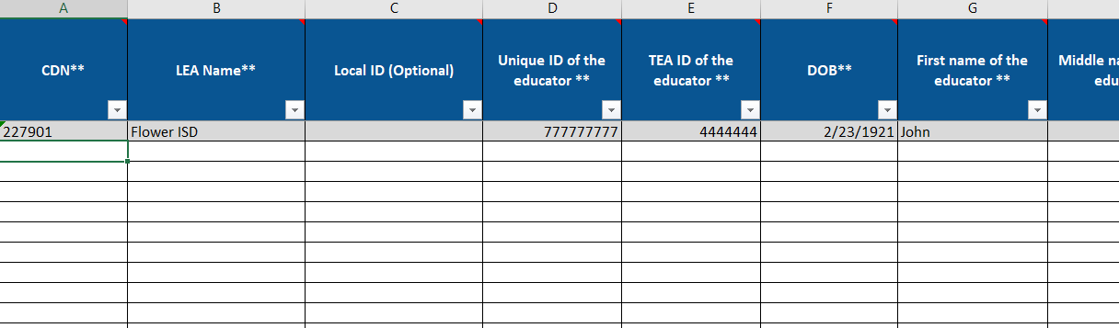
Data Entry Tab
Stars in column headers indicate required data
Hover over columns to see additional note
Unique ID and TEA ID for each teacher, built-in check to ensure identifying the correct teacher
Teacher observation only includes the observable domains

Slide 17
TIA Data Submission Portal

Slide 18
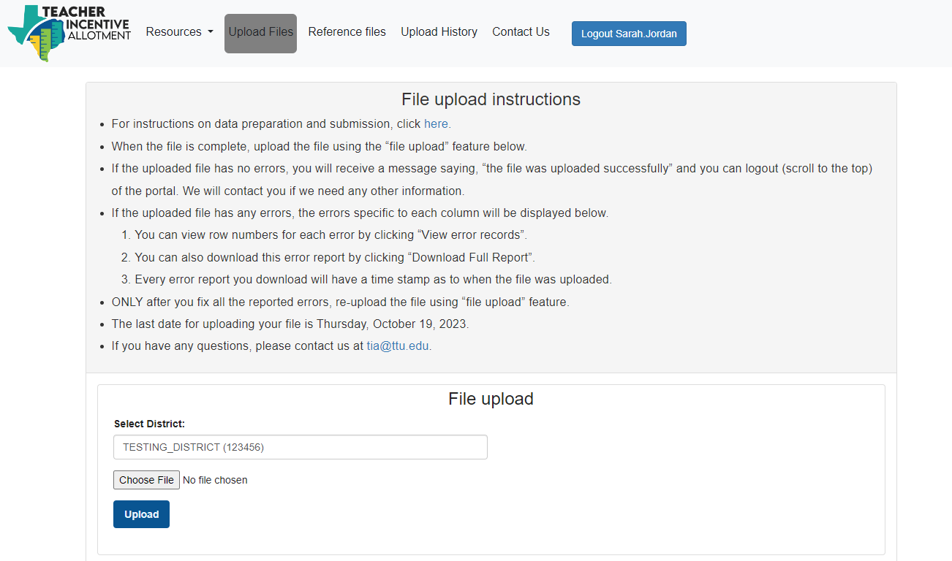
Portal
TIA Data Submission Portal
Open for upload attempts on August 1, 2023.
For assistance with formatting, data entry, or portal access, contact tia@ttu.edu

Slide 19
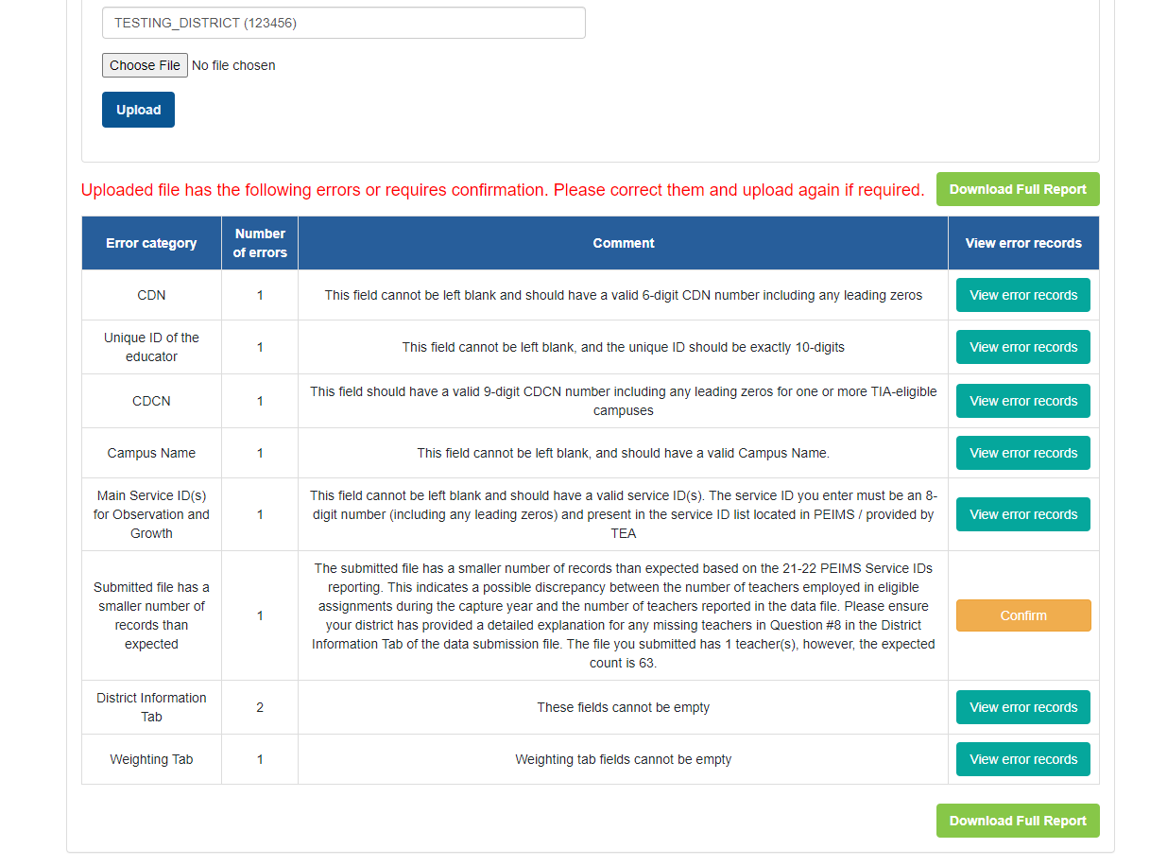
Portal Error Report
A list of technical errors will appear if there are discrepancies in file
Click “View error records” to see error description and example
A full report can be downloaded

Slide 20
Portal Update: Reference Files tab
File | Recommended Use
AskTED Directory File | Use this file to look up district number and campus numbers.
Application File | Use the district’s TIA approved application file to reference the Weighting Tab and ensure all teaching categories are included in the data submission file.
Eligible Teacher List | This is a base list of expected teachers; districts will need to amend based on most current teacher roster. Contains TEA ID for some teachers, district will need to look up the rest by downloading an ECOS File.
TIA Data Submission File Template | File template for building the district’s data submission file.
Previous Year Uploaded File | For reference only, do not resubmit this file.

Slide 21
Resources
Instructions for Data Submission
Data Submission FAQs

Slide 22
FAQ #1
Which teachers should be included in the data file?
The data file should include all teachers who were in an eligible teaching assignment and/or campus during the 2022-2023 school year, including teachers who are no longer employed. Eligible teaching assignments must align with those listed on the weighting tab of the LEA’s approved system application.
For districts who have not been approved through Step 2 in prior years, teachers in eligible assignments cannot opt out the local designation system.

Slide 23
FAQ #2
What if a teacher is missing observation and/or student growth data?
Teachers who do not have complete observation and student growth data should not be included in the data file. On the District Information tab, questions 6 and 7, please outline any discrepancies in the number of teachers employed in eligible assignments compared to the number of teachers reported in the data file.
Only districts with full system approval may omit teachers who were on appraisal waivers for 2022-2023. We caution districts to use waivers sparingly following system approval, as this may impact future data validation.

Slide 24
FAQ #3
What if a teacher is not returning next year? Should they be included in the submission file?
Yes. The data file should include all teachers who were in an eligible teaching assignment and/or campus during the 2022-2023 school year, including teachers who are no longer employed.
However, to be submitted for designation, a teacher must be employed by the district as a teacher (087 role) for the 2023-24 school year.
Therefore, you should include the teacher in the submission file but not propose that they are designated based on eligibility requirements.

Slide 25
Break

Slide 26
Data Validation

Slide 27
Data Validation Approvals
Districts that submitted data in 2022 and then again in 2023 had a 92% approval rate

Slide 28


Data Validation Changes
Continuous Scoring Model
Districts will now receive credit for check scores that are close to each point threshold.
New Supplemental Checks
Districts will now receive 2 new unscored supplemental checks (check 12 and 13). These checks will provide more feedback to districts specifically around teachers that are captured in the statewide VAM.
Check 1: Correlation = .23
0
1
2
3
Old
Score=2
0
1
2
3
New
Score=2.875

Slide 29



Data Validation Changes Continued
Validation Weights Updates
Data validation weights have been updated to create a balance across domains A, B, C. This creates more balance between domains and between observation and growth specific checks.
Statewide VAM change
Shift in the statewide VAM that adjusts for certain student and school demographics that account for shifts outside of a teacher’s control. For this year’s 2023-24 data validation both current model and new model will be used and highest of on data validation will be taken.
Starting next year in the 2024-25 data validation only the adjusted model will be used.
Appeals Process
A subset of districts that do not earn full approval will have the opportunity to appeal the results by submitting qualitative and quantitative context. This addition will promote transparency and additional understanding around the data validation process. Districts that are approved during the appeals process will receive provisional approval for 1 year.

Slide 30
Overview of TTU Data Validation Process
How will district data be validated by TTU?
5 domains
9 scored checks
4 unscored supplemental checks
Data Validation Documentation

Slide 31
TTU Data Validation Summary
Domain A: Check #1
Correlation check between teacher observation and student growth scores.
Domain B: Checks #2-3
Compares district designations with VAM designations.
Domain C: Checks #4-7
Looks at the effect campus, teacher category, or assignment have on designations.
Domain D: Checks #8-9
Compares designated teacher’s observation scores to that statewide performance standards.
Domain E: Supplemental Checks #10-13
Unscored supplemental checks used to provide additional data for districts.

Slide 32



Domain A: Check 1
Domain A
Correlation between teacher observation ratings and student performance ratings
Check 1
The correlation coefficient between observation and growth among all eligible teachers is within the range of expected magnitude reported in the research literature.
Checks for:
How closely aligned district created observation scores and percent of students that met or exceeded their growth target are.
Data used:
Teacher observation and student growth scores of all teachers included in submission file
Are teacher designations used for this check?
No, teacher designations were not used as part of the analysis

Slide 33



What Determines Designations?
District Performance Standards
The minimum standards to meet each designation level for student growth and teacher observation.
System Weights
The weighing of teacher observation, student growth, and other optional components used by the district. Example: 40% teacher observation and 60% student growth.
Optional Prerequisites
Components required by the district but not by statute. Example: teacher’s attendance must be 90% or above to earn a designation.

Slide 34
Domain B: Checks 2-3
District Designations
Statewide VAM Designations
Teacher​ | Designation​
Teacher 1​ | Recognized​
Teacher 2​ | Recognized​
Teacher 3​ | Exemplary​
Teacher 4​ | Exemplary​
Teacher 5​ | Master​
Teacher​ | Designation​
Teacher 1​ | Recognized​
Teacher 2​ | Exemplary​
Teacher 3​ | No Designation​
Teacher 4​ | Recognized​
Teacher 5​ | Master​

Slide 35
Domain B: Check 2
Domain B
Confirm relation between district designations and student growth calculations
Check 2
District designations of Recognized, Exemplary, and Master (REM) teachers are found in similar proportion to designations as determined by the state-wide VAM.
Checks for:
How closely aligned district designations are to VAM designations.
Data used:
Only designated teachers are used that also have a VAM designation from statewide data
Are teacher designations used for this check?
Yes, only designated teachers are used in this check.

Slide 36


Domain B: Check 2 Explained
No Designation | Recognized | Exemplary | Master
1
1
Aligned
2
Under
2
3
Over
3
4
Over
4
5
5
Aligned
District Designations
VAM Designations

Slide 37
Domain B: Check 3
Domain B
Confirm relation between district designations and student growth calculations
Check 3
District designation decisions for REM teachers, in tested subjects, are in proximity to designations as determined by the state-wide VAM.
Checks for:
Proximity of district designations to VAM designations.
Data used:
Only designated teachers are used that also have a VAM designation from statewide data
Are teacher designations used for this check?
Yes, only designated teachers are used in this check.

Slide 38
Domain B: Check 3 Explained
Proximity of district designations to designations determined by statewide VAM.
 |  | Designation Determined by state-wide VAM
 | Designation Level | Non-Designated | Recognized | Exemplary | Master
District Designation | Recognized | 0.00 | 1.00 | 0.75 | 0.50
 | Exemplary | -0.25 | 0.75 | 1.00 | 0.75
 | Master | -1.00 | 0.25 | .75 | 1.00

Slide 39
Domain C: Check 4-7
Domain C
Degree of inter-rater reliability for observation and growth judgements
Across campuses, observation scores and percentages of student growth are similar for teachers in REM (Recognized, Exemplary, Master) groups.
Across teacher category/assignments, observation scores and percentages of student growth are similar for teachers in REM groups.
Checks 4-7
Checks for:
What effect does campus/assignment have on both observation and student growth values as it relates to each designation group.
Data used:
Teacher observation and growth data from designated teachers
Are teacher designations used for this check?
Teacher designations are used to group teachers into categories: Recognized, Exemplary, Master

Slide 40
Domain C: Checks 4-7 Explained
Goal for these checks is to see alignment between designated teachers’ performance across campuses and across assignments (teacher category, STAAR tested, non-STAAR tested)
Campus 2: Recognized Teacher’s Performance
Campus 1: Recognized Teacher’s Performance

Slide 41
Domain D: Check 8-9
Domain D
Comparison of district designation percentage to overall statewide performance
Percentage of students who meet or exceed expected growth in the district is approximately equal to the statewide performance standard for student growth among REM teachers.
Observation ratings for REM teachers in the district are approximately equal to the statewide performance standards for teaching proficiency.
Checks 8-9
Checks for:
Percent of designated teachers that met or exceeded the cut score performance standard for student growth and teacher observation based on the district designation.
Data used:
Teacher observation and growth data from designated teachers
Are teacher designations used for this check?
Yes, only designated teachers are used in this check.

Slide 42
Domain D: Checks 8-9 Explained
Teachers are assigned points based on their proximity to the statewide performance standards established for each designation level.
These values are then averaged within each designation group then a mean value is calculated over all possible designation groups.

Slide 43
Domain E: Supplemental Check 10
Domain E
Supplemental System Checks (not scored)
Check 10
The proportion of teachers on district campuses who are designated as Recognized, Exemplary, or Master is roughly equivalent to other campuses with the same Domain 2A rating
Checks for:
How similar are designation proportions for individual campuses compared to proportions to VAM designations in the same Domain 2A category.
Data used:
All teachers were included categorized as designated or not designated even teachers that are currently designated in a district were included.
Are teacher designations used for this check?
Yes, teacher designations were used in this check

Slide 44
Domain E: Supplemental Check 11
Domain E
Supplemental System Checks (not scored)
Check 11
The variability in observation ratings among all eligible teachers is within the range of historical magnitude.
Checks for:
Spread of teacher observation scores gathered. The expectation is that observation scores for the districts will be distributed in a manner that gives some evidence about the ability of the district to differentiate between effective and ineffective teachers.
Data used:
Teacher observation scores only from all teachers submitted in the submission file.
Are teacher designations used for this check?
No, teacher designations were not used in this check.

Slide 45
Domain E: Supplemental Check 12-13
Domain E
Supplemental System Checks (not scored)
Check 12-13
The ranking of teachers based on observation scores (check 12) or percentages of student growth scores (check 13) closely aligns with their ranking on statewide performance standards for teaching proficiency.
Checks for:
Ranked correlation coefficient (Spearman’s ρ) between observation scores (check 12) or student growth scores (check 13) and state-level value-added scores.
Data used:
All teacher’s observation (check 12) or student growth scores (check 13) that have a connecting state-level value-added score.
Are teacher designations used for this check?
No, teacher designations were not used in these checks.

Slide 46
TTU Data Validation Summary (Repeat)
Domain A: Check #1
Correlation check between teacher observation and student growth scores.
Domain B: Checks #2-3
Compares district designations with VAM designations.
Domain C: Checks #4-7
Looks at the effect campus, teacher category, or assignment have on designations.
Domain D: Checks #8-9
Compares designated teacher’s observation scores to that statewide performance standards.
Domain E: Supplemental Checks #10-13
Unscored supplemental checks used to provide additional data for districts.

Slide 47
Transition Tables FAQ
For TIA, what is considered growth using STAAR Transition Tables?
Locally, districts set student growth targets for all student growth measures, including the transition tables. Generally, most districts will consider a student that scores 1 point as meeting growth. A district may also make a local decision to assign growth to a student who scores ½ a point.
Confirm around ½ point with performance standards
August Data Submission Office Hours Tuesday, August 22 (9:00-10:00 a.m.)
September Data Submission Office Hours Tuesday, September 26 (9:00-10:00 a.m.)
October Data Submission Office Hours Tuesday, October 10 (9:00-10:00 a.m.)

Slide 48
Data Submission Supports and Timeline
Data Submission Office Hours
Time
August Data Submission Office Hours Tuesday, August 22 (9:00-10:00 a.m.)
September Data Submission Office Hours Tuesday, September 26 (9:00-10:00 a.m.)
October Data Submission Office Hours Tuesday, October 10 (9:00-10:00 a.m.)
Technical Question: tia@ttu.edu
Policy or Process Question: tia@tea.texas.gov
Data Submission File due by October 19th
TIA Designation Fees ($500 per designated teacher) due by November 15th
Note, all fees are reimbursed through the FSP

Slide 49
Thank You
TIAtexas.org
TIA@tea.texas.gov

