Slide 1
Overview of Student Learning Objectives
October 4, 2023

Slide 2



Welcome
Please make sure you are muted.
If you are able, turn on your camera.
Locate your participant video and click on the more icon to rename yourself.

Slide 3

Session Materials and Recordings
All 2023-2024 TIA webinar materials in Google Drive, in chronological order
Live recordings available in Google Drive. Recordings will not display participant names or faces.

Slide 4
Agenda
9:00 a.m. – 9:05 a.m.
Welcome, Objectives and Session Overview
9:05 a.m. – 9:35 a.m.
Phase One of the SLO Process: Create
9:35 a.m. – 9:45 a.m.
Phase Two of the SLO Process: Monitor and Collect
9:45 a.m. – 9:50 a.m.
Phase Three of the SLO Process: Determine Growth
9:50 a.m. – 10:00 a.m.
Questions and Survey

Slide 5
Objectives
Understand the basic elements of the three phases of the Texas SLO process
Understand how a body of evidence is a key part of an SLO
Recognize a quality SLO Skill Statement
Explain the difference between an Initial Skill Profile and a Targeted Skill Profile
Understand how SLOs could be used to include teachers in non-tested areas in a district local designation system

Slide 6




Cohort G Approval Process
System Development
Districts engage with stakeholders and develop their local designation system.
System Application
Districts submit their application to TEA
Data Capture Year
Districts implement their system and track student growth and teacher observations.
Data Submission
Districts submit their data to TTU for data validation and TEA reviews outcomes and other pieces of data to determine final approval.
.
Fall 2023/Spring 2024
April 15, 2024
2024-2025 School Year
Fall 2025

Slide 7
Texas SLO Overview

Slide 8
Benefits of SLOs
Versatility
Can be used for any teaching assignment, from core content, to CTE, to Fine Arts, etc.
Teacher Driven
Teachers know their students best. They design the SLO, and their appraiser approves it.
Individualized
Teachers use SLOs to set expected growth targets for each individual student
Evidence-Based Alternative to Testing
Actual student work serves as the evidence of a student meeting their expected growth target, not a test

Slide 9
SLO Training
Contact your local ESC for full SLO training
Review resources available on https://TexasSLO.org/
Formal SLO Training Required

Slide 10
Three Phases of the Texas SLO Process

Slide 11




Three Phases of the SLO Process
PHASE 1
Create an SLO Skill Statement
Create an Initial Skill Profile
Match students to the Initial Skill Profile
Create the Targeted Skill Profile
Set expected growth targets
PHASE 2
Monitor Progress
Build the Body of Evidence
Mid-Year check ins for teacher and appraiser on student progress and body of evidence to date
PHASE 3
Determine end of year skill levels using the body of evidence matched to Targeted Skill Profile
August - September
October - April
April - May

Slide 12
Phase One: Overview
SLO Skill Statement
Based on a foundational skill of the course
Initial Skill Profile
What are typical skill levels at the beginning of the year?
Targeted Skill Profile
What are typical skill levels at the end of the year?
Set Expected Growth Targets
Where do I expect my students’ skill levels to be at the end of the year?

Slide 13

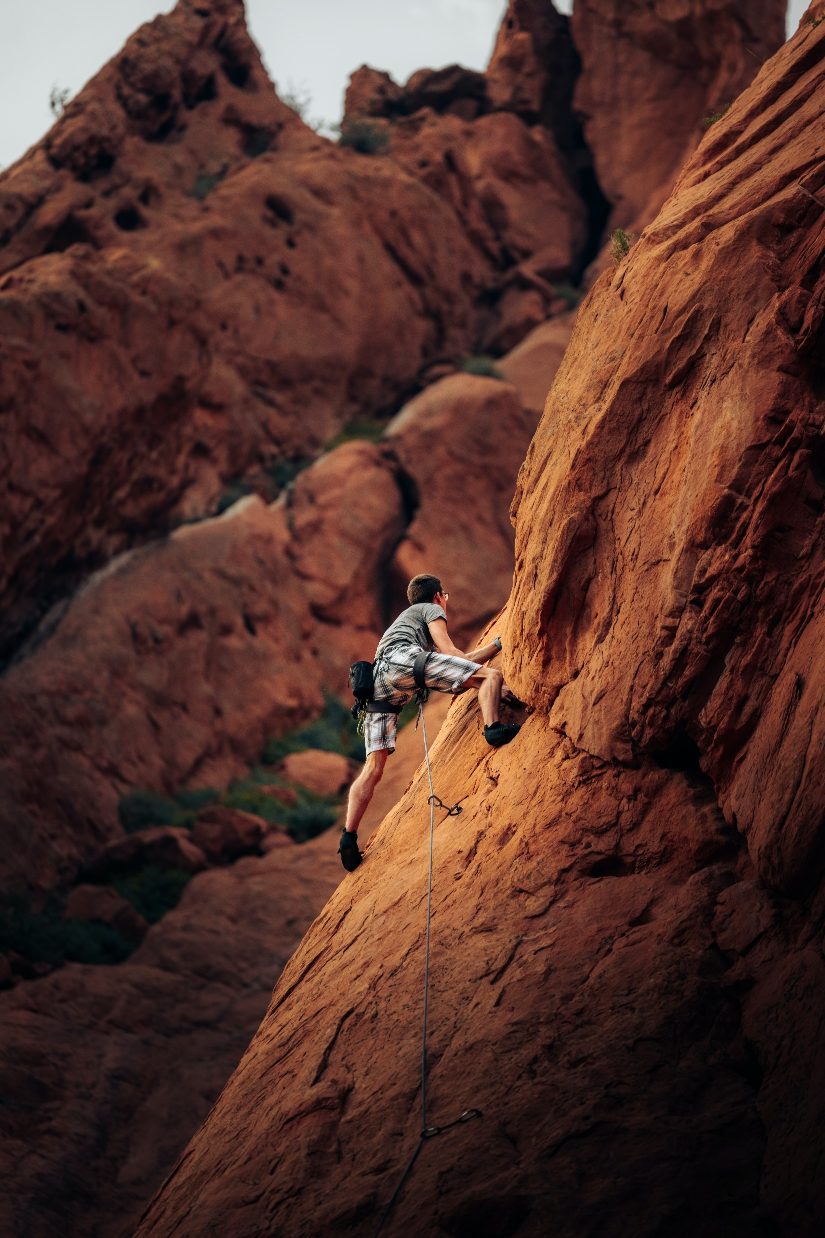


SLO Skill Statement: Success Criteria
Foundational Skill
Persists Throughout the Course
Measurable
Will lead to growth in the course and beyond

Slide 14
SLO Skill Statement: Drawing I
Success Criteria
Example
Use conventions of shading (light and dark) to convey perspective in a pencil/pen sketch
Represents a foundational skill that is specific to the content area
Persists throughout the course
Measurable through a demonstration of student skill
Focus on it will lead to student growth in this course and beyond
Non-Examples
Drawing
Two-week unit on art history

Slide 15
SLO Skill Statement: 8th Grade Science
Success Criteria
Example
Example
Write clear, well documented lab reports that analyze and synthesize experimental results using the language of science
Represents a foundational skill that is specific to the content area
Persists throughout the course
Measurable through a demonstration of student skill
Focus on it will lead to student growth in this course and beyond
Non-Example
Lab Reports
Unit on measurements

Slide 16
SLO Skill Statement: Culinary Arts
Success Criteria
Example
Students will be able to plan and prepare a nutritionally sound meal, applying industry standard cooking techniques and using American Culinary Federation Education Standards for sanitation and safety.
Represents a foundational skill that is specific to the content area
Persists throughout the course
Measurable through a demonstration of student skill
Focus on it will lead to student growth in this course and beyond
Non-Example
Students will use proper cooking conditions and follow recipes to prepare nutritionally sound meals

Slide 17
Phase One: ISP
SLO Skill Statement
Based on a foundational skill of the course
Initial Skill Profile
What are typical skill levels at the beginning of the year?
Targeted Skill Profile
What are typical skill levels at the end of the year?
Set Expected Growth Targets
Where do I expect my students’ skill levels to be at the end of the year?

Slide 18
What is an Initial Skill Profile?
A skill progression rubric.
Describes entering levels of student proficiency at the beginning of the year with respect to the foundational skill.
Begins with what a student “typically” knows and can do when they begin the year with respect to the skill selected for the SLO.

Slide 19



ISP: Success Criteria
Aligns to Skill Statement
Articulates BOY Skills
Differentiates Between Levels
Based on Multiple Sources of Evidence

Slide 20
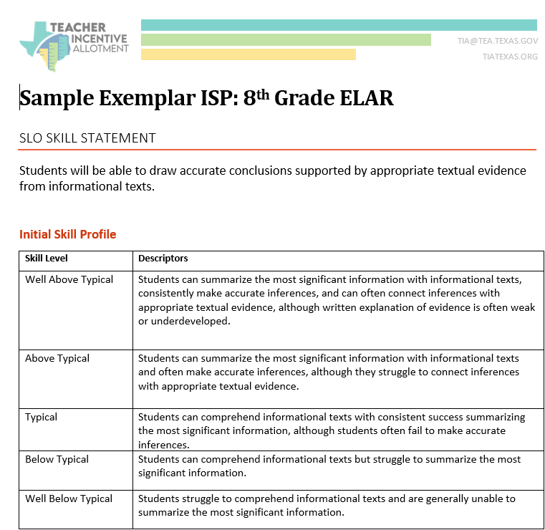
Sample Exemplar ISP
Review the Sample ISP document against the Success Criteria.
Why is this ISP an exemplar?

Slide 21
Evidence of Success Criteria
Described what student skill level typically is at BOY for an 8th ELAR class
Included 5 differentiated skill level descriptors
Aligned to Skill Statement
Based on this teacher’s knowledge of what students can and can’t do at the beginning of the year

Slide 22
ISP Levels
To match students with ISP levels:
Use multiple sources of evidence to determine students’ entering skill levels
Use current year and historical data

Slide 23
Evidence for skill levels at BOY
Student | Mult. Choice | Short Ans. | Prompt Response | Free Write | Analysis Essay
Maria | 4 | 3 | 3 | 3 | 4
Kendrick | 3 | 2 | 3 | 2 | 2
Felipe | 3 | 3 | 3 | 3 | 4
Dayana | 2 | 1 | 1 | 1 | 1
Asim | 2 | 2 | 1 | 2 | 2
Natasha | 3 | 3 | 2 | 2 | 2

Slide 24
Student’s ISP levels
Student | Level
Maria | Well Above Typical
Kendrick | Typical
Felipe | Above Typical
Dayana | Well Below Typical
Asim | Below Typical
Natasha | Typical

Slide 25
Phase One: TSP
SLO Skill Statement
Based on a foundational skill of the course
Initial Skill Profile
What are typical skill levels at the beginning of the year?
Targeted Skill Profile
What are typical skill levels at the end of the year?
Set Expected Growth Targets
Where do I expect my students’ skill levels to be at the end of the year?

Slide 26
What is a Targeted Skill Profile?
A skill progression rubric
Describes different levels of student proficiency with respect to where they should be at the end of the year (EOY), after a full year of instruction
Very different from the ISP which focuses on proficiency levels that are typical for the beginning of the year

Slide 27


TSP: Success Criteria
Articulates EOY Skills
Differentiates between levels, aligned to Skill Statement
Targets are specific to students, and based on multiple sources of evidence
High, yet reasonable expectations

Slide 28
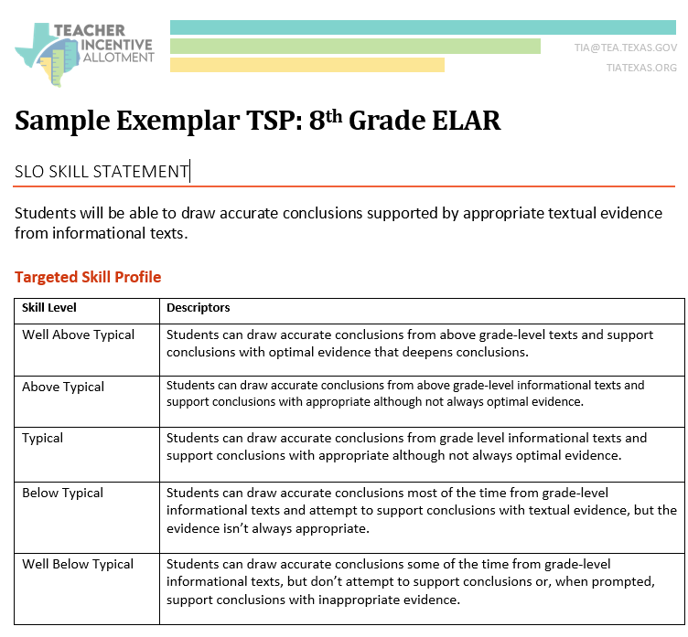
Sample Exemplar TSP
Review the Sample TSP document against the Success Criteria. Why is this TSP an exemplar?
Hint: compare descriptors in TSP to those in the ISP to look for growth

Slide 29
Evidence of Success Criteria:TSP
Described what student skill level typically is at EOY for an 8th ELAR class
Included 5 differentiated skill level descriptors
Aligned to Skill Statement)
Allows for multiple kinds of assessments/assignment to measure student proficiency
Based on this teacher’s knowledge of what students can do at the by the end of the year
Represents significant growth compared to the ISP descriptors

Slide 30
TSP compared to ISP
Initial Skill Profile
Targeted Skill Profile
Above Typical Skill
Students can summarize the most significant information with grade level informational texts and often make accurate inferences, although they struggle to connect inferences with appropriate textual evidence.
Typical Skill
Students can comprehend grade level informational texts with consistent success summarizing the most significant information, although students often fail to make accurate inferences.
Above Typical Skill
Students can draw accurate conclusions from above grade-level informational texts and support conclusions with appropriate although not always optimal evidence.
Typical Skill
Students can make accurate inferences and draw accurate conclusions from grade level informational texts and support conclusions with appropriate although not always optimal evidence

Slide 31
TSP compared to ISP, cont’d
Initial Skill Profile
Targeted Skill Profile
Below Typical Skill
Students can comprehend informational texts but struggle to summarize the most significant information.
Well Below Typical Skill
Students struggle to comprehend informational texts and are generally unable to summarize the most significant information.
Below Typical Skill
Students can understand grade level informational texts draw accurate conclusions most of the time. Students attempt to support conclusions with textual evidence, but the evidence isn’t always clear or consistent.
Well Below Typical Skill
Students can draw accurate conclusions some of the time from grade-level informational texts, but don’t attempt to support conclusions or, when prompted, support conclusions with inappropriate evidence.

Slide 32
Phase One: Set Expected Growth Targets
SLO Skill Statement
Based on a foundational skill of the course
Initial Skill Profile
What are typical skill levels at the beginning of the year?
Targeted Skill Profile
What are typical skill levels at the end of the year?
Set Expected Growth Targets
Where do I expect my students’ skill levels to be at the end of the year?

Slide 33
Setting Expected Growth Targets
Based on evidence, where do I expect each student to be at the end of the year?
What are the teacher’s expectations for each student at the end of the year?
Informed decisions, based on data and observation
Use the descriptors in the TSP to determine where each student’s skill level is likely to be at EOY

Slide 34
Ms. Carnation’s 8th ELA TSP Skill Levels
Well Below Typical | Below Typical | Typical | Above Typical | Well Above Typical
 | Asim, Dayana | Natasha | Kendrick | Maria, Felipe
Data Sources Used:
3 free write essays on making inference on informational texts
2 analysis essays on informational texts
Reading fluency of informational texts (test)
2 prompt responses to increasingly more complex informational texts

Slide 35
ISP and TSP Review
Initial Skill Profile
Targeted Skill Profile
Rubric that defines BOY skill levels
What can do when they get there
Based on current and historical data
Rubric that defines EOY skill levels
What they can do at end of year, after full year of instruction
Content should be very different than the ISP

Slide 36
SLO Phase Two: Monitor Progress

Slide 37
Phase Two of the SLO Process
PHASE 1
Create an SLO Skill Statement
Create an Initial Skill Profile
Match students to the Initial Skill Profile
Create the Targeted Skill Profile
Set expected growth targets
PHASE 2
Monitor Progress
Build the Body of Evidence
Mid-Year check ins for teacher and appraiser on student progress and body of evidence to date
PHASE 3
Determine end of year skill levels using the body of evidence matched to Targeted Skill Profile
August - September
October - April
April - May

Slide 38
Phase Two: Overview
Build the Body of Evidence (BOE)
Define what assignments will be part of the BOE
Ensure at least 5 data points will be part of the BOE
Require mid-year check in on the BOE, growth targets

Slide 39
Body of Evidence Example
Which assignments should be part of the body of evidence for this SLO?
Assignment | Part of BOE?
1. In class analytical essay (Sept)
2. “Explain your evidence”
3. “Drawing Conclusions” short answer
4. Haiku
5. Autobiography
6. In class analytical essay (Feb)
7. Poetry journal
8. In class analytical essay (Apr)
9. Final exam claim/evidence free response
SLO Skill Statement: Students will be able to draw accurate conclusions supported by appropriate textual evidence from informational texts

Slide 40
Body of Evidence Example: Answers
Which assignments should be part of the body of evidence for this SLO?
Assignment | Part of BOE?
1. In class claim/evidence essay (Sept) | YES
2. “Explain your evidence” | YES
3. “Supporting your claim” short answer | YES
4. Haiku | NO
5. Autobiography | NO
6. In class claim/evidence essay (Feb) | YES
7. Poetry journal | NO
8. In class claim/evidence essay (Apr) | YES
9. Final exam claim/evidence free response | YES
SLO Skill Statement: Students will be able to draw accurate conclusions supported by appropriate textual evidence from informational texts

Slide 41
SLO Phase Three: Evaluate Progress

Slide 42
Phase Three of the SLO Process
PHASE 1
Create an SLO Skill Statement
Create an Initial Skill Profile
Match students to the Initial Skill Profile
Create the Targeted Skill Profile
Set expected growth targets
PHASE 2
Monitor Progress
Build the Body of Evidence
Mid-Year check ins for teacher and appraiser on student progress and body of evidence to date
PHASE 3
Determine end of year skill levels using the body of evidence matched to Targeted Skill Profile
August - September
October - April
April - May

Slide 43
Phase Three: Overview
Use the BOE to determine student EOY skill level
Determine to which skill level on the TSP each student’s work aligns
Appraiser reviews the BOE and approves assigned skill levels as part of EOY teacher appraisal conference
Determine if students met their targeted growth or not

Slide 44
Did my students meet expected growth?
Determining End of Year Growth
Comparison of targeted skill level to actual to end of year skill level
Review the Targeted Growth Goal for each student
Review the actual skill level on the end of year skill rubric to determine if students met their growth goals or not

Slide 45
Ms. Carnations’ 8th ELA Class
Expected Targeted Skill levels (where she expected students to be at EOY)
Students’ Actual EOY Skill Levels
Well Below Typical | Below Typical | Typical | Above Typical | Well Above Typical
 | Violet, Dayana | Dwayne | Kendrick | Maria, Felipe
Well Below Typical | Below Typical | Typical | Above Typical | Well Above Typical
Violet | Dayana | Kendrick | Dwayne | Maria, Felipe

Slide 46
Summary: Ms. Carnation’s Class
Student | End of Year Growth Target Met?
Violet | No
Dayana | Yes
Kendrick | No
Dwayne | Yes (exceeded)
Felipe | Yes
Maria | Yes
4 out of 6 students met/exceeded expected growth target
2 out of 6 students did not meet expected growth target
Ms. Carnation had 66% of her students meet/exceed expected growth

Slide 47
SLOs and Pre-test/Post-tests
SLOs
Pre-test/Post-tests
Based on foundational skill
Based on body of evidence of student work, aligned to the skill
Student work from throughout the school year
Multiple data points
Typically based on larger scope of material
Based how students perform on a test, not on student work
Comparison of beginning and end of year tests
Two data points

Slide 48
Benefits of SLOs: Summary
Versatility
Can be used for any teaching assignment, from core content, to CTE, to Fine Arts, etc.
Teacher Driven
Teachers know their students best. They design the SLO, and their appraiser approves it.
Individualized
Teachers use SLOs to set expected growth targets for each individual student
Evidence-Based Alternative to Testing
Actual student work serves as the evidence of a student meeting their expected growth target, not a test

Slide 49
SLO Required Training
Contact your local ESC for full SLO training
Review resources available on https://TexasSLO.org/
Formal SLO Training Required

Slide 50
Thank You
Please complete our survey. We value your opinion and feedback.

