Slide 1
Building a Local Designation System: 2023-24
September 6, 2023

Slide 2
Welcome
Please make sure you are muted.
If you are able, turn on your camera.
Locate your participant video and click on the more icon to rename yourself.

Slide 3
Session Materials and Recordings
All 2023-2024 TIA webinar materials in Google Drive, in chronological order
Live recordings available in Google Drive. Recordings will not display participant names or faces.

Slide 4
Agenda
9:00 a.m. – 9:05 a.m.
Welcome, Objectives and Session Overview
9:05 a.m. – 9:25 a.m.
District Panel
9:25 a.m. – 9:40 a.m.
Best Practices for Getting Started
9:40 a.m. – 10:20 a.m.
Readiness Guide: Building a Local Designation System
10:20 a.m. – 10:30 a.m.
Key Next Steps, Resources and Survey

Slide 5
Objectives
To learn some best practices from approved Cohort F TIA districts
To become familiar with and begin using the Readiness Guide: Building a Local Designation System
To identify district readiness in two Success Factors
To identify key next steps as the district begins to build their local designation system

Slide 6
Our Vision
To support districts in independently building and sustaining strategic compensation systems that differentiate teacher effectiveness. These systems will incentivize teachers to stay, support more robust recruitment, and make the profession more desirable.
Recruit
Retain
Reward

Slide 7
Cohort G Application Timeline
Pre-Application
2022-2023
System Development
Stakeholder Engagement
Year 1
2023-2024
System Application (posts on November 1st)
Application due date: April 15, 2024
TIA Teacher Buy-In Survey
Year 2
2024-2025
Capture Data
Year 3
2025-2026
Data Submission
Full System Approval
Designate & Compensate
Expansion & Modifications
TIA Annual Evaluation Surveys
Annual Program Submission
Post-Approval
2026-2030
New or Higher Designations
Expansion and Modifications
Annual Program Submission
TIA Annual Evaluation Surveys

Slide 8
District Approval Process
System Development
Districts engage with stakeholders and develop their local designation system.
System Application
Districts submit their application to TEA
Data Capture Year
Districts implement their system and track student growth and teacher observations.
Data Submission
Districts submit their data to TTU for data validation and TEA reviews outcomes and other pieces of data to determine final approval.
TIA Annual Program Submission & Surveys submitted to TTU.

Slide 9
District System Components
Teacher Observation
Observation based on T-TESS or aligned rubric​. District application must show evidence of calibration and data analysis.
Student Growth
Student growth measures determined by district. District application must show evidence of validity & reliability of development, administration, and scoring.​
Spending Plan
Districts must spend at least 90% on teacher compensation for student-facing instructional roles and may reserve up to 10% for supporting the TIA system or in supporting teachers in earning a designation by 8/31 each year. ​
Optional Components
Districts may consider additional factors in make designations (e.g., mentoring other teachers, teacher leadership, family surveys, student surveys, etc.).​

Slide 10
Poll #1: Current Level of Readiness
Where is your district, today, in terms of planning for TIA?
We are brand new to TIA and haven’t begun any planning yet
We have done some initial pre-planning, but have not finalized any key decisions yet
Most key decisions have been made, we just need to refine our system and focus on completing the application

Slide 11
District Panel
Eddie Curran
Elizabeth Klammer
Sandy Williamson
Round Rock ISD, Chief Human Resources Officer
Coldspring-Oakhurst CISD, Assistant Superintendent of C&I
Cleveland ISD, Human Resources Consultant

Slide 12
Lessons Learned: Round Rock ISD
Things That Worked
Having a Team
Understanding Requirements of TIA
Road Map the Year
Start small
Things to Avoid
Avoid staff turnover (or plan for it.)
Avoid assigning TIA to just one person
Things I didn’t know
How much work it takes to build a TIA System
More multi-faceted than we thought
Isn’t just about teacher comp
Parting Advice
Collaboration between departments is key

Slide 13
Lessons Learned: Coldspring-Oakhurst CISD
Things That Worked
Appraiser Calibration
Use a phase in model
Look at what you have in place already
Talk with other districts
Things to Avoid
Avoid subjectivity
Don’t try to do everything at once
Things I didn’t know
Things need to be discussed multiple times
We were not using SLOs correctly
Teachers struggle with believing TIA won’t go away
Parting Advice
You Can Do It!

Slide 14
Lessons Learned: Cleveland ISD
Things That Worked
Having a well rounded team
Calibration among appraisers
Good faculty presentations
National Board Cohort
Things to Avoid
Administrative Turnover
Jumping in before you are well informed
Things I didn’t know
TIA is about student outcomes
It is critical to have calibrated appraisers
Parting Advice
Having over-inflated data not only won’t help, it might hurt

Slide 15
Best Practice for Getting Started

Slide 16
Best Practices for Getting Started
Learn about TIA
Use Readiness Guide
Engage Stakeholders, Especially Teachers
Plan to attend 2023-24 TIA Technical Assistance Sessions

Slide 17
Stakeholder Engagement: Rationale
Why does Stakeholder Engagement Matter?
Districts with strong, strategic stakeholder engagement:
Develop stronger, more sustainable local designation systems
Teacher buy-in supports retention and recruitment goals

Slide 18
The Big Three Critical Decisions
Who can earn a designation?
Eligible campuses and teachers
How will we designate?
Observations, student growth measures, and optional components
How and when will we compensate?
Distribution of funds, timing of compensation
1
2
3

Slide 19
Breakout Room 5 minutes Discuss which of the three critical decisions will need the most time in your district's planning.

Slide 20
Readiness Guide: Building a Local Teacher Designation System
2023-24

Slide 21
What is the Readiness Guide?
A resource to break down the Success Factors needed to build a local designation system
A way to ensure critical pre-planning happens before creating specific system details
A guide to key milestones and best practices at each of the various stages in the process
A way to assess the district’s current readiness level for each key milestone

Slide 22
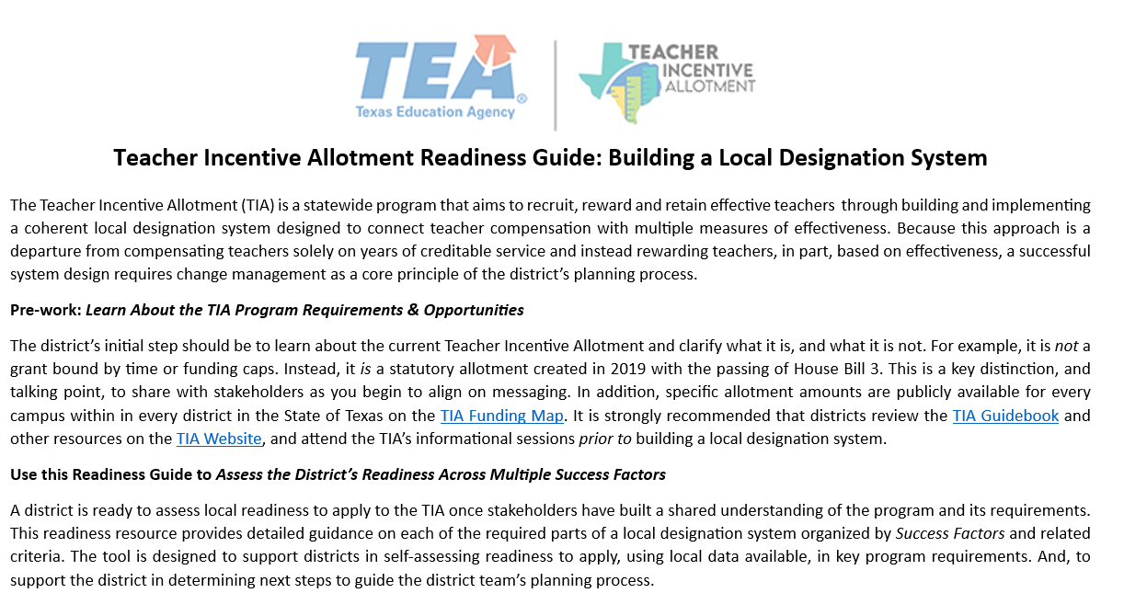
Readiness Guide

Slide 23
TIA Readiness Guide
Are districts required to use the TIA Readiness Guide?
No. This is a resource to help districts build a viable and successful designation system that will be represented in the 2024 Cohort G TIA Application.
The tool can be customized or adapted to fit a district's local context, as needed.

Slide 24
How to Use the Readiness Guide
Pre-work
Learn About TIA
(Summer-September)
Assess District Readiness to Apply
(September-October)
Build System and Submit Application
(November-mid April)
Outline and refine all elements of your designation system and submit your district's application to TEA
Review Success Factors and determine the district’s level of readiness, and any necessary next steps
Best practices and pre-work to ensure sustainability and engagement before designing the local designation system

Slide 25
Phase One: Learn About TIA
Key Milestones of Phase One
Determine a TIA District Lead
Attend TIA trainings
Review the TIA website
TIA Guidebook
TIA Funding Map
"Introduction to TIA" webinar

Slide 26
Phase Two: Assess Readiness
Key Milestones of Phase Two
TIA Planning Committee, determine rationale and goals for building a local designation system
Using the Key Practices listed for each Success Factor, determine:
a) your district’s current level of readiness, and
b) next steps to take to reach full readiness

Slide 27
Using the Readiness Guide
Success Factor Readiness

Slide 28
Success Factor Two: Stakeholder Engagement

Slide 29
Case Study: Daisy ISD
Success Factor 2: Stakeholder Engagement
Key Practice | Success Criteria | Ready or Not Ready Yet and next steps needed
TIA Planning Committee | TIA Planning Committee has: a well-publicized application process (e.g. for small districts, an application process may not be necessary, if the TIA Planning Committee is designed to be representative of the teaching staff) criteria of eligibility for stakeholders to apply TIA Planning Committee includes multiple teachers, campus leaders, and district leaders, at a minimum, and is representative of diverse grade levels, content areas and staff demographics | Ready Next Step: Formalize meeting calendar for the year
Stakeholder Engagement | District has gathered input and feedback from stakeholder groups, including teachers, campus leaders, district leaders, families of students, students (where appropriate), and other stakeholders, using a variety of methods such as focus groups, surveys, professional development or other methods chosen by the district District has a clear plan detailing how feedback from stakeholders will be reviewed and implemented in the design of the local designation system TIA Planning Committee will review and accept changes informed by stakeholders, to finalize the system that will be submitted in the TIA application | Not Ready Yet Next Step: Conduct info meetings with campus leaders and teachers

Slide 30
Solo Review: Success Factor Two 5 minutes What is your district’s current level of Readiness and Next Steps for Success Factor Two?

Slide 31
Breakout Room: Success Factor Two 5 minutes Share your district’s level of Readiness and Next Steps for Success Factor Two.

Slide 32
In the chat, place a next step: a) For an area where your district is Ready b) For an area where your district is Not Ready Yet

Slide 33
Success Factor Three: Eligible Teachers

Slide 34
Solo Review: Success Factor Three 5 minutes What is your district’s current level of Readiness and Next Steps for Success Factor Three?

Slide 35
Breakout Room: Success Factor Three 5 minutes Share your district’s level of Readiness and Next Steps for this area.

Slide 36
In the chat, share something you learned from a colleague that: a) made you think b) you plan to use c) you hadn’t considered

Slide 37
Building Your Plan One Piece at a Time

Slide 38
Daisy ISD
Success Factor Two: Stakeholder Engagement
Key Next Steps | Person Responsible | Due Date
Finalize all TIA Informational Resources | Assistant Superintendent | September 15
Conduct informational meetings and gather feedback from campus leaders and teachers | TIA Planning Committee | September 29
Success Factor Three: Eligible Teaching Assignments
Key Next Steps | Person Responsible | Due Date
Determine the proposed eligible teaching assignments | TIA Planning Committee | October 27th
Determine the teacher observation rubric to be used and the weight it will be assigned | Human Resources Director and TIA Planning Committee | November 10
Determine the student growth measures to be used and the weight they will be assigned | Director of Curriculum & Assessment and TIA Planning Committee | November 10

Slide 39
Survey

Slide 40
Key Points
Learn about TIA
Use the Readiness Guide to determine readiness
Identify key next steps for each Success Factor
Summarize next steps, and assign roles and dates

Slide 41
Technical Assistance: Coming Soon
Overview of student growth measures
Teacher Observation best practices
Choosing Student Growth Measures
Stakeholder Engagement
September 13, 2023
Summary of possible growth measures for a variety of teaching assignments
September 14, 2023
Overview of appraiser calibration and teacher observation data best practices
September 20, 2023
Pre-tests/Post-tests
October 4, 2023
SLOs
Portfolios
October 11, 2023
Best practices in creating a stakeholder engagement plan for your district

Slide 42
Thank You

