Slide 1
Using the TIA Excel Analysis Tool
TIA 2023
Notes:
Section total: 20 min

Slide 2
Welcome
Please make sure you are muted.
If you are able, turn on your camera.
Locate your participant video and click on the more icon to rename yourself.

Slide 3
Presenter
CODY BROWN
Data Analyst

Slide 4
Today’s Agenda
9:00 a.m. – 11:00 a.m.
Identify Skew in Data
11:00 p.m. – 1:00 p.m.
Lunch
1:00 p.m. – 3:00 p.m.
Responding to skew and lack of correlation
2:45 p.m. – 4:00 p.m.
Office Hours

Slide 5
Find More Resources Online
Visit us at tiatexas.org/resources to find the resources you need.

Slide 6
Application and Approval Timeline
Pre-Application
2020-2021
System Development
Stakeholder Engagement
Year 1
2021-2022
System Application
TIA Teacher Buy-In Survey
Year 2
2022-2023
Capture Data
Expansion and Modifications
Year 3
2023-2024
Data Submission
Full System Approval
Designate & Compensate
Expansion & Modifications
TIA Annual Evaluation Surveys
Annual Program Submission
Post-Approval
2024-2029
New or Higher Designations
Expansion and Modifications
Annual Program Submission
TIA Annual Evaluation Survey
Notes:
1min
Reminder of the TIA timeline: This is a Cohort E schedule

Slide 7
Data Submission/Approval Timeline
Submit Data
By October 19, 2023
Via TTU Portal
Final Approval Notification
February 2024
Designation and Allotment Verification
April 2024
Payout through FSP
September 2024
Notes:
1 min
This year’s data submission/approval timeline
Emphasis on being careful how you communicate information to teachers as you do not find out about approval until February and designations are not verified until April.

Slide 8
Webinar Training Updates
Date and Time | Training | Link
July 26th 9:00-11:00am | Determining Designations During this webinar, districts will input their district system requirements to determine proposed designations | Registration Link
July 26th 1:00-3:00pm | Data Submission and Validation During this webinar, districts will learn about the data submission and validation process as well as changes for this year’s data validation. | Registration Link
August 12th 9:00-11:00am | Data Submission Office Hours An optional time for districts to ask questions about data submission | Registration Link
September 26th 9:00-11:00am | Data Submission Office Hours An optional time for districts to ask questions about data submission | Registration Link
October 10th 9:00-11:00am | Data Submission Office Hours An optional time for districts to ask questions about data submission | Registration Link
Notes:
1 min

Slide 9
Session Agenda
9:10 a.m. – 9:20 a.m.
Purpose & Overview
9:20 a.m. – 9:30 a.m.
TTU Portal
9:30 a.m. – 9:55 a.m.
Correlation
9:55 a.m. – 10:00 a.m.
Break
10:00 a.m. – 10:25 a.m.
Teacher Performance
10:25 a.m. – 10:45 a.m.
Campus, Teacher Category, & Subject-Grade Level Analysis
10:45 a.m. – 11:00 a.m.
Guided Takeaway Practice
Notes:
1 min

Slide 10
Session Objective
Understand how to use the TIA Excel Analysis Tool
Identify, using the tool, areas of concerns and areas of strengths within your LEA’s data
Notes:
1 min

Slide 11
Data Literacy Framework
Ask: Identify problems, frame questions.
Acquire: Understand and acquire relevant data.
Analyze: Transform data into insights
Apply: Validate Insights
Act: Transform insights into decisions
Announce: Communicate Decisions
Assess: Evaluate decisions made
Turning Data into Insight
Source: Klidas, A. & Hanegan, K. (2022). Data Literacy in Practice: A complete guide to data literacy and making smarter decisions with data through intelligent actions
Notes:
2 min

Slide 12
Data Literacy Framework for TIA
Ask: Who are my most effective teachers?
Acquire: Gathering data for data submission. Constructing the data submission file.
Analyze: Excel analysis tool. Determining designations.
Apply: Determine root cause of issues.
Act: Action plan for discoveries from your root cause analysis..
Announce: Communicate decisions through data validation in the fall.
Assess: Evaluation of data through data validation process. Reflection on how to improve moving forward.
Notes:
2 min

Slide 13
Breakout Group: Data Literacy
What area of the framework are you doing well right now? What area do you want to grow in?
Notes:
Breakout group time 6 min

Slide 14
Does and Does Not
What the Excel Tool Does
What the Excel Tool Does Not
Shows individual areas of skew.
Shows overall correlation and some subgroups of correlation.
Shows what your overall distribution of designated teachers and comparison to state
Shows what appraisers, campuses, and subject groups skew
Max 5000 teachers
Does not show how a district will perform on TTU’s data validation for TIA.
Does not show why your correlation is strong or weak.
Does not show which teachers you should be designating.
More than 5000 teachers
Notes:
1 min

Slide 15
Constructing Data Submission File & Accessing the TTU Portal
Notes:
Section total: 10 min

Slide 16
Key Data Submission Links
Step 2: Data Submission
Step 2 Data Submission Directions: https://tiatexas.org/wp-content/uploads/2022/03/Step-2-Data-Submission-Directions-2023_4.5.2023.pdf
Download your specific file template found at the bottom of the webpage or through the TTU portal:
tiatexas.org/local-designation-system
FAQ document: https://tiatexas.org/wp-content/uploads/2023/04/Data-Submission-FAQ-Fall-2023_4.04.2023.pdf
Notes:
1 min

Slide 17
Assembling Data: Levels of Implementation
Level 1
Manually typing in data for each teacher based on the historical data you have collected. This method may work for small districts but can become challenging a larger the dataset. Pitfalls: you may encounter a data entry error as you are manually typing in the data
Level 2
Copy-paste the data. This method involves copying and pasting the data from the various sources to assemble your data. This method can work for large and small districts. Pitfalls: you may encounter alignment issues when assembling the data.
Indexing/ V-Lookup data. This method involves indexing/ v-look up to link the data sources when assembling the data. View how to use v-lookup in excel to use this method. Pitfalls: you may encounter errors in creating the formulas in Excel to index the data.
Level 3
Direct connection to the data source. This method is the most advanced method of assembly of the data. It requires knowledge of databases and data management to directly link the data from the source. See an example on accomplishing this using an Access Database. Pitfalls: this requires in-depth knowledge of database and data management systems.
Level 4
Notes:
4 min

Slide 18
Steps for using the Excel Tool
Construct your data submission file using the appropriate data submission template for your district.
Download the appropriate excel tool file based on he rubric that you use.
Copy over the data from your data submission file to the excel analysis tool.
Notes:
1 min

Slide 19
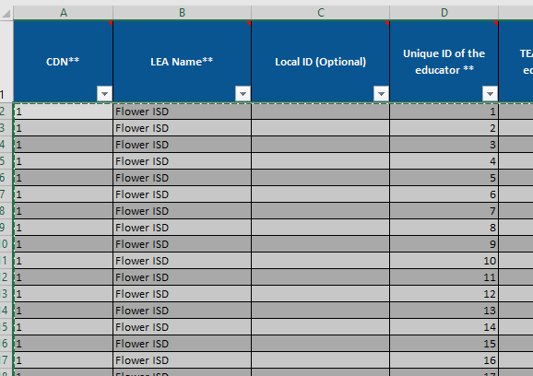
Copying data to the Excel Tool
Not including the header row, select all the data you wish to copy to the tool.
Starting in row 2 of the Excel tool. Paste the data over. Depending on your computer, it may take a few minutes to process the information.

Slide 20
TTU Portal
COMING SOON! The TTU portal will soon have the excel analysis tool built into the platform. You will have the ability to upload your submission file and output the excel tool.
The data portal will run light checks on the data to confirm its accuracy and then output an Excel tool file.
Release of this feature is expected at the end of June/Early July
Notes:
1 min

Slide 21
Sample Dataset
For today’s training we will be using a sample dataset.
After today’s training you can use your own data to identify areas of concern and areas of strength
Notes:
1 min

Slide 22
Key Changes to Excel Tool
Visual Updates
Performance standards scoring of checks 8 & 9
Larger focus on campus and teacher category breakdown to identify concerns for checks 4-7
Notes:
1 min

Slide 23
Process for the Excel Analysis Tool
Identify skew in the distribution of your teacher performance data
Correlation
Teacher Performance
Dashboards
Identify areas of concern from the correlation tab. Note that good analysis is contingent upon strong correlation.
Using what was identified form the correlation and teacher performance tabs, identify specific areas to focus on.
Notes:
2min

Slide 24
Correlation
Notes:
Section total: 20 min

Slide 25
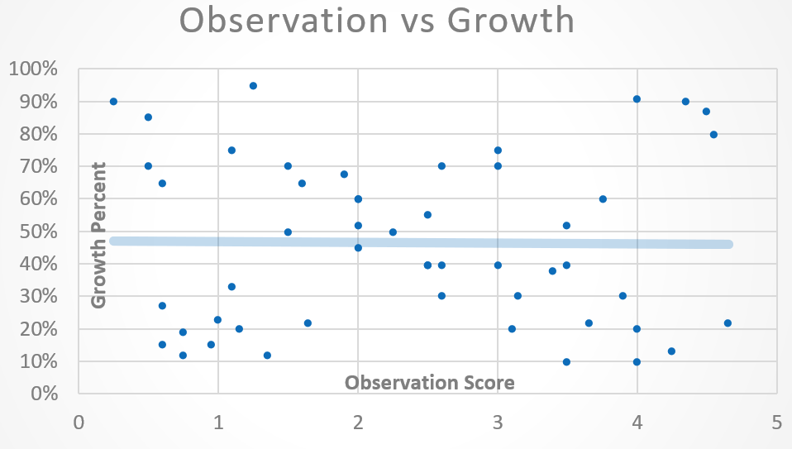
Correlation Tab: What is Correlation?
The relationship of teacher observation scores to student growth scores
Positive Correlation
No Correlation
Notes:
1 min

Slide 26
Correlation Tab: Overview
This tab provides an overview of correlation for your district. It also shows several sub-group correlation values.
Notes:
1 min

Slide 27
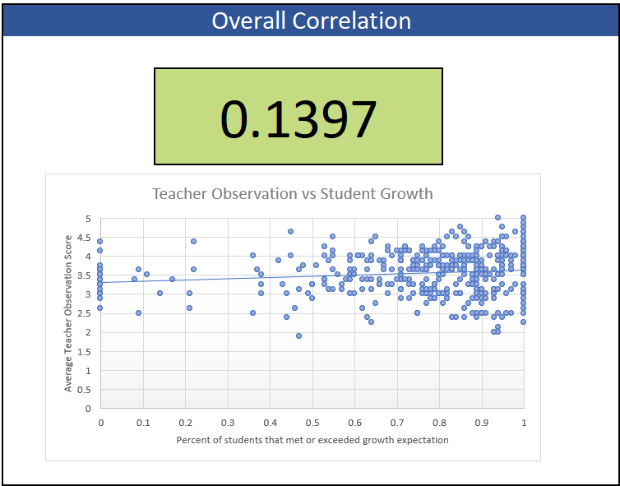
Correlation Tab: Overall Correlation
Your overall correlation is used to score check 1 during your data validation process. Refer to the chart below to see how your LEA would score on check 1 of the data validation process!
Notes:
1 min

Slide 28
Correlation Tab: Subgroup Correlation
Subgroup correlation by:
Teacher Category
Campus Type
Grade Level
Subject Group
Notes:
1 min
Voice over:
There are also several sub-group correlation values provided to you. These can be helpful in beginning the process of diving deeper into your LEA’s data to identify areas of concern for your LEA.

Slide 29
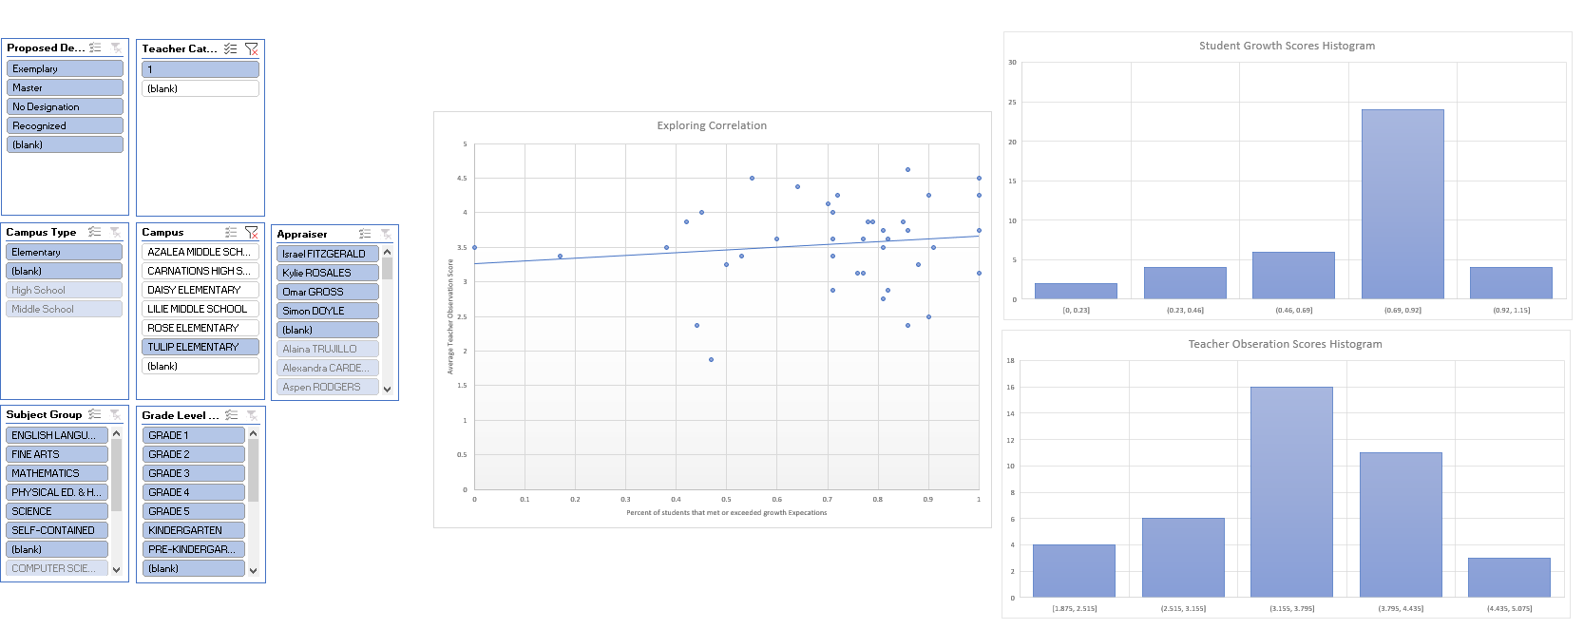
Correlation Tab: Visualizing the Data
Use the filters to see a scatterplot and histogram of the data:
Notes:
1 min

Slide 30
Demo Time: Correlation Tab
Quick Demo
Notes:
5min

Slide 31
Correlation Tab: Breakout Rooms
Looking at only the correlation tab:
What are some areas of concern that you may have for this district?
What are some strengths that you see for this district?
Notes:
7 min

Slide 32
Correlation Tab: Takeaway
Area of Concern
Area of Strength
Overall Correlation
Science
Notes:
1 min

Slide 33
Teacher Performance
Notes:
Section time: 15 min

Slide 34
Process for the Excel Analysis Tool
Identify skew in the distribution of your teacher performance data
Correlation
Teacher Performance
Dashboards
Identify areas of concern from the correlation tab. Note that good analysis is contingent upon strong correlation.
Using what was identified form the correlation and teacher performance tabs, identify specific areas to focus on.
Notes:
2min

Slide 35
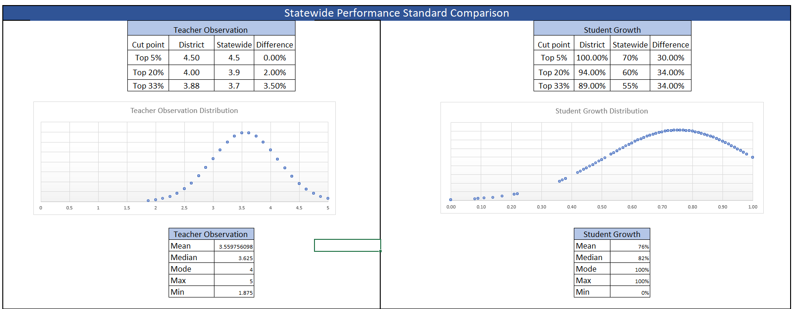
Teacher Performance Tab: Overview
This tab provides a variety of distribution related datasets for your district, along with a few helpful distribution graphs.
Notes:
2 min

Slide 36
Teacher Performance Tab: Top Teachers
Comparison of top teachers in state to top teachers in district
Overall distributions
“5 M’S” Descriptive Statistics
Notes:
2 min
Tables: These tables show how the district’s top teachers compare to that of the state. This can be really helpful in grounding as a comparison point for the district as it relation to the state.
Graphs: These graphs show the overall distribution of both teacher observation and student growth. Goal here is to have a nice “bell” curve which would signal that you have an even distribution. Skew left of skew right would bring to question how your district compares to that of the state.

Slide 37
Designated Teacher Breakdown
These tables provide you with breakdown of how closely aligned your designated teachers are to the statewide performance standards. This will show you how well you will perform on checks 8 & 9.
Notes:
2 min

Slide 38
Teacher Performance Tab: Breakout Rooms
Looking at only the distribution tab:
What are some areas of concern that you may have for this district?
What are some strengths that you see for this district?
Notes:
7 min

Slide 39
Teacher Performance Tab: Takeaway
Area of Concern
Area of Strength
Inflated student growth scores when compared to the state
Good distribution and stretch of teacher observation scores
Notes:
1 min

Slide 40
Break
Notes:
5 min

Slide 41
Campus, Appraiser, Teacher Category, & Subject-Grade Level Analysis
Notes:
Section time: 15 min

Slide 42
Process for the Excel Analysis Tool
Identify skew in the distribution of your teacher performance data
Correlation
Teacher Performance
Dashboards
Identify areas of concern from the correlation tab. Note that good analysis is contingent upon strong correlation.
Using what was identified form the correlation and teacher performance tabs, identify specific areas to focus on.
Notes:
2min

Slide 43
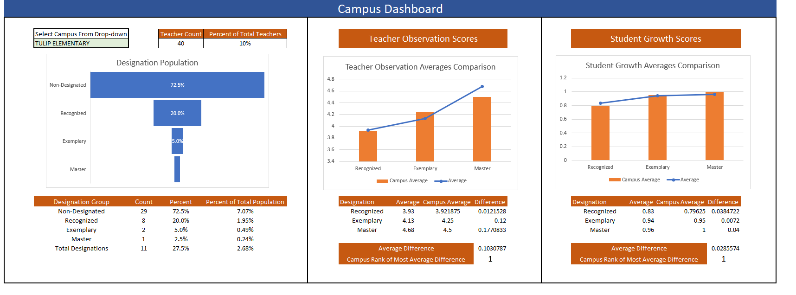
Dashboards
Select from the drop-down to view a dashboard of your selection.
Notes:
1 min

Slide 44
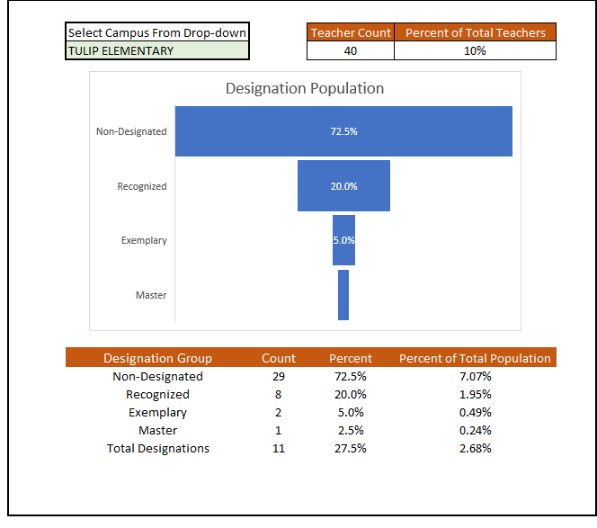
Designation Population
View overall teacher count of selection
View designation breakdown
View designation counts compared to overall population
Notes:
2 min

Slide 45
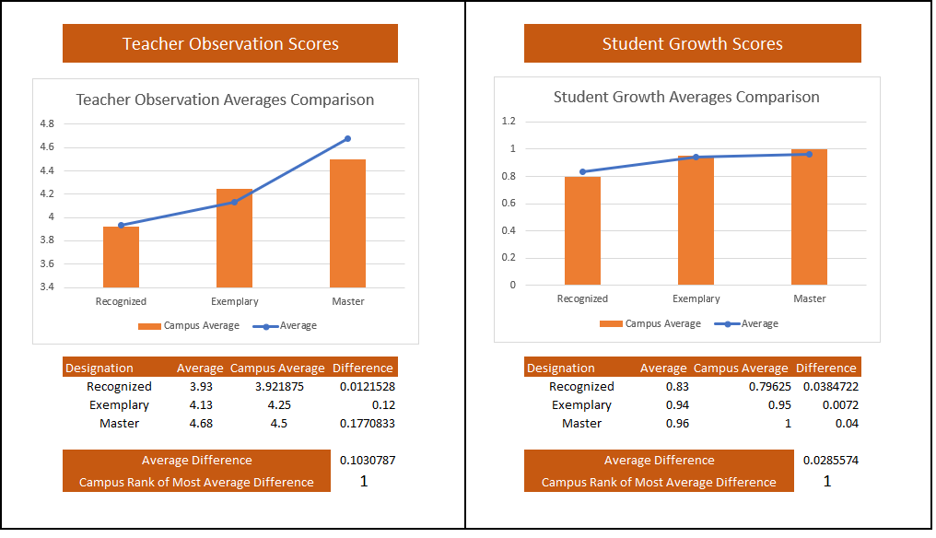
Teacher Observation and Student Growth Scores
View designation results broken up by teacher observation and student growth scores.
Compare scores to overall averages (blue line)
See a ranking of the most average difference
Notes:
3min

Slide 46
Subgroup Data: Overview
Each subgroup has its own tab and provides so key individual information specific to that subgroup
Notes:
1 min

Slide 47
Subgroup Data: Average Difference
This portion of the analysis helps you identify flaws that will come up during data validation in checks 4-7
Notes:
2 min

Slide 48
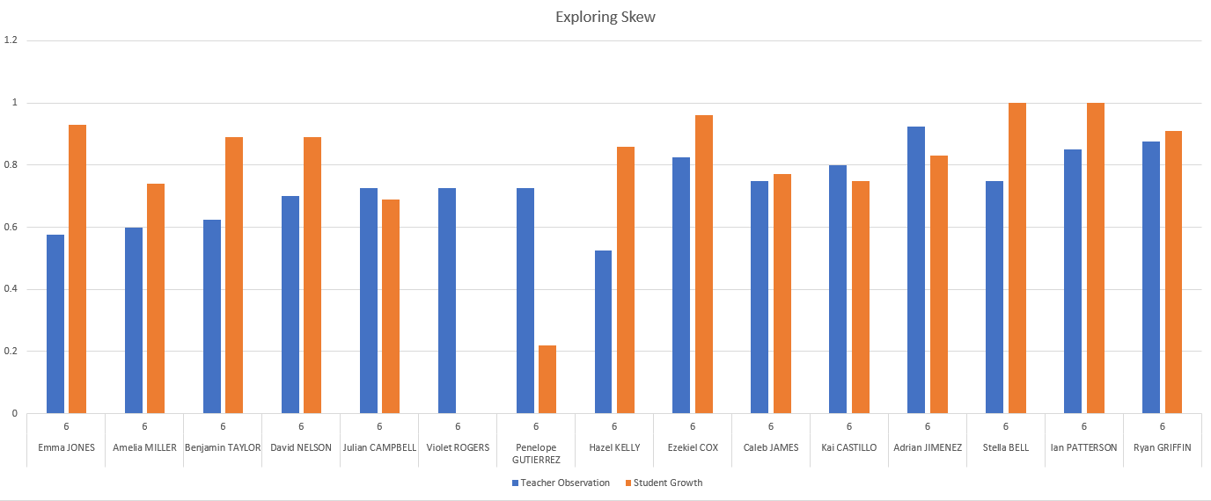
Exploring Skew: Visualize the Data
You will have the ability to slice the views based on the filters you choose.
Notes:
1 min

Slide 49
Demo Time: Dashboards
Quick Demo
Notes:
2 min

Slide 50
Guided Practice
Notes:
Section Time: 15min

Slide 51
Guided Practice: Recall
Recall the areas of concerns throughout this sample dataset:
Overall Correlation
Inflated Student Growth Scores
Notes:
1 min

Slide 52
Process for the Excel Analysis Tool
Identify skew in the distribution of your teacher performance data
Correlation
Teacher Performance
Dashboards
Identify areas of concern from the correlation tab. Note that good analysis is contingent upon strong correlation.
Using what was identified form the correlation and teacher performance tabs, identify specific areas to focus on.
Notes:
2min

Slide 53
Guided Practice: Your turn
Now it is your turn to look at the sample data and identify a few specific areas of concern.
What is one area that you would recommend this district focus on improving? Why?
Extra Credit: What is one area of strength that this district could use as a model for other areas? Why?
Notes:
10 min

Slide 54
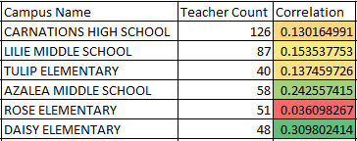
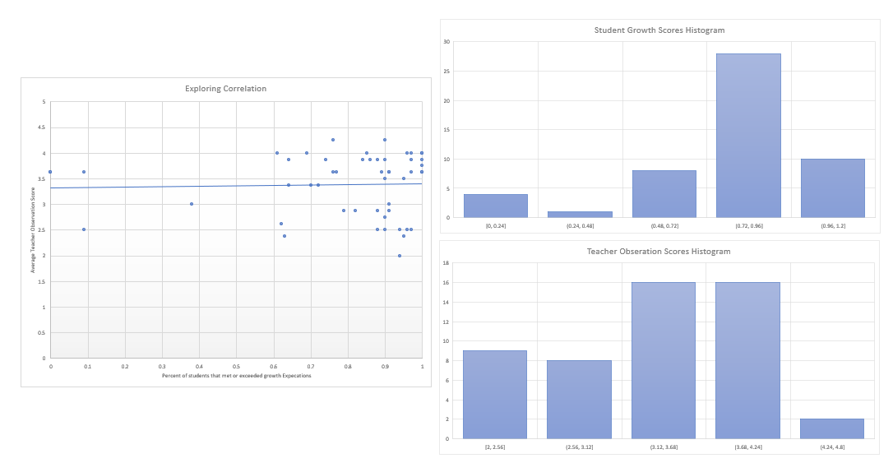
Guided Practice: Bring it all together concern 1
Specific Area of Concern 1:
Rose Elementary
Lowest Campus Correlation
High degree of difference in designation averages for both teacher observation and student growth
Notes:
2min

Slide 55
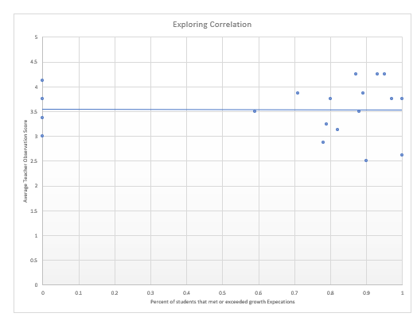
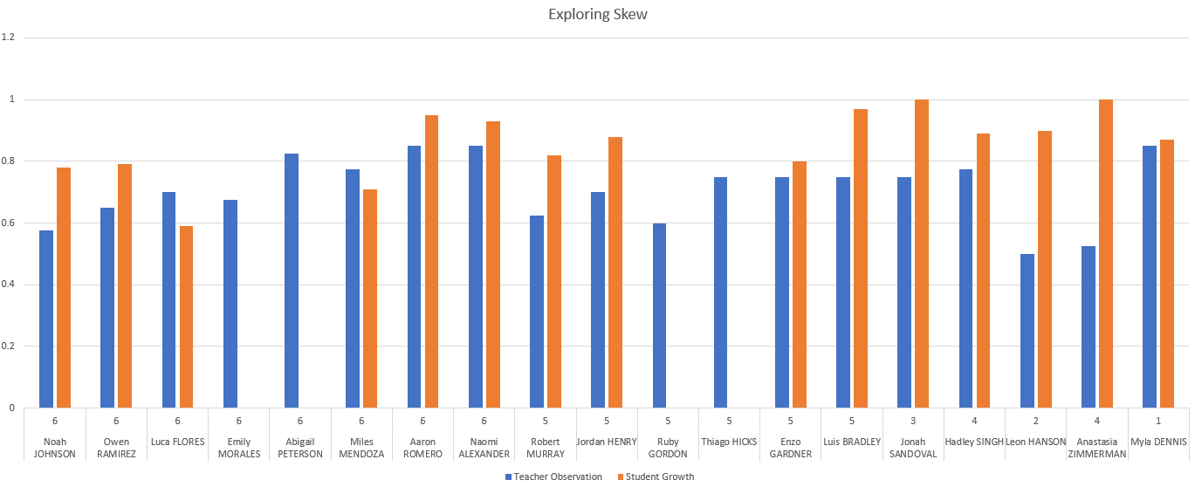
Guided Practice: Bring it all together concern 2
Specific Area of Concern 2:
PE
Negative correlation
Lots of 0 percent growth along with high percent of growth.
Notes:
2min

Slide 56
Thank You
Please take our quick 5-minute survey to let us know how we can improve this presentation in the future.

Slide 57
Today’s Agenda
9:00 a.m. – 11:00 a.m.
Identify Skew in Data
11:00 p.m. – 1:00 p.m.
Lunch
1:00 p.m. – 3:00 p.m.
Responding to skew and lack of correlation
2:45 p.m. – 4:00 p.m.
Office Hours
Notes:
1min

Slide 58
Q/A Time:
Notes:
15min

