Slide 1
Verifying and Confirming 2023-24 Allotments
For Districts Employing Designated Teachers

Slide 2
Audience Note
This session applies only to districts:
Employing a teacher(s) with an active TIA designation; and/or
Cohort A-E districts recently approved to issue 2023-24 designations; and/or
Employing a National Board Certified Teacher(s) in a teaching position
Key participants:
HR administrator
TIA leads, for districts with a local designation system
Business office: finance, budget, payroll

Slide 3
Office Hours and Session Resources
TEA will host allotment verification and spending office hours on May 1st from 9:00-10:00 AM Registration Link
Google Drive resources for today’s session
Slide deck and session recording (to post by end of day)
SCOMS District User Guide Spring 2024
Allotment Confirmation Attestations
Spending Plan Guidance for Districts Receiving Funding for the First Time
Copy of May 23 TEA Email to Designated Teachers

Slide 4
Additional Resources
Guidance for Districts Employing Designated Teachers without a Local Designation System
TIA Spending Guidance for District Business Offices
Teacher Communication and Celebration Resources

Slide 5
Session Objectives
District administrators will be able to:
Access and view Teacher Incentive Allotment data in SCOMS
Verify, dispute, and confirm allotments in SCOMS using district records
Understand next steps for communicating with teachers and spending the allotment

Slide 6
TIA Basics
3 Designation Levels: Recognized, Exemplary, Master
$3K-$32K annually to districts per designated teacher
Greater funding at high-needs and/or rural campuses​
90% of funds go to teacher compensation on designated teacher’s campus​
5- year designation validity regardless of placement

Slide 7
How Teachers Earn Designations
Local Designation System
National Board Certification
District-created system requiring TEA approval ​
District determines and issues teacher designations
Designations valid for 5 years
Individual teacher achieves National Board Certification​
Designation valid through July following NBCT certificate expiry

Slide 8
Funding for Teachers
The Teacher Incentive Allotment provides extra funding, from $3,000 - $32,000 per designated teacher per year, with more money for high needs and rural schools​
RECOGNIZED | $3 - $9K
EXEMPLARY | $6 - $18K
MASTER | $12 - $32K

Slide 9
Fee Reimbursements
TIA allows for collection and reimbursement of fees
Districts may receive fee reimbursement for:
Teacher Designation Fees (LEAs with a local designation system)
System Renewal Fees (LEAs with a local designation system)
National Board Certification Fees
No fees are required to maintain existing designations or receive allotment funds for employing designated teachers

Slide 10
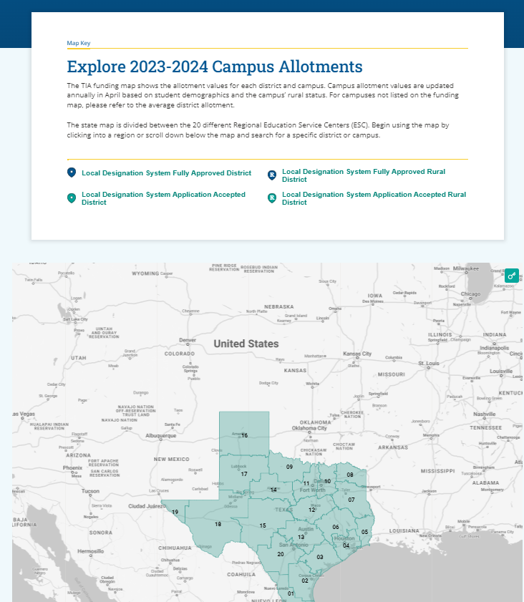
Interactive Funding Map
Allotment values by district and campus
2023-24 campus values for each designation level
Campus allotments may shift from year to year based on student demographics

Slide 11
Allotment Funding Distribution
90% must go to teacher pay on the campus the designated teacher works.
10% may be used to implement a local designation system or to support teachers in earning a designation.

Slide 12
FAQ: Funding
How does our district receive funds to pay teachers?
Funds are awarded through the Foundation School Program. They will not arrive as a separate payment. Districts must spend all funds by August 31, 2024. For districts receiving funds for the first time, funds will arrive as a reimbursement in September 2024.

Slide 13
Allotment Basics
District allotments are distributed through the Foundation School Program; no action is required to receive the funds once the allotment is confirmed, including fee reimbursements
No PIC codes for TIA funds
All funds are TRS eligible
Districts must spend all funds by August 31st
Spending Plan (for districts without a local designation system)
Percentage to be awarded to the designated teacher
Estimated timeline for payout
Policy for teachers who resign or retire before the payout date
Spending resources in Google Drive

Slide 14
2023-24 Designations and Allotments

Slide 15
Designation and Allotment Eligibility
Reported as a teacher in Class Roster Winter Submission with Role ID of 087-Teacher. All teaching assignments are eligible.
Reported in the Class Roster Winter Submission as having met or will meet a creditable year of service (YOS) by the end of the contracted school year.
If a teacher moves districts during the school year, Class Roster Winter Submission determines which LEA will receive the funds, if any.

Slide 16
Creditable Year of Service
Employed and compensated by a Texas school system in a teacher role (087 role ID) for at least 90 days at 100% of the day or 180 days at 50–99% of the day, or the equivalent of one semester
Paid leave days and staff development days count towards the year of service
May not align with number of days on campus or instructional days
Met or will meet by the end of the school year
Closely monitor part-time teachers and/or teachers taking unpaid leave.

Slide 17
TEA Administrative Discretion
087 Role ID: A professional employee who is required to hold a valid teacher certificate or permit in order to perform some type of instruction to students
Teachers in atypical roles are TIA eligible including: SPED inclusion, interventionists, dyslexia teachers, itinerant teachers
In some cases, an HRIS system will not allow a teacher to be reported as an 087:
Alternate Role ID reporting guidance for special assignment teachers
Funding source for the position
Centrally assigned support teachers
TEA may exercise administrative discretion to determine eligibility and may request additional information from the district

Slide 18
Designations and Allotment Timeline
Class Roster Winter Submission snapshot determines teacher placement and eligibility
TEA processes new designations
TEA verifies teacher placement and allotment eligibility
Allotments calculated using Class Roster Winter Submission district/campus placements
Districts access and verify allotment data
Districts confirm or dispute allotments by May 3
TEA processes all disputes and confirms final allotments
May 22 New designations placed on teacher certificates
Deadline to spend scheduled allotment funds (not fees)
Year 1 allotment funding arrives
Two separate TIA line items on district SOF report
Continued funding for 2024-2025 based on projections
February-April
April 24-May 3
May
August 31
September

Slide 19
Designated Teacher Movement
FALL
Aug - Nov
WINTER
Dec - Feb
SPRING
Mar - May
SUMMER
Jun - Aug
Teacher A Generates Allotment
Teacher B Does NOT Generate Allotment
Teacher C Generates Allotment
February – Winter Class Roster Submission (TSDS)

Slide 20
Teacher Movement
What if a designated teacher resigned or retired after the February 23th snapshot date?
If the teacher met eligibility criteria and was reported in the Class Roster Winter Submission, they will generate an allotment for the district that employed them on February 23th. Districts must refer to their TIA spending plan and ensure they spend the funds in compliance with statute.

Slide 21
Introduction to SCOMS
Strategic Compensation Operations Management System

Slide 22
SCOMS Resources
SCOMS User Guide
Allotment Confirmation Attestations

Slide 23
SCOMS Overview
Online Application accessed through TEAL
TEA administrators process designations and allotments, create reports, and export allotments for the Foundation School Program (FSP)
LEA users may view, sort, filter and export annual allotment data, including fee reimbursements, if applicable
Districts verify and confirm annual allotment in SCOMS
If needed, districts may dispute allotment values in SCOMS
For districts with approved local designation systems, SCOMS maintains history of submitted designations

Slide 24
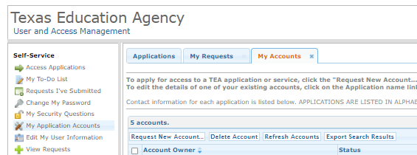
Requesting SCOMS Access
Sign into your TEAL Account. To create a new account, please visit https://tea.texas.gov/about-tea/other-services/secure-applications/teal-account-and-password-help
Click “My Application Accounts.”
Request New Account.
Select SCOMS from the Application IDs.
Click “Add Access.”
Notify district TEAL approver if needed. This is typically the superintendent.
Submit a Help Desk ticket for assistance.
Do Not approve account requests from teachers.

Slide 25
Who Needs SCOMS Access
Who should have an SCOMS account?
Up to five accounts per LEA
Business office
Human Resources
District TIA lead
Optional: PEIMS coordinator, data analysts, payroll
Do not grant access to teachers.

Slide 26
SCOMS for TEA Users
TEA imports new designations. New and existing designations run through system checks.
087 Teacher Role ID
Year of Service Check
IDs district and campus(es) of employment
If multiple designations, system defaults to higher designation
Moves designations into “Active” status
Rejects designations for teachers who do not qualify
Districts confirm/dispute allotments by May 3
TEA resolves errors and confirms final allotments by May 10
TEA updates designated teacher certificates to display designation
TEA exports district-level allotment data for FSP
Checks for certificate sanctions and Do Not Hire (DNH) registry
Prevents new designations from being awarded
Revokes existing designations if sanction or DNH
Matches allotment values with campus(es) of employment and level of designation
TEA turns on district visibility window
Batches allotments by district for district viewing and verification by 4/24
Class Roster Winter Submission Check
Sanctions/DNH check
Designation Determination
Allotment Processing
Confirmation

Slide 27
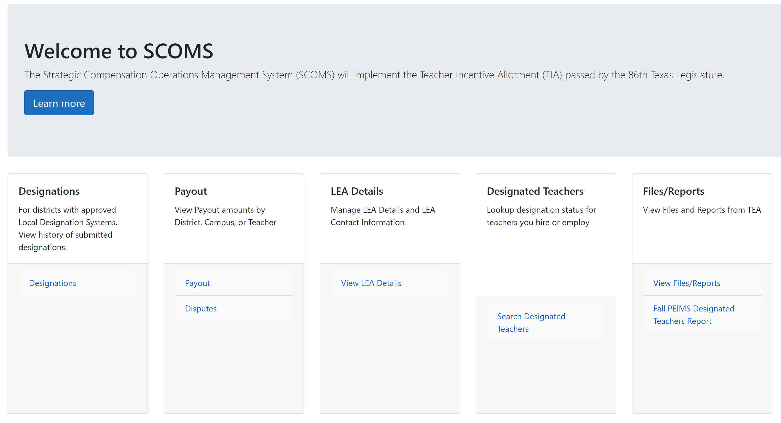
Home Page

Slide 28
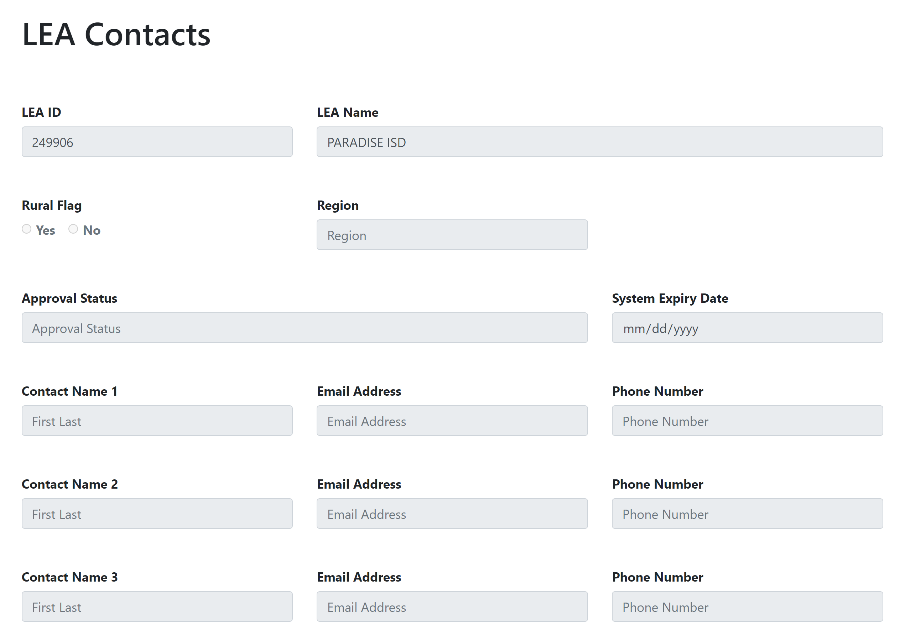
LEA Details

Slide 29
Designations Page
Does not represent designated teachers employed by the LEA
Applies to LEAs approved to issue designations under a local designation system
Displays history of submitted designations by school year
Teacher Name and Unique ID (TSDS), level of designation, expiry date
Displays outcomes
Approved-the designation was awarded
Rejected-the teacher did not meet eligibility criteria to earn a designation
Does not reflect the current status or district of employment

Slide 30
Payout Page
View, filter, sort, export allotment data by school year, teacher, campus, and teacher/campus breakdown
View fee reimbursements, if applicable
Export to Excel function
Option to confirm or dispute the allotment
Will match with Summary of Finances (SOF) report in September 2024

Slide 31
Verifying and Confirming Allotments

Slide 32
Pre-Work: Confirm Eligible Teachers
Review local records of:
Teachers submitted for designation in Fall 2023 (approved LEAs only)
Teachers with an existing designation
National Board Certified Teachers who do not yet have a designation
Reference list of teachers sent 2/20
Recommended: create a district tracking document with all potentially eligible teachers with campus(es), Role ID, year of service, and notes on TIA eligibility

Slide 33
Sample District-Created Tracking Document
Local ID | First | Last | Unique ID | CDCN | Campus(es) | Designation Source | Designation Level | Role ID | Met Year of Service? | Allotment Eligible? | Notes
123456 | DOLLY | CLARK | XXXXXXXXXX | 100906999 | Centrally Assigned | Local system, existing | Master | 087 | Yes | Yes
123457 | ISAAC | RODRIGUEZ | XXXXXXXXXX | 100906002 | Flower HS | NBCT | Recognized | 012 | No | No | Not a teacher
123458 | SAM | FLEMING | XXXXXXXXXX | 100906123 | Gladiola Elem | Local System, new | Exemplary | 087 | Yes | Yes
123459 | DALE | WASHINGTON | XXXXXXXXXX | 100906035, 100906147 | Magnolia Jr H+ Elem | Local System, new | Recognized | 087 | Yes | Yes | Split campus
123450 | ARETHA | BROWN | XXXXXXXXXX | 100906022 | Davis MS | Local System, new | Master | 087 | Yes | Yes
123402 | JENNIFER | SHEPHERD | XXXXXXXXXX | 100906147 | Magnolia Elem | Local System, new | Exemplary | 087 | No | No | Resigned 1/21/24

Slide 34
Review Designation Outcomes
For districts approved to award designations in 2023-24
From the home page, click Designations
Select 2023-24
View each teacher designation and outcome (can export to Excel). Reasons for Rejected designation status:
Not reported in the Class Roster Winter Submission
Reported in Class Roster in a different LEA (moved districts mid-year)
Reported with a Role ID other than 087
Reported as not meeting the creditable year of service
The educator has a sanctioned certificate or is listed in the Do Not Hire registry
Compare outcomes with local records for teacher eligibility
Were any teachers Approved who did not meet eligibility criteria?
Were any teachers Rejected who met eligibility criteria?
Are any teachers missing from the list?

Slide 35
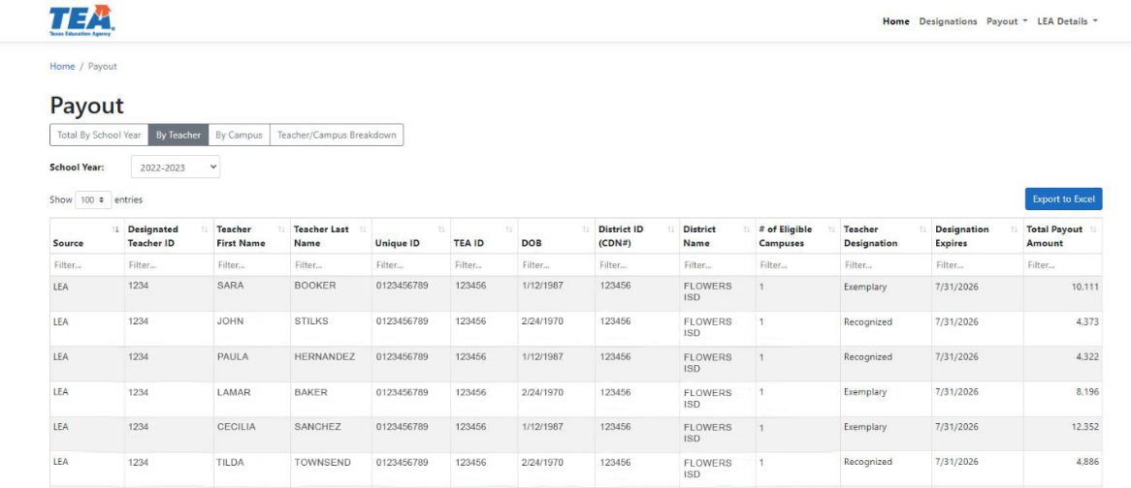
Review Allotments by Teacher
Visit the Payout page and select By Teacher from the header
View and/or export teacher-generated allotments
Compare to district records for eligible teachers
Ensure all teachers identified as eligible appear on the Payout by Teacher Page
View and/or export from the Teacher/Campus Breakdown and verify each teacher was reported at the correct campus(es)

Slide 36
Teachers Serving on Multiple Campuses
How is the allotment calculated for teachers at multiple campuses?
SCOMS will divide each campus allotment by the total number of reported campuses, and then sum the campus allotments.

Slide 37
Verifying Allotments
Steps to verification before confirming the allotment
For districts with approved designation systems, review Designation data and compare to local records
Are all eligible teachers submitted for new designations in Fall 2023 listed and in Approved status?
Are any teachers in Approved status who should not be eligible?
Are any teachers in Rejected status who should be eligible?
Are any teachers missing from the designation list?
Review Payout by Teacher and Payout Teacher/Campus Breakdown data
Did all eligible teachers (new and/or existing designations) generate an allotment?
Was the correct campus reported for all eligible teachers?
If any discrepancies are found, make notes in your district’s tracking document. Add columns if needed to track if disputes are needed.

Slide 38
Sample Tracking Document with Dispute Notes
Local ID | First | Last | Unique ID | CDCM | Campus(es) | Designation Source | Designation Level | Role ID | Met Year of Service? | Allotment Eligible? | Notes | Allotment Generated | SCOMS Reported Campus | Dispute Required?
123456 | DOLLY | CLARK | XXXXXXXXXX | 100906999 | Centrally Assigned | Local system, existing | Master | 087 | Yes | Yes |  | 25,613 | 100906999 | No
123457 | ISAAC | RODRIGUEZ | XXXXXXXXXX | 100906002 | Flower HS | NBCT | Recognized | 012 | No | No | Not a teacher this year | 7,762 | 100906002 | Yes, not 087
123458 | SAM | FLEMING | XXXXXXXXXX | 100906123 | Gladiola Elem | Local System, new | Exemplary | 087 | Yes | Yes |  | 12,322 | 100906123 | No
123459 | DALE | WASHINGTON | XXXXXXXXXX | 100906035, 100906147 | Magnolia Jr H+ Elem | Local System, new | Recognized | 087 | Yes | Yes | Split campus | 6,517 | 100906035 | Yes, not reported at both campuses
123450 | ARETHA | BROWN | XXXXXXXXXX | 100906022 | Davis MS | Local System, new | Master | 087 | Yes | Yes |  | 24,655 | 100906022 | No
123402 | JENNIFER | SHEPHERD | XXXXXXXXXX | 100906147 | Magnolia Elem | Local System, new | Exemplary | 087 | No | No | Resigned 1/21/24 | 0 | 0 | No
123003 | DAVID | GOMEZ | XXXXXXXXXX | 100906002 | Flower HS | Existing through other LEA | Exemplary | 087 | Yes | Yes |  | 0 | n/a | Yes, not on allotment report

Slide 39
Verify Fee Reimbursements If Applicable
Only applies to districts that:
Submitted new teacher designations in Fall 2023
Submitted system renewal fees in April 2024
Submitted a request for National Board fee reimbursement
Are receiving fee reimbursements on behalf of an 1882 partner
Verify fee data in SCOMS reflects records from the district business office
For fee discrepancies, please email TIA@tea.Texas.gov

Slide 40
View Fee Details
Click the Total Fees Value to view details
Most districts without a local designation system will have $0 in fee reimbursement

Slide 41
Submitting Disputes

Slide 42
What are Disputes?
A dispute is a request for manual error resolution of inaccurate, teacher-level data.
Errors or inaccuracies in Winter Class Roster reporting will impact teacher eligibility, designations, and allotment values.
Disputes are resolved in SCOMS with no impact on TSDS data.
Disputes must be entered by May 3. TEA will resolve all disputes by May 10
The district may be asked to provide supporting documentation for the dispute, such as HR records, payroll data, master schedule)
For fee disputes, email tia@tea.Texas.gov

Slide 43
When to Submit a Dispute
Districts may submit a dispute in SCOMS if:
Winter Class Roster data does not accurately reflect a teacher’s campus of employment
Centrally assigned teachers
Teachers with students commuting from several campuses to the teacher’s campus
An eligible teacher did not generate an allotment or earn a designation because:
The teacher was mistakenly not reported in Class Roster Winter Submission or reported without a TIA Designation Code
The year of service was not reported as “Y”
The teacher was reported with a Role ID other than 087
A teacher generated an allotment that did not meet the year of service in a teacher role

Slide 44
Disputes Page and Managing Disputes
Go to Payout→ Total by School Year screen
Click “Dispute” to view, add, edit, or delete disputes

Slide 45
Dispute Categories
Teacher missing from allotment report
Not employed in a teaching role (087)
Change year of service indicator (Yes→No or No→ Yes)
Incorrect CDCN(s)
Other

Slide 46
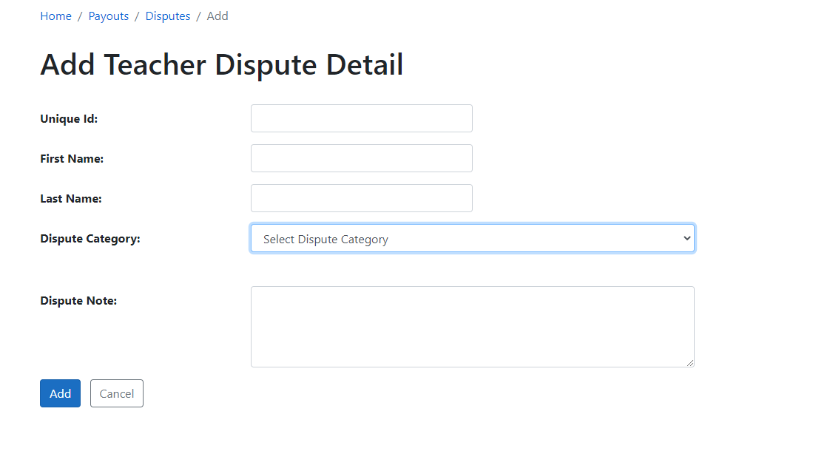
Adding a Dispute
Click “Add Dispute Detail.”
Select a Dispute Category.
Enter all requested details and click “Add.”
Review the dispute on the main Disputes page.
Edit or delete the dispute if needed.

Slide 47
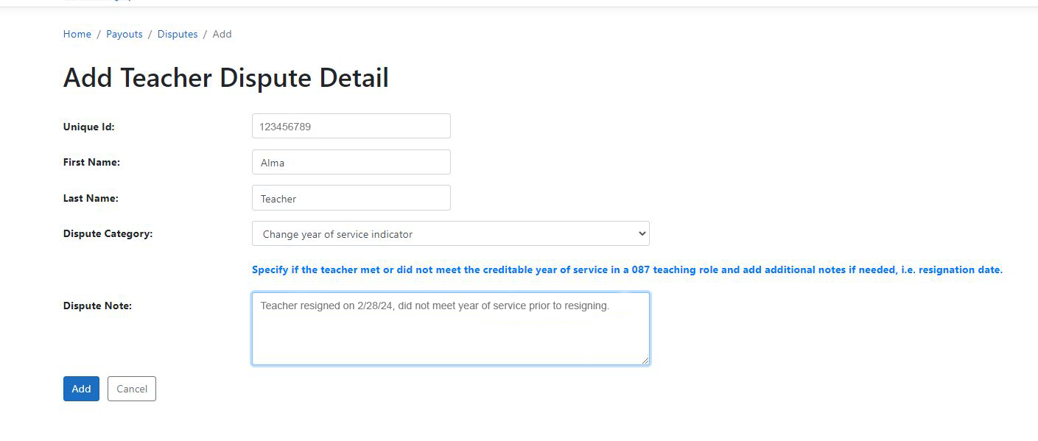
Sample Dispute

Slide 48
Required Information for a Dispute
Reason/Category for the dispute will determine what information is required
Teacher Unique ID, 10-digit number for TSDS reporting
DOB, if teacher is missing from the allotment report
Campus CDCN(s)
Role ID
Creditable Year of Service Y/N
Notes may be required depending on the selected reason

Slide 49
Next Steps After a Dispute
Export dispute data for next phase of verification.
TEA will process disputes between May 3 and May 10
Designation outcomes and allotment values will not change unless a dispute was submitted.
By May 13, districts must repeat the allotment verification process after the dispute is resolved before confirming the allotment.

Slide 50
Sample Disputes Page

Slide 51
Confirming the Allotment

Slide 52
Prior to Confirmation
Prior to confirmation, verify:
All eligible teachers submitted for a new designation are present on the designations page and in “Approved” status (Cohort A-E participating LEAs)
All eligible teachers generated an allotment
All eligible teachers were reported at the correct campus
Fees are accurate
Disputes were resolved, if applicable
Review attestations with relevant departments and maintain a local record of superintendent sign-off TIATexas.org/attestations

Slide 53
Confirm the Allotment
Click Confirm and review disclaimer.
Click “Confirm” a second time. This serves as the district signature. Do not submit signed attestations to TEA.

Slide 54
District Next Steps
Allotment Timelines and Teacher Communication

Slide 55
Next Steps Overview
Verify Allotments
Notify District Business Office
Communicate with Teachers
Ensure Funds are Spent by 8/31/24

Slide 56
Summary of Finances (SOF) Report
After the September Settle-up process, the final SOF report will match the 2023-24 Payout by School Year page

Slide 57
Spending Plan FAQ
Must our TIA spending plan be approved by the school board?

Slide 58
Teacher Communication
Teachers should know:
If they met eligibility criteria for designation and/or allotment
Employed in a teaching role
Met year of service requirement*
How much they will generate for the district
For new designations, when it will show on their certificate (by May 22)
The district spending plan (by May 22)
Percentage awarded to the teacher, along with estimated deductions
Estimated payout date
District policy if teachers resign or retire before the payout date
Best practice: communicate in writing and post policies on the district website
Teacher questions to TEA regarding district spending plans will be referred to the district’s TIA point of contact.
*additional verification may be required at EOY for teachers who work part-time or have taken leave

Slide 59
Spotlight on Designated Teachers
Local celebrations and school board recognition
Door signs, badges, stickers, and logo requests
Congratulatory email from Commissioner Morath

Slide 60
Teacher Notifications
When will TEA notify designated teachers?
On May 23, designated teachers will receive an email from GovDelivery to their ECOS email address with:
Congratulatory remarks from Commissioner Mike Morath
Designation information and expiry date
State policies around future allotment eligibility and district spending requirements
The amount generated for their LEA

Slide 61
Designated Teacher Registry
Designated Teacher Registry updates annually in late May
Designated teachers are assigned a designated teacher ID
Uncertified teachers can print a virtual certificate of designation through the Designated Teacher Registry

Slide 62
Expiring Designations
What can we do for teachers with designations expiring* in 2024 or 2025?
*excluding NBCTs
Districts with a local designation system should communicate their TIA timeline, eligible assignments and designation performance criteria.
Teachers who presently work in an eligible assignment may requalify for a new or higher designation in 2024-25 based on their performance in 2023-2024.
Teachers not working in an eligible assignment may wish to consider moving into an eligible assignment for 2024-25 to requalify in 2025-26 or later.

Slide 63
Immediate Next Steps
Date/Deadline | Action Step
Immediately | If needed, develop a TIA spending plan
By May 1 | Verify designations and allotments: Create a district tracker for teachers with existing and pending designations Verify teacher eligibility: employed by the LEA in a 087 Role ID for a creditable year of service Verify campus(es) of employment for eligible teachers Export designation and payout data from SCOMS and compare to district tracker Submit disputes if needed Review attestations and obtain a local record with superintendent signature
May 1 | Attend allotment verification office hours, if needed
May 3 | Deadline to confirm or dispute allotment
May 13 | Deadline to reconfirm allotment, if a dispute was submitted
Before May 22 | Communicate with designated teachers Allotment generated for the district District spending plan and timeline for payout

Slide 64
Upcoming Dates for Awareness
Date/Deadline | Action Step
May 23 | Public Designated Teacher search available with virtual certificate of designation TEA notifies designated teachers who generated an allotment via ECOS email address: Name and Designated Teacher ID District and Campus(es) of employment Amount generated for the LEA Statutory spending requirements
August 31 | Deadline to spend 2023-24 allotment 90% or more must be spent on teacher compensation on the campus where the designated teacher works/worked Up to 10% may be withheld by the district for costs directly associated with TIA or supporting teachers in earning designations Spending resources, FAQ, and best practices in Google Drive
September 2024 | 2023-24 allotment reflected in SOF report

Slide 65
Please enter questions in the Q&A feature

Slide 66
Survey

Slide 67
Thank You

