Slide 1

Title
Understanding and Planning for
National Board Certification (NBPTS)
Stacey Hicks, NBCT
Director, Outreach and Partnerships, NBPTS
Sarah Pinsky
Director, Policy, NBPTS

Slide 2

Understanding and Planning
Understanding and Planning for National Board Certification
What is National Board Certification?
What is the Opportunity?
Discuss the process and benefits of certification
Understand HB3, TIA, and funding mechanisms
How do I Get Started?
What Resources are Available to Me?
Learn how to seize the opportunity provided by the Teacher Incentive Allotment
Learn your next steps toward certification
Find tailored resources that meet your needs

Slide 3

What is National Board Certification?
What is National Board Certification?
Understand the process and benefits to Board Certification

Slide 4

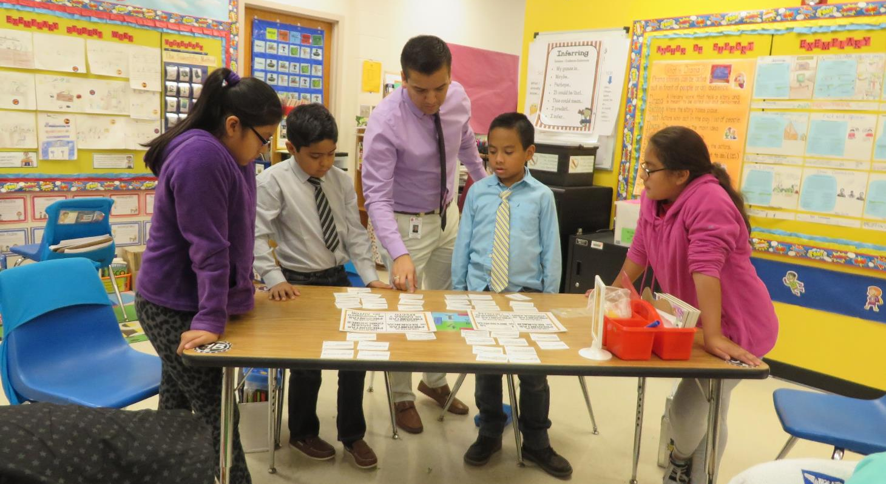
National Board Certification
National Board Certification
Voluntary Process
Based on Accomplished Teaching Standards
Designed to Develop, Recognize, and Retain
Considered the “gold standard” for teacher certification
By Teachers, For Teachers
Written, revised, and scored by peers

Slide 5


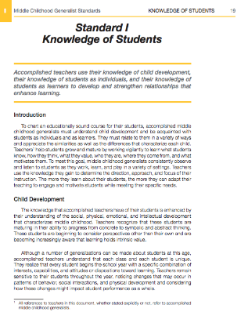
Foundational Beliefs
Foundational Beliefs
Five Core Propositions
Critical dispositions that establish the vision for accomplished teaching
Architecture of Accomplished Teaching
Analytic and reflective framework for lesson creation, study, and planning
Content-Specific Standards
25 certificates across 16 subject areas and four developmental levels

Slide 6

The Certification Process
The Certification Process
Content Knowledge
Differentiation of Instruction
-Computer-based assessment
-Measuring content knowledge and pedagogical
practices
1
2
-Classroom-based portfolio
-Analyzing and planning for individual student
needs while providing student evidence and
work samples
4
3
Teaching Practice and
Learning Environment
Effective and Reflective Practitioner
-Portfolio-based entry
-Highlights understanding and use of
assessments to plan for/impact student learning
-Classroom-based portfolio
-Record and submit video recording that demonstrates
student engagement and impact

Slide 7
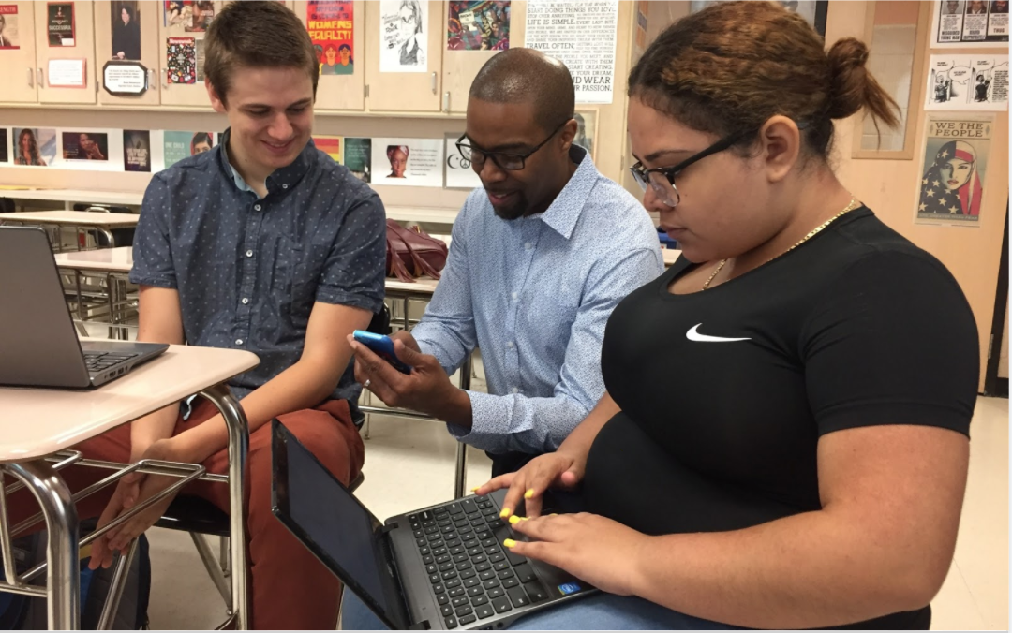
National Board Impact
Teachers who engage with the National Board standards report making specific changes to their instructional practices including:
  Adjusting lesson plans to meet the needs of individual students
  Gaining and/or deepening knowledge in content areas
  Using data in new ways to assess student progress

Slide 8
What is the Opportunity?
What is the Opportunity?
Understand HB3, TIA, and the mechanics of funding

Slide 9
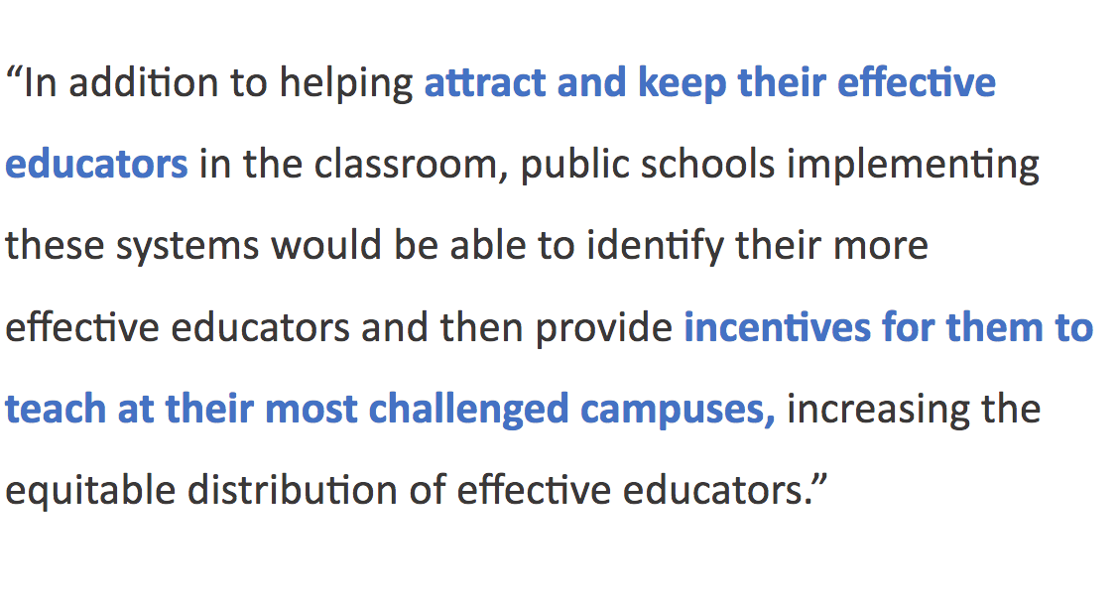
HB3/TIA Opportunities
HB3/TIA Opportunities
TIA Theory of Action
HB3 went into effect in June 2019
Provides compensation increases
Prioritizes high-need and rural communities

Slide 10
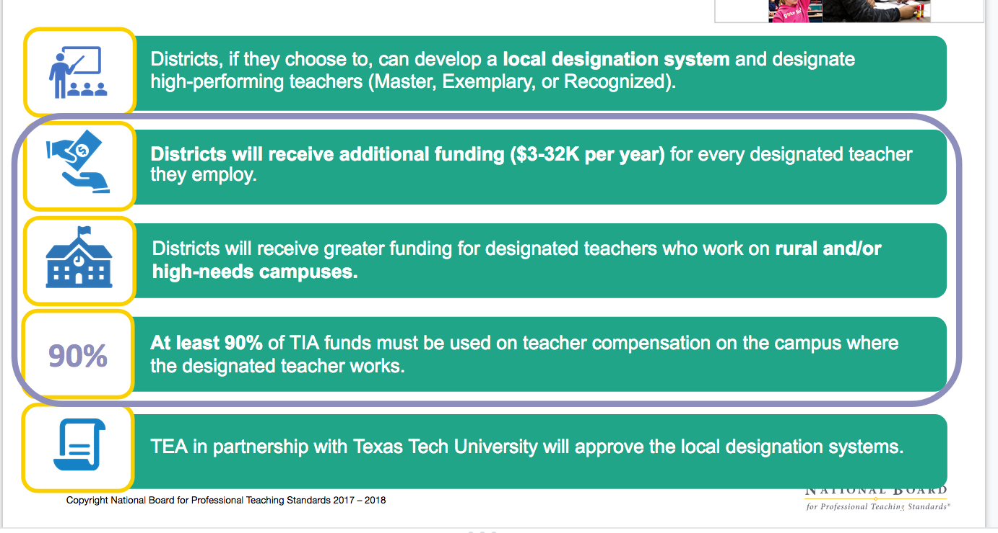
Key Points
Key Points
The TEA website will allow the public to conduct a map search of possible TIA funding per campus, based on a teacher’s designation.
This will also include a downloadable list of yearly funding available per campus.

Slide 11
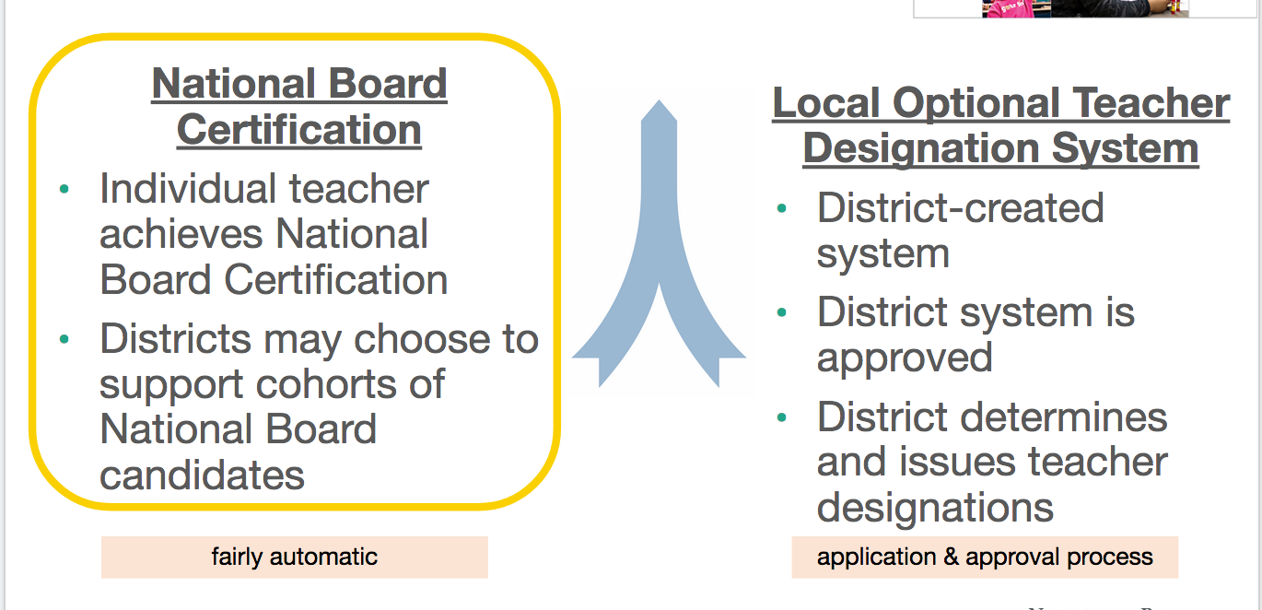
Two Pathways to Designation
Two Pathways to Designation
The Recognized designation process of NBCTs is fairly automatic, generating between $3K-$9K per NBCT at their campus
NBCTs with a Recognized designation may also qualify for a designation according to their local designation system, with the highest designation taking precedence

Slide 12


Board Certification: Recognized Designation Eligibility
Teachers with a National Board Certification are eligible to earn a Recognized designation if they meet the following eligibility requirements:
Working as a teacher (reported as a 087 Role ID in Winter Class Roster)
Valid National Board certificate
NBCT directory listing reflects Texas employment
Recognized designation valid until July following the NB certificate expiration
Recognized Designation

Slide 13
Allotment Eligibility
National Board teachers with a Recognized designation will generate allotment funding annually if they:
  Are employed as a classroom teacher for at least 90 days at 4 or more hours per day
    Reported as 087 Role ID in Winter Class Roster
    Assistant teachers, reading specialists, interventionists, inclusion teachers are all eligible provided they are employed in a 087 PEIMS Role ID
  Were or will be compensated for a creditable year of service
Notes:
087 role ID in PEIMS
Assistant teachers, reading specialists, interventionists, inclusion teachers are all eligible provided they are employed in a 087 PEIMS Role ID
NBCT working as counselors, librarians, administrators, may earn a Recognize designation if they hold an active Texas teaching certificate, but will not generate annual allotment fund

Slide 14
Teacher Designation Levels
Master
$12-32K
Exemplary
$6-18K
Through a local designation system
Expires after five years
Recognized
$3-9K
Automatic for eligible NBCTs
Expires with NB certificate

Slide 15
Funding for Eligible NBCTs
Timeline
NBCTs working as teachers will earn a Recognized designation beginning 2020-2021
Automatic; TEA will annually process new designations for newly certified NBCTs and NBCTs moving to Texas from out of state and update expiry dates for NBCTs who successfully renewed or maintained certification
Districts notified of designations and allotment funds in April/May
NBCTs who move/have moved to Texas must have an updated NBCT directory listing by January 31 to earn a designation for that school year. Designations will not be issued retroactively.
Teacher Compensation Considerations
Districts must use at least 90% of the TIA fund on teacher compensation on the campus where the designated teacher works
Districts will need to shape a local plan for how to use these funds

Slide 16
National Board Fee Reimbursements
With documentation, districts may request up to $1900 for initial certification, $1250 for renewal, $495 for maintenance of certification
Districts may request reimbursement of fees paid directly to National Board if they were a third-party payer or fees paid out of pocket by the NBCT
Districts must reimburse the NBCT prior to submitting a reimbursement request through TIA
To be eligible for fee reimbursement, the NBCT teacher must:
  Have earned NB Certification or renewal in 2019 or later
  Have documentation of fees paid out of pocket to the National Board
Fees paid by grants or third parties other than the district are not eligible

Slide 17
How Do I Get Started?
How do I Get Started?
Learn about HB3, TIA, and the mechanics of funding

Slide 18
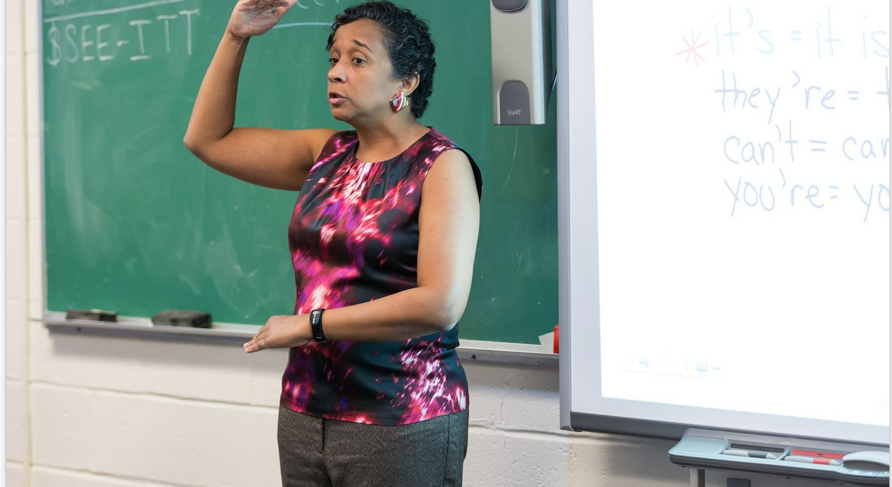
Are you a National Board Certified Teacher?
Are you a National Board Certified Teacher?
✅ Update your profile in your National Board Account
✅ Join the Texas National Board Coalition for Teaching
✅ Send this flyer to your district leadership
✅ Sign up for the virtual PLF Course
✅ Provide input as part of stakeholder engagement in
your district’s spending plan

Slide 19

Are you a teacher interested in becoming certified?
Are you a teacher interested in becoming certified?
✅ Visit www.nbpts.org
✅ Read through the What Book and the Standards
for your certificate area
✅ Ask your districts/ESC/teacher association if they
will organize a cohort to support you and other
interested teachers
-Take this flyer to your districts/ESC
✅ Sign up for monthly webinars
✅ Discover the resources the Texas National Board
Coalition of Teaching has for supporting candidates

Slide 20

Are you a leader who wants to support teachers pursuing NBC?
Are you a leader who wants to support teachers pursuing NBC?
✅ Identify NBCTs in your district(s); they will be a great
resource!
✅ Sign up district staff and/or teacher leaders for the
virtual PLF training course
✅ Sign up for monthly webinars
✅ Request technical Assistance, including virtual
coaching
✅ Check nbpts.org/Texas frequently for updates and
additional training opportunities

Slide 21

Are you an association leader interested in supporting members pursuing NBC
Are you an association leader interested in supporting members pursuing NBC?
✅ Consider ways to support members pursuing NBC in terms of time,
space, financial or cognitive support
✅ Advocate for teacher voice as district’s develop TIA spending plans
✅ Encourage members to consider this professional development
opportunity, focused on instructional leadership

Slide 22
What Resources are Available to Me?
What Resources are Available to Me?
Learn about HB3, TIA, and the mechanics of funding

Slide 23
Available Resources
Available Resources
Awareness webinar template
Canvas Courses
  Pre-Candidacy Course for Facilitators
  Canvas for Candidates
  Canvas for Professional Learning Facilitators
ATLAS for candidates
Virtual Professional Learning Facilitator (PLF) training
Monthly webinar series beginning July 2020
National Board Certified Teacher Directory
Visit the Texas state page on www.nbpts.org

Slide 24
Questions?
What questions do we have in the room?

Slide 25

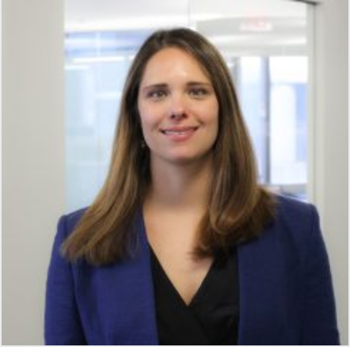
Presenters
Stacey Hicks, NBCT
Director, Outreach & Partnerships
shicks@nbpts.org
Sarah Pinsky
Director, Policy
spinsky@nbpts.org

